Slide 1
Microsoft 365 Copilot
Adoption and Change Management Guide
A practical roadmap with proven adoption guidance to deliver AI outcomes with Copilot and Agents.
May 2026

Slide 2
What’s inside
This deck is a modular M365 Copilot and Agents adoption kit. Use the table of contents to navigate directly to the phase or topic most relevant to your rollout.
1
Introduction — Program explanation, planning, and roles
2
Plan — Readiness, Alignment & Setup
3
Implement — Launch & First Value
4
Adopt — Habit Formation, Agents & Scale
5
Manage and Improve — Optimization
6
Additional resources

Slide 3
Introduction

Slide 4

What is this program?
This guide will outline a successful, repeatable Copilot adoption framework including activities, content and success metrics.
  Provide a step-by-step guide to Copilot adoption
  Divide the adoption program into four phases: Plan, Implement, Adopt, Manage/Improve
  Provide guidance for what to do in each phase by three main roles: Technical, Adoption team, Team Leads/Champions
This guide is intended for those leading and supporting adoption and change management, specifically, the Copilot adoption team composed of: Adoption Leads, Copilot Admins, AI Council, Team Leaders, and Champions. Leaders play a key role through executive sponsorship and the AI Council.
This guide primarily focuses on user enablement. We mention technical requirements so they can be tracked but that is not the focus.
Microsoft is available to help with every step of your journey.

Slide 5
Copilot implementation overview (edit as required)
 | Plan | Implement | Adopt | Manage/Improve
Goal | Document vision and goals Create deployment plan and adoption milestones Ensure technical readiness | Deploy Copilot and agents Activate Champions Community Execute launch plan | Multi-modal training plan with organization-wide and champion activities Measure usage and report ROI Collect feedback | Expand use cases for Copilot and agents Share success stories Drive awareness of what’s new
Define Success | Alignment on goals and metrics for Copilot. Deployment and adoption plan in place. Technical and data governance issues remediated | Admin center controls in place Licenses assigned Launch activities completed – all users complete initial training Usage goals achieved | Implement team-level use cases with tracked KPIs Usage goals achieved | Increasing ROI measurements Team-level KPIs achieved
Timeline | 2 weeks | 2 weeks | 4 weeks | Ongoing
% complete
Measure Success | % technical issues addressed | Excite Days and Prompt-a-thons completed 50% Active* Copilot Users 30% Active Agent Users (% of Active Copilot Users) | 90% users trained 60% Active Copilot Users 30% Active Agent Users (% of Active Copilot Users) | Increasing ROI measurements 90% Active Copilot Users 30% Active Agent Users (% of Active Copilot Users)
*Interpret M365 Copilot usage report; active user rate shows the number of active users in your organization divided by the number of enabled users.

Slide 6
Primary ACM roles
Leadership
Executive Sponsorship and AI council, pulls in leadership from across the business, setting business goals and AI strategy, selects areas of investment, success metrics and inspires usage leading by example and praising success. We estimate this effort will require about 1 hour per week during the adoption project.
User Enablement
Responsible for preparing users and driving adoption of Copilot. This team must engage with executives for planning and reporting. They must also provide clarity to employees on what Copilot can do, how it will change workflows, and how to achieve value.
IT Administration
The primary technical owner of Copilot deployment, responsible for coordinating licensing, data access, identity, compliance readiness, and service configuration across teams. They must also manage analytics and support.
Team Leaders/Champions
Focused on use cases and KPIs at the team and role level. Champions provide role-specific support and training that is essential for Copilot adoption and value creation. Team Leaders establish goals, review use cases, and inspire usage through success stories and leading by example. We estimate Champion efforts will take about 4 hours per week.

Slide 7
Plan

Slide 8

Plan – Overview
Key Activities:
Align executive leadership. Establish an AI Council made up of executive and business leaders to define success metrics, incentives, and priorities. This group should confirm initial departments, Copilot use cases and agents, and overall direction for the deployment.
Complete technical readiness. Conduct a risk assessment and implement data governance and mitigation strategies to meet regulatory and internal policy requirements. Review identity and access controls, configure the tenant for Copilot, and ensure the support organization is prepared with training and a Copilot knowledge base.
Build a Champions program. Use your pilot program to identify and enable Champions who can translate Copilot into role‑specific, everyday value for their teams. Champions play a critical role in reinforcing new work habits and driving sustained adoption.
Document the deployment plan. Create a comprehensive plan covering both technical and adoption activities across the Implement and Adopt stages. The plan should include communications, training, and gamification strategies, and be reviewed and agreed upon by all stakeholders.
Establish an analytics baseline. Define current processes and metrics before deployment to clearly measure impact and value after Copilot is rolled out. This baseline is essential for demonstrating progress and ROI post‑deployment.
Duration: The planning stage is typically spent on remediating data governance issues and can take anywhere from several weeks to several months depending on the maturity of existing data governance policies and the complexity of your environment. The majority of the time will be spent updating data governance policies. In our experience companies with fewer than 1,000 users should spend less than 2 weeks on this step. Larger organizations with more complex environments or companies that need to meet specific regulatory requirements may take longer.
Success Measures:
It’s critical to have executive buy in on goals and success metrics.
All compliance and security issues should be addressed or have a plan for remediation.
A deployment and adoption plan should be completed.

Slide 9




Plan – Checklist
Shared Activities | Develop a comprehensive deployment plan
Adoption Team | Select executive sponsors and achieve executive level alignment of Copilot goals through an AI Council Identify clear business goals and success metrics and pick initial department/use cases for pilot program including Microsoft agents to deploy Develop gamification and incentive program Establish Champions program Develop a communications plan Develop a training plan
Team leads/ Champions | Define team and role-level goals, high value use cases, and what’s in it for employees Create an analytics baseline
Technical team | Perform risk assessment Configure the tenant for Copilot Prepare the support organization (Chapter 4 on this page)

Slide 10
Implement

Slide 11
Implement – Overview
Key Activities:
Deploy Copilot licenses and set up usage monitoring and ROI reporting. Assign access to team leaders for usage reports and set up additional business metrics if required.
Initiate employee launch and communications. Enablement teams can take advantage of Microsoft content for Launch Day materials, training materials, and email templates for the launch. Start with a welcome email and a series of executive communications to promote Copilot goals.
Initiate the training plan across enablement team and champions. Organization-wide training on Copilot capabilities and basic prompting skills should be supplemented with team-level training on role-specific use cases and prompts.
Duration: The implementation stage should take 1-2 weeks. Large companies may break up the implementation into groups of users by role
or department.
Success Measures:
Admin controls in place, agents enabled.
Licenses deployed.
Launch activities completed.
Initial usage reports showing 50% MAU by team.

Slide 12
Implement – Checklist
Shared Activities | Set up analytics and reporting.
Adoption Team | Leverage adoption content Launch Day. Executive and user onboarding email templates, manager onboarding email templates. Initiate training sessions on Copilot capabilities, basic prompting, and available agents. Prompt a thon. Great Copilot Journey. Establish communities.
Team leads/ Champions | Conduct onboarding sessions. Help users develop and share use cases for their roles. Create team communities.
Technical team | Complete tenant deployment activities. You may find the Copilot deployment guides helpful. Set up organizational messages as part of communications plan. Set up Copilot Dashboard and Viva Insights reports.

Slide 13
Adopt

Slide 14
Adopt – Overview
Key Activities:
Implement an ongoing communications strategy. Maintain regular, consistent messaging to reinforce awareness, value, and success stories.
Continue the training strategy. Use feedback and usage reports to identify skill gaps and target training where it’s most needed. Introduce gamification and incentives to encourage more frequent and effective usage.
Establish structured feedback mechanisms. Collect feedback at both the company-wide and team levels to continuously improve enablement, scenarios, and support.
Execute the reporting plan. Track adoption, usage trends, and outcomes to measure progress and inform decisions.
Continue expanding use cases. Champions should work with their teams to identify, document, and share impactful use cases. Expand usage beyond basic chat to Microsoft agents, Create, Search, Notebooks, and other capabilities. Capture and showcase examples through an organizational prompt gallery and established best practices to illustrate real-world value.
Duration: The adoption stage should take 1-2 months.
Success Measures:
Expanding MAU.
Mean time to resolution of support cases.

Slide 15
Adopt – Checklist
Shared Activities | Share use cases and best practices.
Adoption Team | Deploy agent adoption content. Implement gamification strategies. Develop communities. Continue communications and training plans.
Team leads/ Champions | Collect feedback. Foster team communities. Conduct lunch and learn sessions on Copilot and agents. Expand use cases. Respond to questions and assist with user issues.
Technical team | Implement reporting. Respond to feedback.

Slide 16
Manage and Improve

Slide 17
Manage/Improve – Overview
Key Activities:
Stay current on new product capabilities. Regularly monitor and communicate new features and updates to ensure teams understand what’s possible and how to take advantage of new functionality as it’s released.
Continue expanding use cases and the shared prompt gallery. Identify new scenarios, refine existing prompts, and centrally share vetted examples to accelerate adoption and consistency across teams.
Deploy additional agents using a phased launch approach. Start with first‑party (1P) agents such as Prompt Coach and Research & Analysis to build foundational skills and confidence. Then expand to third‑party (3P) and line‑of‑business (LOB) agents aligned to specific team workflows and priorities.
Collect and share success stories. Capture real-world examples that demonstrate productivity gains and business impact, and regularly share them to reinforce value and inspire broader adoption.
Review and adjust reporting and KPIs as needed. Evolve metrics over time to reflect maturity—shifting from adoption and usage to impact, value, and outcomes.
Duration: The manage and improve stage continues indefinitely.
Success Measures:
Expanding MAU.
Mean time to resolution of support cases.
Departmental and Team KPIs.
ROI reporting.

Slide 18
Manage/Improve – Checklist
Shared Activities | Share success stories. ROI reporting updates as required.
Adoption Team | Regular feedback mechanisms. Continue gamification strategies. Amplify success stories. Continue to nurture Champions communities. Continue Leadership engagement and education. Keep adoption materials up to date new product capabilities.
Team leads/ Champions | Foster team communities. Conduct training sessions of new capabilities. Expand use cases Respond to questions and use issues. Collect success stories. Manage shared prompts.
Technical team | Implement new models and capabilities. Service health reviews. Begin agent development with agent templates

Slide 19
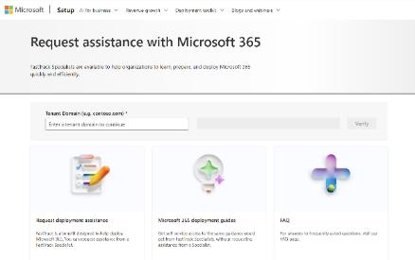
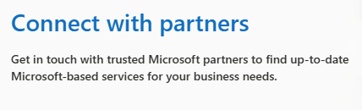
Want additional help? Microsoft can assist with FastTrack and Unified Support
Microsoft FastTrack Deployment Support
Unified Support with
Value Acceleration Services
Find an AI Transformation partner
FastTrack provides remote guidance and best practices to maximize deployment, adoption, and optimization.
Enable Copilot with services based on Microsoft Intellectual Property, expertise, and proven methodologies.
Copilot Immersion Workshop
Copilot End User Workshop
Copilot Business Value Workshop
AI Agents: Workshop, Immersion and Governance
Data Readiness for Copilot
Leverage a partner to help with Microsoft 365 Copilot scenarios, adoption , and agentic transformation.. The partners in our ecosystem create and sell differentiated products and end-to-end solutions—in many scenarios and industries—to drive your success.
Review https://aka.ms/fasttrack to submit a request for FastTrack Assistance.
Contact your Customer Success Account Manager or Account Team for more details
Find a partner in the marketplace based on specialty, industry, solution, etc.

Slide 20
Additional Resources

Slide 21
Copilot adoption site
  Copilot Success Kit
  Tools and Templates
  Agent Success Kit
Our implementation framework and how-to resources are designed to streamline and accelerate your time to value with Microsoft 365 Copilot skills.
We’ve developed a collection of user-facing tools and templates for you to quickly onboard your organization onto Microsoft 365 Copilot and drive product engagement.
Use our kit to prepare your tenant for AI agents and to enable your users to create and use agents.
Leader planning guide to work with your leadership team and establish and AI Council.
Technical readiness guide to prepare your tenant and use the Admin Center.
User enablement guide – to drive user adoption.
Planning checklists and worksheets.
Copilot Chat Success Kit link.
Email templates to onboard users.
Event planning like Launch Day, Prompt-a-thon, Virtual Skilling Event.
Trainer Kit with training resources.
Great Copilot Journey.
Agent overview guide for user training.
IT Controls Guide to prepare the tenant for agents.
Microsoft agent guide to prepare users for agents that come with. Microsoft 365 Copilot.

Slide 22
Inside Track – How Microsoft Deployed Copilot
Deploying Microsoft 365 Copilot in five chapters - Inside Track Blog
A comprehensive guide with checklists and best practices based on Microsoft’s experience with Copilot. Organized into five chapters to help various deployment roles easily find the content
they need.
1
Getting governance right – overview of governance frameworks and practical guides to addressing data labeling, DLP, and global compliance needs.
2
Implementation with intention – planning, licensing assignments, and communications are covered in this section.
3
Driving adoption to capture value – how to tailor your change management programs for Copilot.
4
Building a foundation for support – how to prepare your support team for Copilot.
5
Extending Copilot through agents – setting up agent governance and enabling agents.

Slide 23
Deploying AI at Scale white paper
Copilot ACM best practices shared by Microsoft adoption teams
Microsoft has deployed Copilot for Microsoft 365 to more than 330,000 employees and contractors. Microsoft used its global change management team augmented by department-level adoption teams and champion to rapidly drive user enablement.
1
Planning and governance
  Preparing the tenant.
  Selecting departments and employees to prioritize.
  Extending Copilot with agents.
2
Onboard and engage
  Generating excitement with a comms plan.
  Building communities.
  Champions program.
  Developing departmental use cases.

Slide 24
Plan Appendix

Slide 25
Copilot adoption roadmap
 | Plan | Implement |  | Adopt |  | Manage/Improve
 | Week 0 | Week 1 | Week 2 | Week 3 | Week 4 | Week 5 | Week 6
Shared activities
Adoption Team
Champions
Technical
Identify business goals
Share success stories and testimonials
Select initial users and use cases
  Usage Reporting
ROI reporting
Analytics baseline
Feedback collection
Champion Welcome Post 📣
Launch-Day Announcement 🚀
Executive Comms
Copilot Excite Day
Challenges/gamification to encourage use
Coming soon announcement 🚀
Great Copilot Journey
One week until launch: What to expect 🔍
Prompt training
Prompt-a-thon
Agent training
Agent-a-thon
Leader training
Prompt-a-thon
Community development and support
Train the Champions
Champions driven sessions and events – Prompt gallery, Trainer Kit, Lunch and Learn, Agents, new capabilities, etc
Community support and office hours
Champion Feedback
Use case development
Champion Feedback
  Prepare analytics/Dashboard
  Confirm technical readiness
  Complete tenant settings
  Service health review
Sample plan
  Prepare support org
  Organizational Messages
Ongoing support through FAQs and other Microsoft resources

Slide 26

Adoption Team
Plan Items

Slide 27
User Enablement team model
Example
Learn more on how to set up your user enablement team - see slides 14–22 here
WW Executive Sponsor
Team Leaders
Sends key local communications.
Appoints Business Integration Lead.
Represents sponsor with core team.
Monitors enablement.
Works with Team Leaders for. Communications and Cascade.
Worldwide User
Enablement Team
Core IT services and support
Business Integration Lead
Provide scenario-based guidance
on Microsoft 365 Copilot.
Provide global package of assets to leverage (comms, training, readiness, etc.).
Provide onboarding, enablement, and
issue reporting.
Consolidate feedback and share
via Service Health Reviews.
Provide operations, service, and support experiences for new scenarios and features.
Local Copilot Champions
Provide local support.
Provide local training as needed.
Example model – Implementation teams can modify as needed.
Supplier capacity may be added as needed for key activities.

Slide 28
Secure exec sponsorship
How to engage with Executives for sponsorship.pptx
  Ensure they understand
  the ABCs
  Executive Sponsors should
  Executive Sponsors may
A
Active, visible, and consistent participation.
Help the project team identify and prioritize their top business needs.
Encourage shared planning between user enablement and technical teams.
Play a role in communicating the vision to leaders across the organization.
Actively participate in and use Copilot to help drive and reinforce enablement.
Promote the enablement program. Studies show engaged employees are 2.6x¹ more likely to fully support a successful AI transformation.
Lead or participate in the organizational AI Council.
Have purchasing authority for licenses or services from supporting suppliers.
Be directly accountable for Microsoft 365 or broader digital workplace initiatives.
B
Build a coalition with their executive peers.
C
Communicate directly with employees to support landing the change.
¹The state of AI change readiness eBook, Microsoft Viva People Science

Slide 29
Phases of a Copilot communications campaign
Plan This is the warm-up phase. Before Copilot goes live, you prepare the organization, so nobody feels unprepared. You build awareness: What is Copilot? Why are we doing this? You set expectations: What will happen and when? You equip champions and early supporters & establish stakeholders and direction. Goal: Make people curious and ready - not confused or resistant - when the big “go live” happens.
Implement This is the “lights on” moment. Copilot becomes available, and you need to bring everyone along quickly. Announcements, welcome messages, simple “start here” guidance. Tools and templates to help users take their first steps. Training invites or bite-sized tips to reduce the initial learning curve. Goal: Help users start using Copilot immediately with confidence instead of hesitation.
Adopt Once the novelty fades, this phase drives real adoption - the difference between “people tried it once” and “people use it every day.” Quick tips and small wins (“Did you know you can do this?”). Scenario-based examples relevant to different roles. Inspiration from real users. Goal: Move users from experimenting to building lasting habits with Copilot.
Manage/Improve This is the long-term support phase. After the initial buzz, you help people keep improving and discovering new value. Deeper use cases and advanced guidance. Sharing success stories and best practices. Refreshers, reminders, and updates as features evolve. Goal: Ensure Copilot remains a natural, trusted tool - not something people forget about after a few weeks.

Slide 30
Communications activities timeline
Comms & Events | Plan | Implement | Adopt | Manage/Improve
 | Foundational Comms: Leadership announcement Coming-soon teaser What-to-expect guidance Readiness checklist & safety messaging | Launch - Activation Communications Launch-day announcement “How to get started” guides Feature spotlights First-week tips + reminders | Engagement (Adoption-building Communications) Weekly feature highlights Prompt challenges (behavior-themed) Use-case stories & quick-wins Community polls + AMA invites | Sustainment (Ongoing Value Communications): • Persona-based scenario playbooks • Success stories & testimonials • Advanced tips + optimization guidance • Feedback loops & checkpoint updates
How to: Write effective prompts
How to: Use Copilot
How to: Use Copilot
Challenges to encourage use
Themed by roles (HR, Marketing, etc.)
How to: Quick Bites
Coming soon announcement (leadership communication) 🚀
Security announcement (Safe AI)
Share success stories and testimonials
One week until launch: What to expect 🔍
Ask me Anything
One week until launch: What to expect 🔍
Agent Use cases
Introducing 1P agents, identifying use cases for custom agents
Share success stories and testimonials
Launch-Day Announcement 🚀
Ask me Anything
Ask me Anything
Challenges to encourage use
Themed by behavior (Summarize, plan, draft, ideate)
Champion Welcome Post 📣
Sample

Slide 31
Copilot skilling levers
 |  | Focus & Objectives | Audience | Format | When to use it? | Who can leverage it? | Learn more
Self-Learning | Microsoft Learn | Self‑paced learning to build Copilot fundamentals and Chat skills ; curated learning hub for business users. | End users, champions, admins, developers | On‑demand courses, including learning paths & modules; videos; labs. | Any time: baseline readiness before/after rollout; ongoing upskilling; reinforce skills after live training | Everyone (public, free) | Microsoft Learn for Organizations • Copilot Learning Hub • Explore Copilot Chat path (MS-4023) • Build agents in Copilot Chat
 | Copilot Academy | Structured Copilot curriculum in Viva Learning | End users; adoption leads; IT admins | In‑tenant Academy (self‑paced) with curated learning sets; optional tenant customized version. | Early rollout and beyond: give every user a guided journey; use when the customer has Viva Learning | Any Microsoft 365 tenant via Viva Learning | Copilot Academy (Viva Learning
 | The Great Copilot Journey | 30-day guided experience on Copilot Chat with one prompt per day to build habits and usage | End users; champions; adoption leads | Kit with 30 business-day email templates how-to videos, completion badges. | Post-Enablement: drive adoption and prompt craftmanship; great for broad scale | Everyone (public, free, self‑run or field‑assisted) | Overview: Great Copilot Journey • Impact write‑up: How it drives usage
Scale | Customer Hub | A virtual webinar series that gets customers ready to deploy and drive healthy usage; sessions on discovery, user enablement, and org change. | End users; champions; adoption leads; IT & business decision makers | Live, virtual instructor‑led sessions; on‑demand recordings; recurring series. | Pre‑deployment and early rollout: align stakeholders; learn recommended practices & next steps. | Everyone (public, free) | Event Registration + On-Demand recordings at Customer Hub by end of week We will run each session twice a month with alternating time zones.
 | Copilot End-User Training & Microsoft Virtual Day | Role‑based end‑user training that covers Copilot fundamentals with demos and Q&A; multiple role tracks (IT, Finance, HR, Operations, etc.). | End users; champions; adoption leads | Live, virtual instructor‑led sessions; on‑demand recordings; recurring series. | Launch & scale phases: deliver fast, repeatable skilling without custom build; pair with Learn/Academy for reinforcement. | Everyone (public, free) | Microsoft Virtual Training Days | Microsoft Events
 | Org Skilling | Enterprise skilling program providing curated scalable digital and 1:many training for foundational Copilot Chat usage | End users; champions; adoption leads | Mix of self‑paced, virtual instructor‑led, and curated learning experiences. | Depth & scale: when large customers need structured, role‑based skilling programs beyond baseline end‑user sessions. | Eligible customers | Training for organizations
Custom | Unified | Expert-led training tailored to organization needs to help end-users gain practical skills to use Copilot Chat securely and productively, enhancing daily workflows and fostering innovation. | End users; champions; adoption leads | On-site (preferred) engagement or remote | Depth & scale: when a customer has Unified and wants structured/customized learning path + advisory alongside deployment/optimization | Unified customers | Services Hub Learning • Unified + Copilot learning overview

Slide 32
Skilling workstream timeline
Training / Skilling | Plan | Implement | Adopt | Manage/Improve
 | Business Value Readiness | Copilot training (Organizational Skilling): Awareness & Engagement Readiness & Training | AoP training (Organizational Skilling) Use case and Outcome based prompting: Post‑Launch scale‑up Skills Deepening & Confidence Empower your workforce with Microsoft 365 Copilot Use Cases | AoP training (Organizational Skilling): Persona Playbooks Consolidation & Checkpoint
Office hours : Dependent on the survey
Office hours : Dependent on the survey
Office hours : Dependent on the survey
MS-4023: Explore Microsoft 365 Copilot Chat
  MS-4004.1: Executives use case
  MS-4004.2: Sales use case
  MS-4004.3: IT professionals use case
  MS-4004.4: Marketing use case
  MS-4004.5: Finance use case
  MS-4004.6: HR use case
  MS-4004.7: Operations use case
  MS-4004.8: Communications use case
  MS-4004.9: Customer service use case
  MS-4004.10: Legal use case
AI-3025: Work smarter with AI
Envision Business Value & Vision
MS-4019: Transform your everyday business processes with agents
MS-4018: Draft, analyze, and present with
Microsoft 365 Copilot​
Baseline security and compliance configuration validation
Scenario Discovery
Champions Readiness
Microsoft 365 Copilot Overview, AoP, Day in Life, Hands-on Basic & Advanced, Prompting Microsoft 365 Researcher and Analyst Overview
Product Updates for end-users
Readiness:
Align leadership / sponsor
Customize assets
Set Expectations
Viva Engage Community
Create Scenario Library
Prompt a thons
Scenario discovery with Champions, Champions readiness
Champions driven sessions and events
Champions led Prompt-a-thons
Sample

Slide 33

Team Leads/ Champions
Plan Items

Slide 34

The role of team leaders
1
Plan the rollout for your team – identify pain points and select use cases with your Champions.
2
Set success metrics for process change and establish a baseline for value measurement.
3
Prepare your team – work with the adoption team to coordinate communications and training.
4
Drive ongoing usage – share personal use cases and team success stories.
5
Review usage reports and feedback from Champions to identify training needs.

Slide 35
Invest in Champions
See how Microsoft uses Copilot Champions
Why Champions
  Act as trusted guides within their teams, demystifying AI and modeling responsible usage.
  Surface real-world use cases and adoption roadblocks, providing actionable insights.
  Serve as first-line support for their peers, reducing strain on IT and ACM teams while fostering a self-sustaining adoption ecosystem.
  Collect feedback to identify roadblocks and share best practices.
Best practices
  Define success metrics (number of end-user sessions delivered, use-case collected, Copilot chat usage metrics) – Leverage Champions Program Guidance with guideline on how to create/extend your network.
  Incentive Champions and end-user participation via gamification (leaderboard, cohorts, swags, …).
  Collect use-cases: ensure use-cases are captured centrally and connected to business value.
  Be programmatic and structured:
  Build a time-bounded plan that’s replicable across “cohorts”.
  Leverage self-service and reusable assets as much as possible to scale and reinforce (make daily usage).

Slide 36
Value Measurement
Read more about how Microsoft measures the impact of Copilot value and the value framework used.
Microsoft 365 Copilot value realization step-by-step
Establish baselines so you can prove value.
Ensure proper telemetry for key processes.
Monitor changes to measure value achieved.
Recapture savings with intention.
Change Management
accelerated by Champions
Measure the identified processes to understand the impact of Copilot post deployment
Identify 3–5 pain points that AI could help with by role
Invest in enterprise AI skilling customized to roles
01
02
03
04
05
06
Measure those processes then carefully consider how AI could help to make them more efficient
Deploy Copilot by cohorts starting with roles that could see the greatest benefits
Recapture value from productivity savings and apply to new business challenges or opportunities
Reinforcement & Reskilling

Slide 37

Technical Team
Plan Items

Slide 38



Three steps to deploy M365 Copilot
Protect your data – Secure and govern Copilot, Copilot Control System Security and Governance
1
Implement SharePoint best practices and SharePoint Advanced Management
Deploy sensitivity labels
Set up DLP policies
Create retention and deletion policies with Data Lifecycle Management
Configure Copilot and agent settings – Copilot Control System Management Controls, Set Up Copilot, Deployment accelerators
2
Enable web search
Pin the app to the Windows taskbar and Chat in the apps
Enable additional models
Enable agents
Configure required connectors
Set up usage reports and Copilot Dashboard – Copilot Control System Measurement and Reporting
3
Assign roles
Create custom reports

Slide 39
Three steps to deploy Copilot Chat (Basic)
Pin Copilot to key apps and Windows
1
Make Copilot Chat easy to find and use by pinning the Microsoft 365 Copilot app to the Windows taskbar and pinning Copilot Chat in the Microsoft 365 Copilot app, Teams, and Outlook using these simple instructions.
Configure web grounding
2
Allowing Microsoft 365 Copilot Chat to reference web content improves the quality of Copilot responses by grounding them in the latest information from the web. You can lean more about web grounding here.
Redirect to Copilot
3
Address Shadow IT and Bring Your own AI by configuring relevant DNS settings, Firewall rules, Proxy Server redirects, or Azure Cloud Traffic Manager to redirect other AI assistants to m365copilot.com.

Slide 40
Implement Appendix

Slide 41
Microsoft 365 Copilot (Premium) adoption content
Implement content
Programs
Launch Day Kit – Framework, templates, and digital assets for running your own Microsoft 365 Copilot launch event
Onboarding materials
User and manager onboarding templates – Customizable email templates for introducing Microsoft 365 Copilot to your organization and driving usage. Includes leadership communication templates to promote rollout, as well as function-specific templates sharing Copilot guidance and prompt examples.
Digital swag – badges and Teams backgrounds
Adopt content
Programs
Prompt-a-thon – Digital assets and trainer videos for running an interactive “hack” event to deepen your organization’s prompting skills
Great Copilot Journey – Ready-to-use email templates for a 30-day skilling experience that teaches users what’s possible with Copilot Chat and drives usage
Virtual skilling event – Event kit for planning, delivering, and evaluating a virtual training session for Microsoft 365 Copilot
Scavenger hunt – fun activity to help your team learn prompting
Microsoft 365 Copilot Prompting guides
Top 10 prompts for Microsoft 365 Copilot – Handout to share with users on top use cases to get started with Microsoft 365 Copilot
Microsoft 365 Copilot experience guide – Practical guide to Copilot prompts, terminology, and actionable tips
Microsoft 365 Copilot prompt pack for Sales, Marketing, Customer Service: Ready-to-use Copilot prompts to help people use Copilot in their roles
Training handouts
Quick start guide – Editable handout to share with users on how to get started with Microsoft 365 Copilot
Get started with Microsoft 365 Copilot app, Excel, Word, PowerPoint, Teams, and agents in Microsoft 365: Guides to share with users on how to use Microsoft 365 Copilot for common scenarios
Research and Analyst user guide – how to use Researcher and Analyst
Agent overview guide – help your users understand agent use cases and get started using them
Lunch and learn courses
Agent Builder demos – examples of how to create agents in Agent Builder
Analyst – how to use Analyst
Researcher – how to use Researcher
Value and use cases
Scenario Library – examples of how to use Copilot to solve problems in industries and functions
Becoming a Frontier Firm – functional use case examples from Copilot to Foundry
Defining business value – how to think about the value of Copilot and agents

Slide 42
Microsoft 365 Copilot (Basic) adoption content
Implement content
Programs
Launch Day Kit – Framework, templates, and digital assets for running your own Copilot launch event
Onboarding materials
User onboarding templates – Customizable email templates for introducing Microsoft 365 Copilot Chat to your organization and driving usage
Digital swag – badges and Teams backgrounds
Adopt content
Programs
Prompt-a-thon – Digital assets and trainer videos for running an interactive “hack” event to deepen your organization’s prompting skills
Great Copilot Journey – Ready-to-use email templates for a 30-day skilling experience that teaches users
Training handouts
Copilot Chat user training guide: Training course to introduce Microsoft 365 Copilot Chat and how to use it for common scenarios
Get Started in Outlook: Guides to share with users on how to use Microsoft 365 Copilot Chat for common scenarios
Top 10 prompts for Copilot Chat – Handout to share with users on the top 10 use cases to try first with Copilot Chat
Lunch and learn courses
Get started with Chat – introduction to Copilot Chat and prompting
Chat review – second session on Copilot Chat with additional use cases such as using advanced models, using personalization, and saving prompts
Advanced Chat capabilities – third course in the Chat series to introduce Pages, Create, and agents
Value and use cases
Scenario Library – examples of how to use Copilot to solve problems in industries and functions

Slide 43
Adoption Team
Implement Items

Slide 44
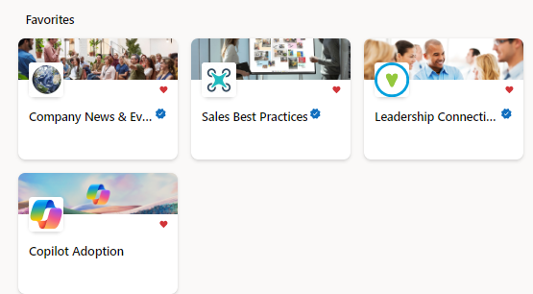
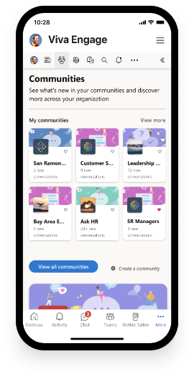
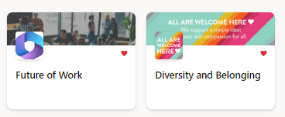
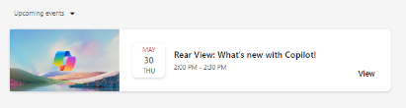
Build your Community of Practice with Viva Engage
Connect and empower employees
Create a community in Viva Engage to generate excitement, share learning, and support Copilot Champions and experts.
Give employees a place to:
Share best practices, such as prompts.
Share success stories of Copilot saving time and driving productivity.
Access company announcements on AI usage, direction, and mission.
Facilitate peer to peer learning and Champion engagement.
Picture

Slide 45
Team Leads/ Champions
Implement Items

Slide 46
Developing Copilot use cases with your team
FRAMEWORK
This framework isn’t just a checklist—it’s a conversation starter. At each step, ask yourself and your team: what does success look like for us? Where are our biggest opportunities? What’s holding us back? For more information download this guide. For help discovering use cases for specific roles and industries check out the Scenario Library.
Step 1
Step 2
Step 3
Step 4
Step 5
Start with your team’s goals
Select processes that impact those goals
Transform those processes with AI
Define success
Identify success metrics and
measure Impact
What is your team truly trying to achieve? Is it cost savings, revenue growth, leading your industry, or avoiding unnecessary costs?
Are there manual, repetitive tasks slowing you down? Approval processes, customer interactions, or reporting cycles that could be streamlined?
How could AI enhance, automate, or optimize these processes? Imagine your teams focusing on high-value work while AI handles the routine.
Agree on what the process will look like when fully segmented with AI.
Track KPIs like time saved, revenue growth, or customer satisfaction. Make sure you’re set up to measure not just adoption, but real business outcomes.

Slide 47
Technical Team
Implement Items

Slide 48
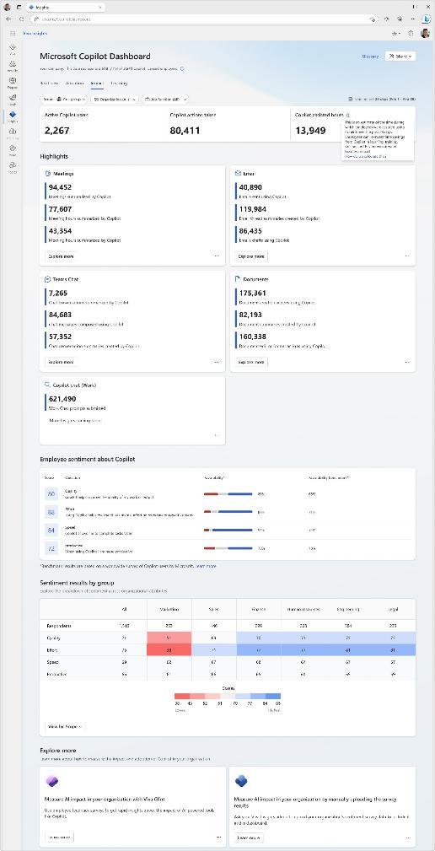
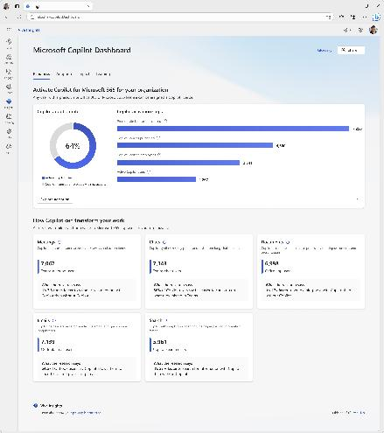
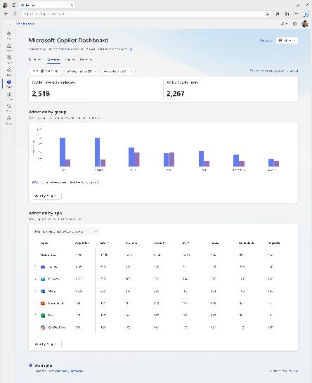
Copilot Dashboard
Enable the Copilot DashBoard
Pre-built dashboard for business leaders to prepare for their Copilot rollout, understand and drive usage and adoption, and measure the impact of their investments.
Access directly at aka.ms/CopilotDashboard.
Readiness tab to see licensing and copilot activation status across the tenant.
Adoption tab to see Copilot trends and usage down to the app feature level, with filters to drill down by group, organization, and job function.
Impact tab to view Copilot actions by productivity categories, Copilot assisted hours and related value calculator and how Copilot usage is correlated with behavioral patterns in your business. Sentiment data from uploaded survey results is also available.
Learning tab for research and best practices to inform your AI journey.
Use the Copilot Dashboard metrics eBook to help understand and interpret the data.

Slide 49
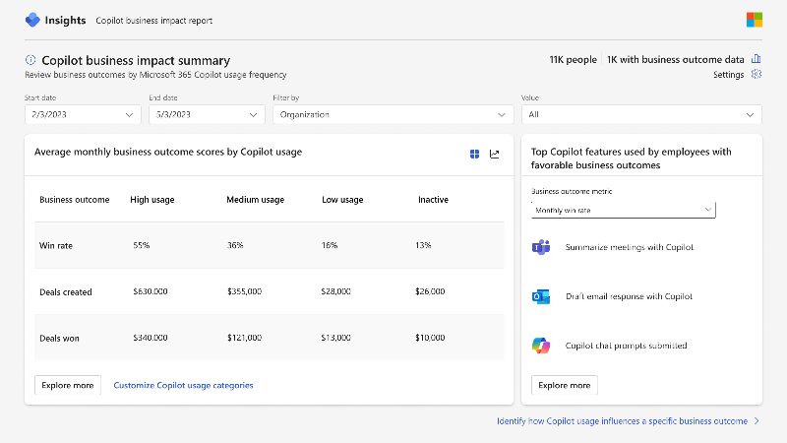
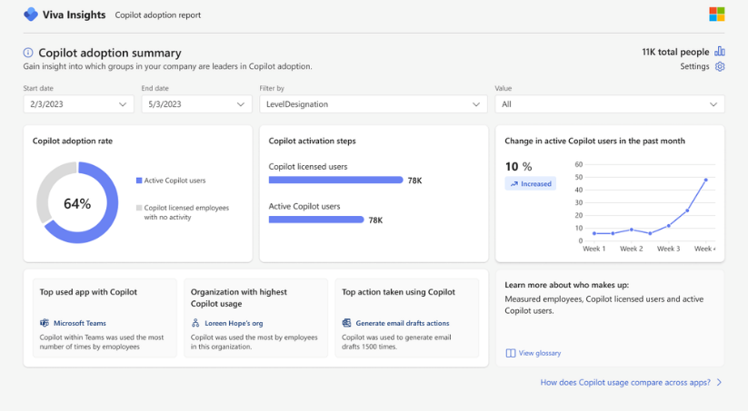
Viva Insights advanced impact reports
  Included with Microsoft 365 Copilot
  Copilot business impact reports
Measure the value of Microsoft 365 Copilot with your key business metrics.
See setup details
  Advanced adoption and impact reports
Get a deeper look into Microsoft 365 Copilot adoption and impact trends with a customizable, prebuilt report.

Slide 50
Adopt Appendix

Slide 51
Use Gamification to drive adoption
See how Microsoft uses gamification to boost Copilot usage
Sample activities | Points
Attend "Train the Trainer" | 10 pts
Invite team members to attend training session | 5 pts
Helping a colleague (print or testimonial) | 5 pts
Conduct hands-on session with team | 15 pts
Share prompt in the "Success Story & Prompts" channel | 10 pts
Suggest improvement/feedback | 5 pts
Complete On-Demand Training | 10 pts
Share Value Impact of a Copilot Chat Usage Scenario in the "Success Story and Prompts" channel | 15 pts
Comment, reply, or ask questions in the "Ask, Answer, and Learn" channel | 3 pts
The benefits we’ve found from gamification are:
Drive lasting engagement: Gamified activities ignite fun, excitement, and learning that continues well beyond an event.
Offer experiences: Creative training methods like friendly competition and interactive workshops significantly enhance employee engagement. Engaged employees are more likely to embrace AI tools.
Foster innovation: Encouraging creative thinking empowers employees to explore AI applications, enhancing their problem-solving capabilities and increasing their productivity.
Build trust and skills: Peer-led training leverages existing knowledge within teams, making it easier for employees to learn from each other about AI tools.
Encourage experimentation: A risk-free environment allows employees to experiment with AI tools without fear of failure, which is vital for discovering practical applications.

Slide 52
Microsoft 365 Copilot (Premium) adoption content
Implement content
Programs
Launch Day Kit – Framework, templates, and digital assets for running your own Microsoft 365 Copilot launch event
Onboarding materials
User and manager onboarding templates – Customizable email templates for introducing Microsoft 365 Copilot to your organization and driving usage. Includes leadership communication templates to promote rollout, as well as function-specific templates sharing Copilot guidance and prompt examples.
Digital swag – badges and Teams backgrounds
Adopt content
Programs
Prompt-a-thon – Digital assets and trainer videos for running an interactive “hack” event to deepen your organization’s prompting skills
Great Copilot Journey – Ready-to-use email templates for a 30-day skilling experience that teaches users what’s possible with Copilot Chat and drives usage
Virtual skilling event – Event kit for planning, delivering, and evaluating a virtual training session for Microsoft 365 Copilot
Scavenger hunt – fun activity to help your team learn prompting
Microsoft 365 Copilot Prompting guides
Top 10 prompts for Microsoft 365 Copilot – Handout to share with users on top use cases to get started with Microsoft 365 Copilot
Microsoft 365 Copilot experience guide – Practical guide to Copilot prompts, terminology, and actionable tips
Microsoft 365 Copilot prompt pack for Sales, Marketing, Customer Service: Ready-to-use Copilot prompts to help people use Copilot in their roles
Training handouts
Quick start guide – Editable handout to share with users on how to get started with Microsoft 365 Copilot
Get started with Microsoft 365 Copilot app, Excel, Word, PowerPoint, Teams, and agents in Microsoft 365: Guides to share with users on how to use Microsoft 365 Copilot for common scenarios
Research and Analyst user guide – how to use Researcher and Analyst
Agent overview guide – help your users understand agent use cases and get started using them
Lunch and learn courses
Agent Builder demos – examples of how to create agents in Agent Builder
Analyst – how to use Analyst
Researcher – how to use Researcher
Value and use cases
Scenario Library – examples of how to use Copilot to solve problems in industries and functions
Becoming a Frontier Firm – functional use case examples from Copilot to Foundry
Defining business value – how to think about the value of Copilot and agents

Slide 53
Microsoft 365 Copilot (Basic) adoption content
Implement content
Programs
Launch Day Kit – Framework, templates, and digital assets for running your own Copilot launch event
Onboarding materials
User onboarding templates – Customizable email templates for introducing Microsoft 365 Copilot Chat to your organization and driving usage
Digital swag – badges and Teams backgrounds
Adopt content
Programs
Prompt-a-thon – Digital assets and trainer videos for running an interactive “hack” event to deepen your organization’s prompting skills
Great Copilot Journey – Ready-to-use email templates for a 30-day skilling experience that teaches users
Training handouts
Copilot Chat user training guide: Training course to introduce Microsoft 365 Copilot Chat and how to use it for common scenarios
Get Started in Outlook: Guides to share with users on how to use Microsoft 365 Copilot Chat for common scenarios
Top 10 prompts for Copilot Chat – Handout to share with users on the top 10 use cases to try first with Copilot Chat
Lunch and learn courses
Get started with Chat – introduction to Copilot Chat and prompting
Chat review – second session on Copilot Chat with additional use cases such as using advanced models, using personalization, and saving prompts
Advanced Chat capabilities – third course in the Chat series to introduce Pages, Create, and agents
Value and use cases
Scenario Library – examples of how to use Copilot to solve problems in industries and functions

Slide 54
Manage/Improve Appendix

Slide 55
Keep up with what’s new
 | What’s New Sources | What’s New Actions
Adoption Team | Microsoft 365 Roadmap – announcements, what’s available, what’s coming soon. Microsoft 365 Copilot blog –details on what’s new in Copilot. Adoption Hub – What’s new section for email templates and content for your users. | Drive awareness and excitement of new capabilities to enhance AI skills through: Training sessions AMAs Prompt-a-thons
Team leads/ Champions | Customer Hub – webinars on Copilot and agents. Get Started guides – training guides that are regularly updated with the latest use cases and prompts. | Keep up to date with Customer Hub webinars on the latest capabilities Deliver Lunch and Learns based on these sessions and The Get Started guides to provide real-world use cases for new features. Get the latest demos from the Get Started guides
Technical team | Message Center Posts – technical details of what’s new. Microsoft 365 Roadmap – announcements, what’s available, what’s coming soon. Microsoft 365 Copilot blog –details on what’s new in Copilot. Release notes – detailed explanations of roadmap items as they are released. | Prepare for new features in partnership with Adoption team and AI Council to accelerate org priorities and feature availability Keep your tenant settings updated to enable new models and capabilities
Leadership | Jared Spataro on LinkedIn Judson Althoff on LinkedIn Work Trend Index | Engage the AI Council, Adoption team, and Technical Team to enhance Frontier transformation plan with new capabilities that accelerate business outcomes and maximize ROI.

