Slide 1

Transform sales with Gen AI
Microsoft 365 Copilot for Sales

Slide 2

Microsoft 365 Copilot of Sales
Scenarios for Sales

Slide 3

A day in the life of a Sales Executive
Steer corporate sales strategy, oversee major accounts, and ensure alignment with broader business objectives.
Omar is a Sales Executive at Contoso
8:00 am
11:00 am
4:30 pm
Omar starts his day by reviewing his calendar and messages. On a typical day, he gets 300 emails and 200 Teams messages. Being able to use Copilot is game changing – he can prioritize responses by asking “Do I have any urgent asks?”
Omar has a short working block to prepare for an upcoming strategic planning session. As he scrolls through his calendars, Omar sees he has two upcoming meetings with customers and uses Copilot for Sales in Outlook to quickly get up to speed on account and opportunity details.
Feeling a sense of accomplishment, Omar ends his day on a lighter note, using Copilot’s image generation capabilities to create a fun image to share in the leadership Teams chat with an inspiring “We’ve got this!” message.
10:00 am
2:00 pm
He then reviews sales data and key performance issues using Copilot to highlight important insights and heads into the monthly business review.
After his meeting, Omar calls a sales director on his team to share key takeaways from this strategic customer identifying new sales opportunities to grow revenue. Copilot for Sales takes notes and recaps the meeting.
Notes:
Responsibilities: Leads sales division focusing on sales strategy, operations, and alignment with corporate goals. Sets and tracks progress against targets.
Skills: Leadership, advanced strategic planning, client relationship building, and high-level communication.
Common Titles: VP of Sales, Chief Revenue Officer (CRO).

Slide 4

A day in the life of a Sales Leader
Achieve sales targets and optimize team performance, ensuring strategic alignment and customer satisfaction.
Amy is a sales lead at Contoso
8:00 am
11:00 am
3:00 pm
Amy starts her day by reviewing sales data with the help of insights collected from Copilot for Sales integration with their Salesforce CRM.
She gathers the sales team for a morning huddle. She uses Copilot to record and recap the meeting capturing insights on revenue opportunities, top risks and priorities for her team.
To stay on top of market dynamics, Amy uses Copilot to conduct customer and competitor research helping her stay ahead in a rapidly changing market.
10:00 am
1:00 pm
She updates her team briefing deck, adding a new slide on lessons learned from recent lost deals, using Copilot to analyze and present key takeaways clearly.
Since she’s often triple-booked across customers her team owns, Amy uses meeting recaps to review sales insights. She analyzes call recordings, focusing on sentiment to identify coaching opportunities.
Notes:
Responsibilities: Oversees sales teams, monitors performance, and provides coaching.
Skills: Leadership, data analysis, client relationship building, and team motivation.
Common Titles: Sales Manager, Regional Sales Director.

Slide 5

A day in the life of a Field Seller
Drive sales by engaging directly with customers, pursuing leads, nurturing relationships, and closing deals through personalized interactions.
Beth
is a Sales Rep at Contoso
8:00 am
11:00 am
2:00 pm
Beth wakes up to a strategic customer escalating on pricing and technical issues related to a current deal with strong competitive pressure. She views customer account and opportunity summary information in Salesforce.
Beth asks Copilot for Sales to create an email update for her manager and broader account team, summarizing the customer escalation and next steps on resolution. Salesforce is updated with key items.
Beth jumps into a customer call with minimal prep due to the earlier escalation. Using Copilot for Sales, she receives real-time tips during the call, later capturing CRM tasks from the recap. After, she sends a meeting summary and saves it to her CRM.
10:00 am
1:00 pm
4:00 pm
Beth asks Copilot to summarize all the emails and Teams chats in the past month from this customer, highlighting the primary asks and open items.
After starting a Teams deal room to keep folks engaged on this deal under risk, Beth receives the OK to provide the customer with an additional discount. As they work through the issue, Copilot for Sales suggests a new opportunity close date.
Monitoring the Teams deal room chat, Beth feels good about progress on the customer escalation. She uses the extra time Copilot for Sales has freed up to catch up on the latest AI training course.
Notes:
Responsibilities: Engages directly with customers to foster strong relationships and drive/close sales. Conducts demos, handles objections, looks for upsell opportunities.
Skills: Interpersonal skills, relationship-building, negotiation, and understanding customer needs.
Common Titles: Sales Representative, Sales Development Representative (SDR), Account Executive, Enterprise Account Manager.

Slide 6

A day in the life of a Sales Enablement Manager
Elevate organizational sales performance by tailoring strategies and tools to meet diverse needs and enhance overall effectiveness.
Joe is a Sales Enablement Manager at Contoso
8:00 am
11:00 am
2:00 pm
As a champion user and enablement leader, Joe kicks off the day reviewing usage stats in the Copilot for Sales dashboard to get detailed understanding of Copilot uptake and collect insights for sales executives.
He checks out the Microsoft adoption website to learn about new capabilities so he can optimize their sales team’s internal target scenarios and elevate sales performance.
Gamification can be a powerful tool in driving Copilot for Sales adoption, so Joe sends his weekly “team challenge” reminder asking people to submit their best sales prompts for a shared library. He’ll then recognize those with the most or best submissions.
10:00 am
1:00 pm
3:00 pm
He develops new training materials for an upcoming product launch, using Copilot’s assistance to review existing training content and tailors it to be sure it supports the right sales strategies and addresses customer needs.
During Office Hours, Joe coaches new hires on using Copilot for Sales, walking them through the Top 10 skills to try and then role-playing use of those skills in customer conversations.
As part of planning for his monthly sales readiness session, Joe uses Copilot to draft event agendas, coordinate logistics based on team availability and generate engaging content to ensure the event’s success.
Notes:
Responsibilities: Develops and implements strategies to enhance sales team efficiency and effectiveness. Manages training programs and sales support resources.
Skills: Training development, content management, and performance metrics analysis.
Titles: Sales Enablement Manager, Sales Training Manager

Slide 7





Top 10 to try first with Microsoft 365 Copilot
Foundational skills for new users
1
2
3
4
5
Recap a meeting
Let Copilot keep track of key topics and action items so you can stay focused during the meeting and avoid listening to the recording after.
Summarize an email thread
Get quickly caught up to a long, complex email thread.
Draft email
Personalize the tone and length.
Summarize a document
Get right down to business by summarizing long documents and focusing on the relevant sections.
Tell me about a topic/project
Provide insights and analysis from across multiple sources to get up to speed quickly.
Draft an email to [name] that informs them that Project X is delayed two weeks. Make it short and casual in tone.
Draft an email with notes and action items from meeting.
Click on the Summarize icon.
Give me a bulleted list of key points from file.
Tell me what's new about topic organized by emails, chats, and files?
6
7
8
9
10
Give me some ideas for …
Boost your creativity with ideas for your work such as agendas, product names, social media posts, etc.
Help me write …
Jumpstart creativity and write and edit like a pro by getting a first draft in seconds.
What did they say …
When you vaguely remember someone mentioning a topic, have Copilot do the research.
Revise this content
When you’ve got a rough draft of an idea, turn it into usable text and then vary the length and tone.
Translate a message
With business becoming increasingly international, it’s important to be able to read or write messages in other languages.
Suggest 10 compelling taglines based on file.
Generate three ways to say [x].
What did person say about topic.
Rewrite with Copilot.
Translate the following text into French:
For more prompts, visit Copilot Lab at: aka.ms/CopilotLab

Slide 8
Top 10 to try first with Microsoft 365 Copilot for Sales
Foundational skills for new users
1
2
3
4
5
Save customer emails and meetings to CRM easily
Capture a new customer contact or a lead from email
View opportunity summary in Outlook
Create or edit an Opportunity or Account from Outlook
Get ready for customer meetings with a summary card
Show consistent customer engagement by capturing emails and meetings in CRM automatically.
Create new contacts or leads directly from your Outlook inbox so that you can keep track of your stakeholders.
View opportunity summary, and relevant insights (Budget, Authority, Need, Timing) in Outlook
Create new accounts and opportunities without switching to your CRM.
Prepare for a customer meeting thoroughly and quickly with an AI generated summary leveraging data in CRM and M365.
6
7
8
9
10
Follow up with an email after a customer meeting
Update CRM after customer meetings
Summarize an email thread with sales data from CRM
Draft an email reply with sales information
Share CRM data in Outlook and Teams
Follow up on next steps and action items immediately after a meeting with AI generated draft.
Capture CRM tasks directly from AI generated summary when recording a Teams meeting
Get quickly caught up on a long email thread with customers
Generate customer replies using sales prompts, data, and insights. Personalize email by adjusting tone and length.
Share sales data from CRM such as contacts, accounts, opportunities without switching application.
For more scenarios, visit: aka.ms/CopilotForSalesAdoption

Slide 9
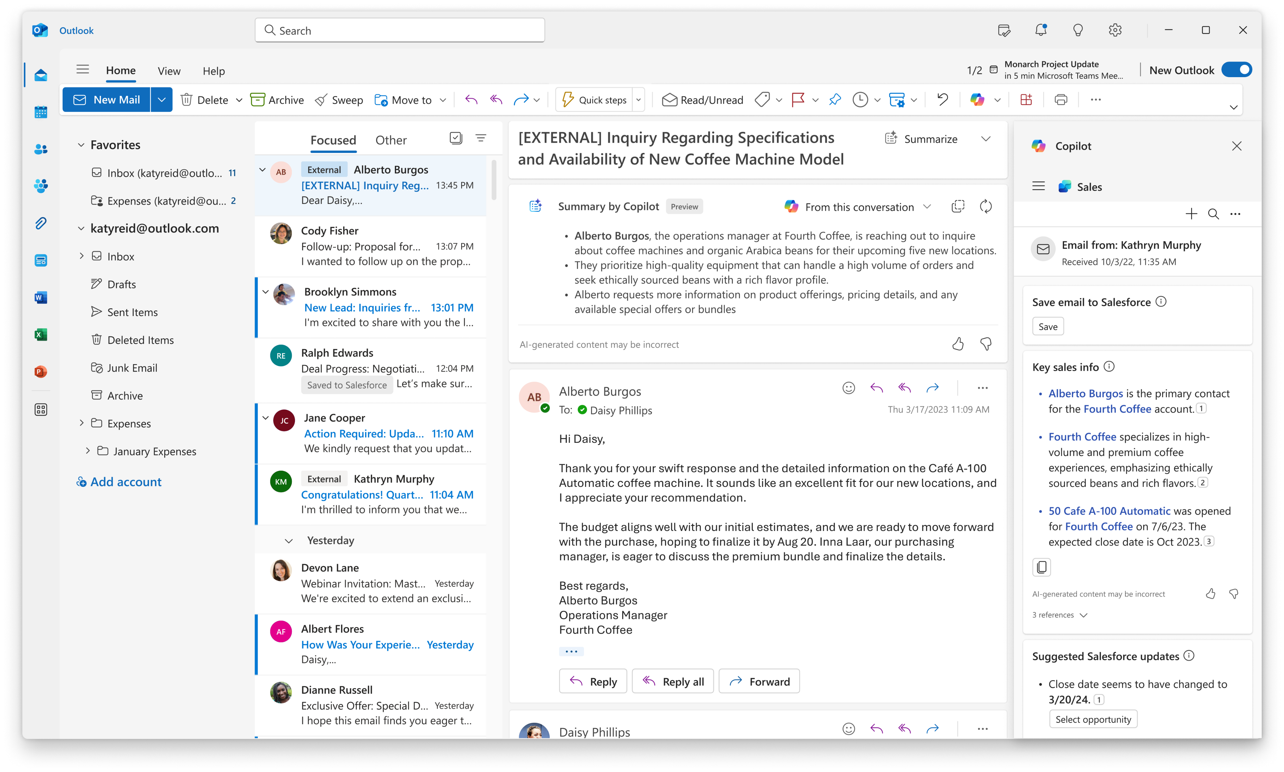
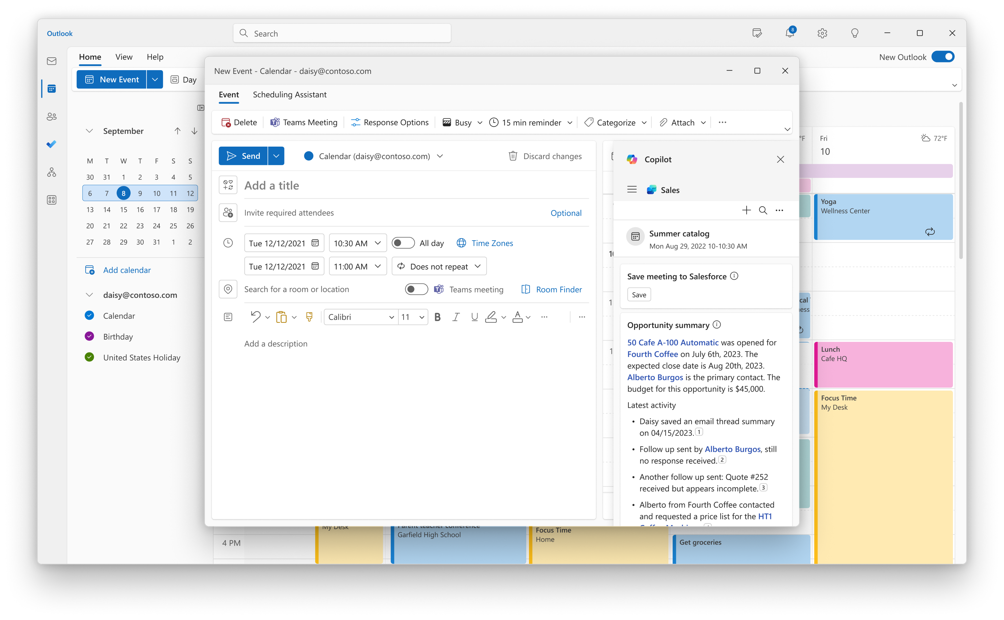
Save customer emails and meetings to CRM easily
1

Slide 10
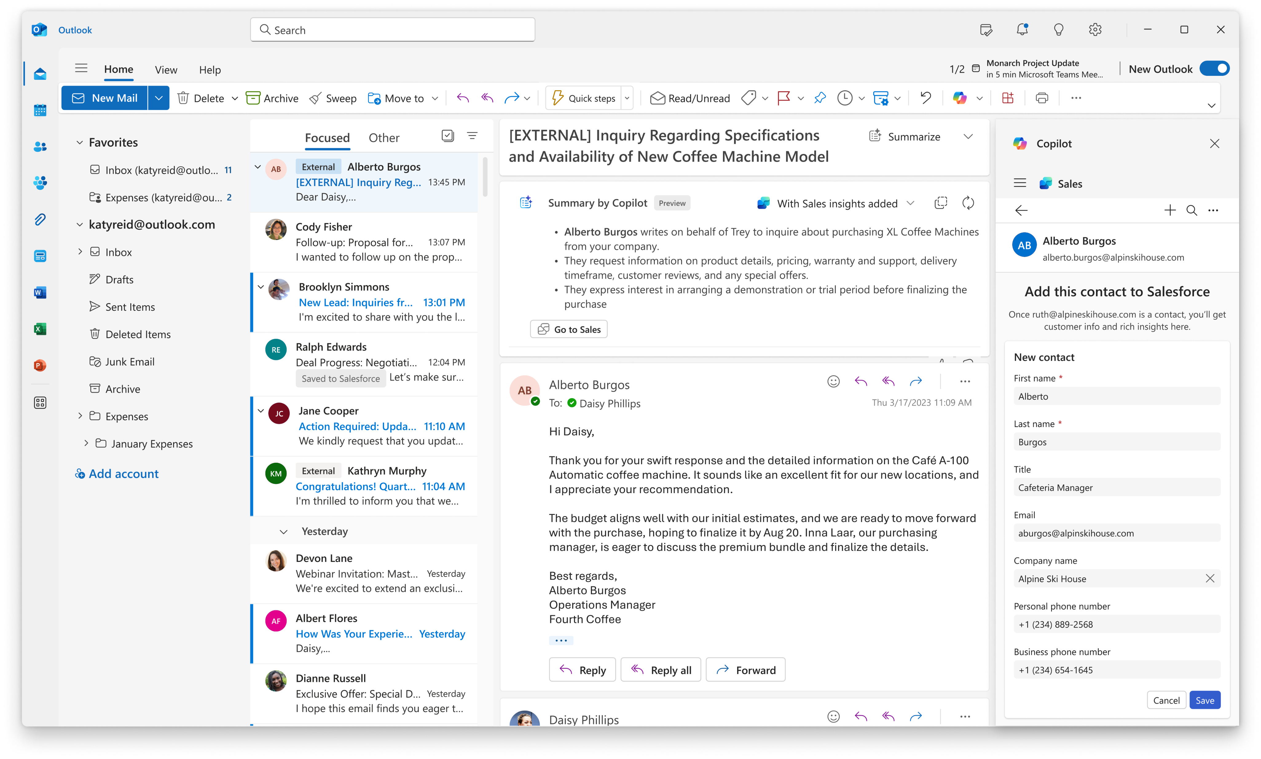
Capture a customer contact or a lead
2

Slide 11
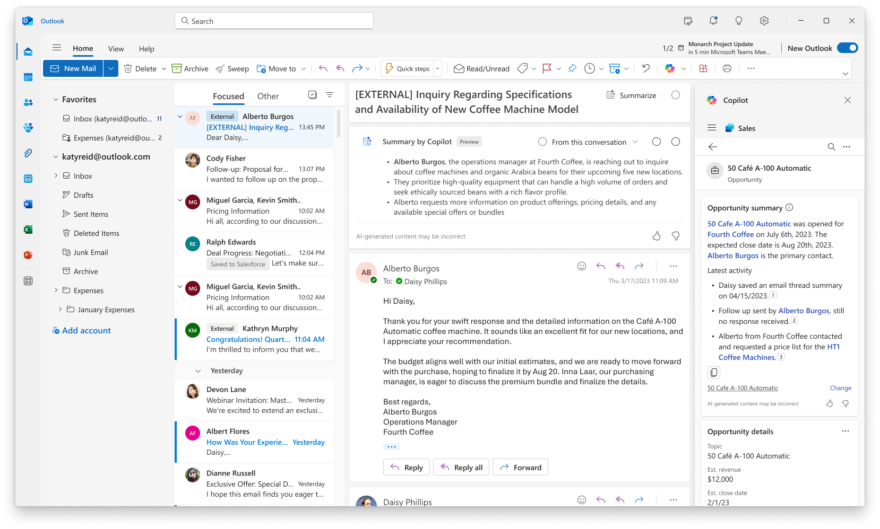
View opportunity summary in Outlook
3

Slide 12
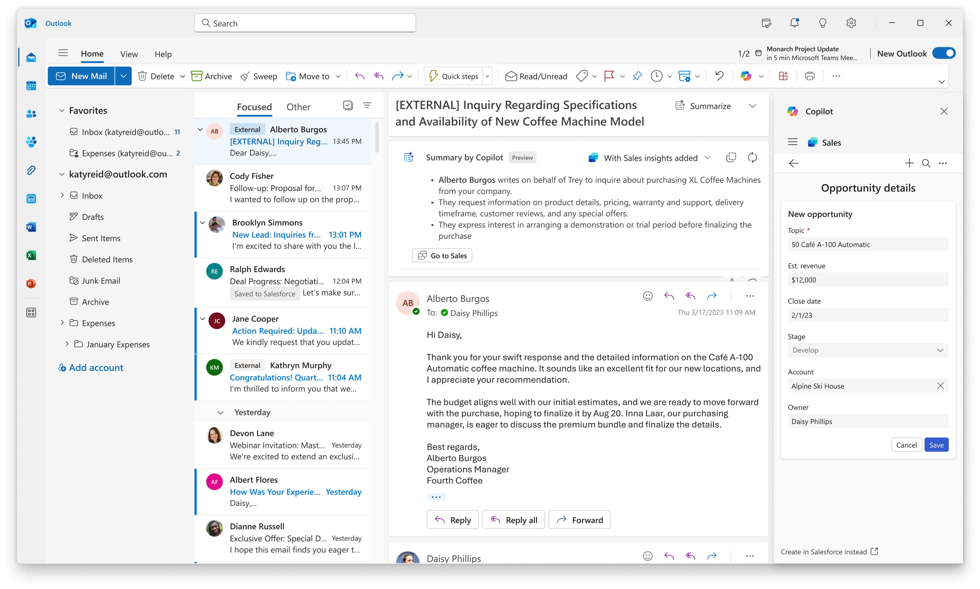
Create CRM data from Outlook
4

Slide 13
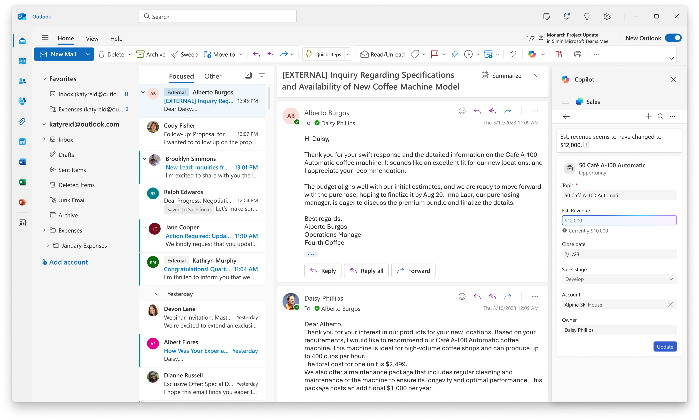
Update CRM data in the flow of work
4

Slide 14
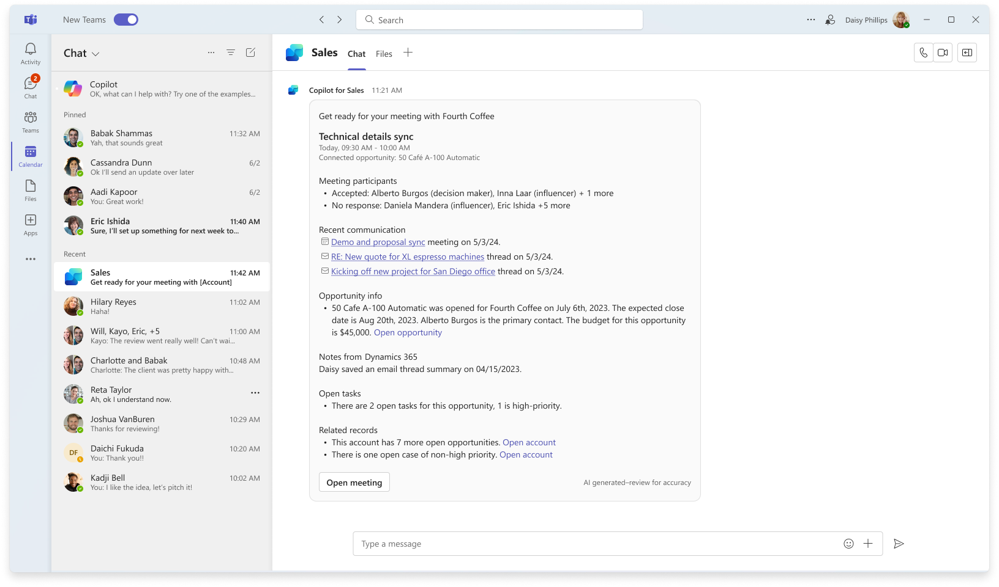
Join a meeting prepared with a summary card
5

Slide 15
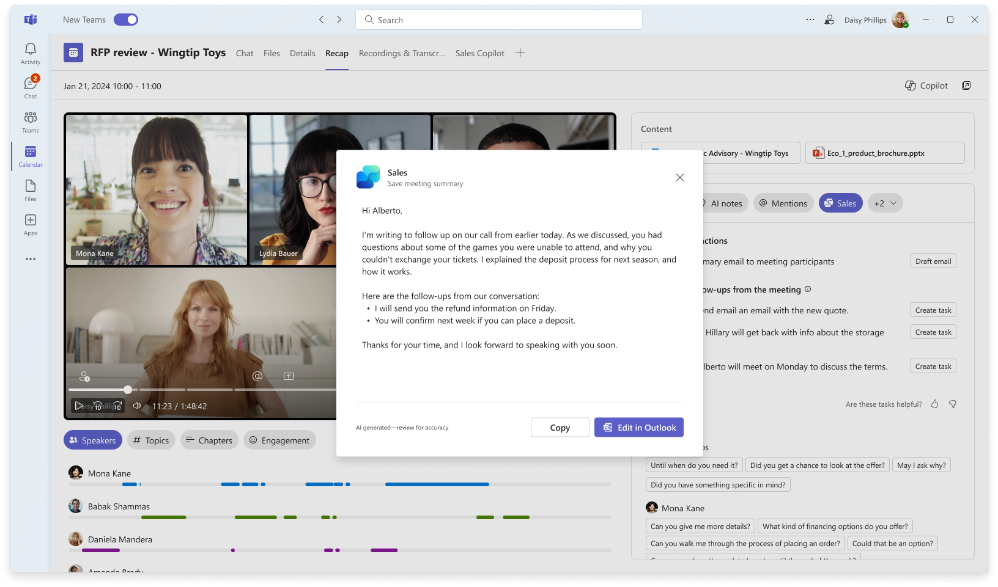
Follow up quickly after a customer meeting
6

Slide 16
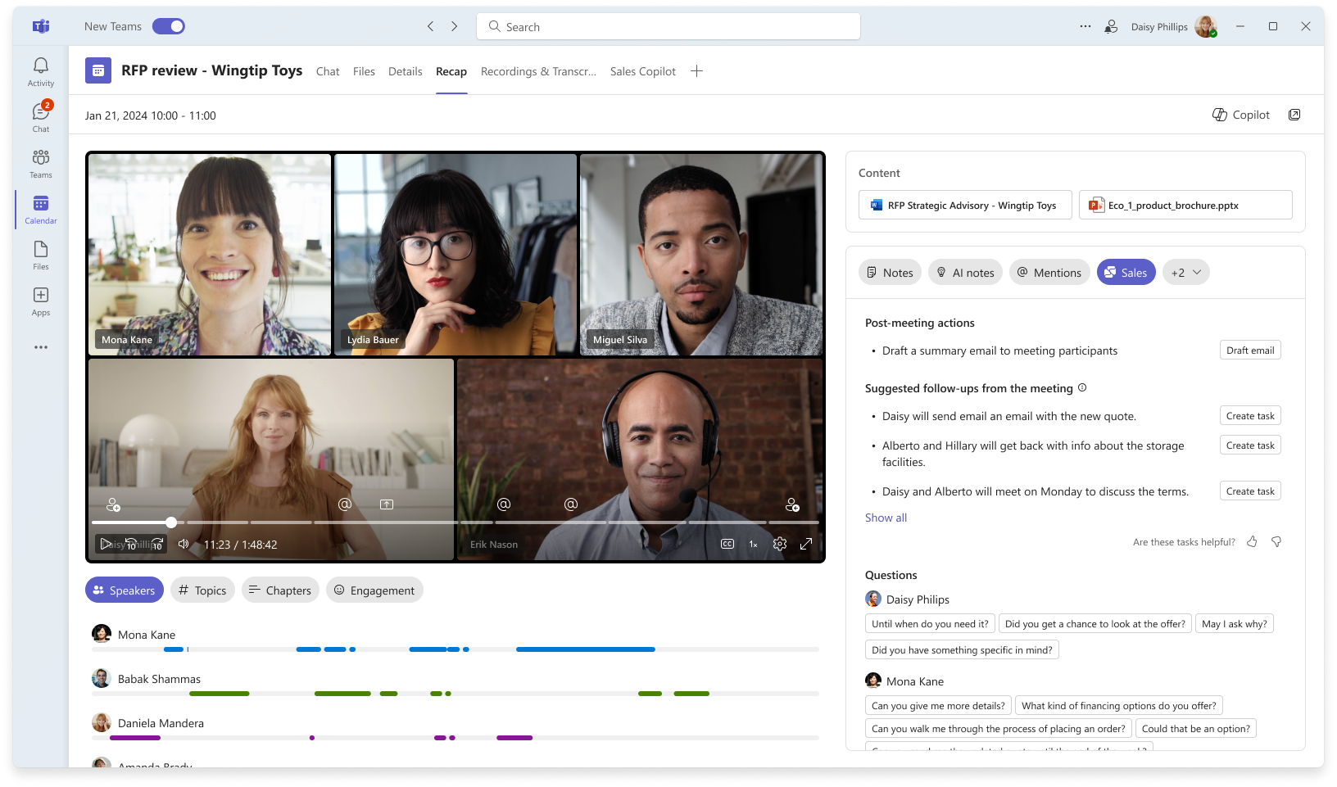
Update CRM after a customer meeting
7

Slide 17
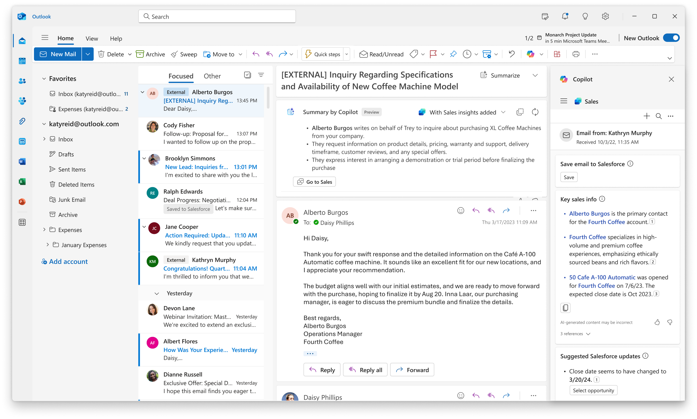
Summarize an email thread with sales data from CRM
8

Slide 18
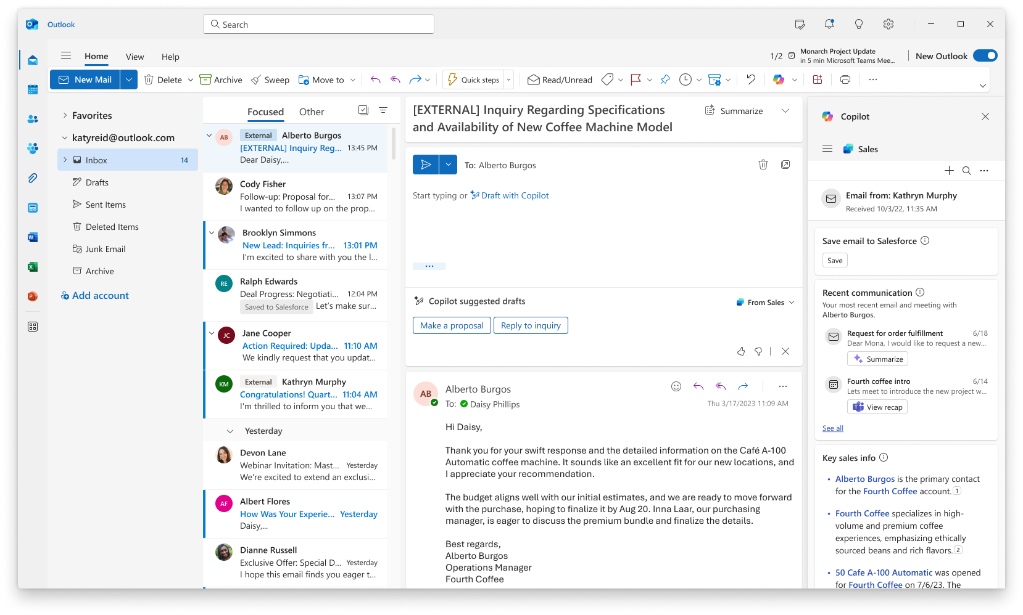
Draft an email reply with sales templates
9

Slide 19
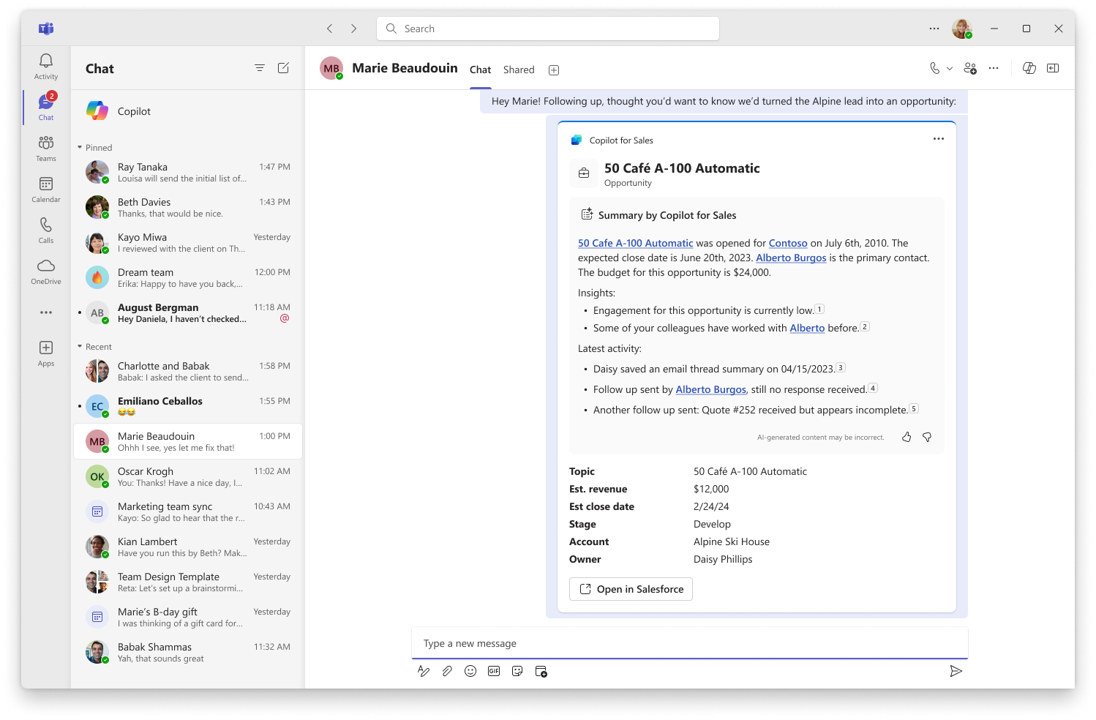
Share CRM data in Outlook and Teams
10

Slide 20
Sample Scenarios

Slide 21
Copilot for Sales: Scenario library
Maximize CRM investment value with automatic data capture
Key Features
Create new accounts/opportunities without switching to your CRM
Use BANT insights and CRM update suggestions to keep your CRM current while staying in the flow of work.
View opportunity summary from Salesforce in Outlook
Search for any record in Outlook
Chat in Teams on CRM data
Pain Point
KPI
Loss of focus from switching apps
Updating CRM is tedious and not core to job
Out of date or incorrect customer information in CRM
CRM data quality improvements

Slide 22
Copilot for Sales: Scenario library
Make the most of your customer meetings
Key Features
Prepare yourself and your team with meeting prep card
View opportunity summary, sales tips and related information about competitors mentioned during call
Recap sales meetings
Capture CRM tasks easily
View call recording and KPIs (e.g., Call sentiment)
Research account news/insights
Pain Point
KPI
Active listening vs. note taking
Lack of time to prepare for a meeting
Exponential increase in meetings
Meeting to Win ratio
Sales meeting KPIs

Slide 23
Copilot for Sales: Scenario library
Accelerate deals and keep customers happy with regular updates and deal insights
Key Features
Follow up with next steps after each customer meeting leveraging Gen AI
Send more regular updates across all customers not just top priority with Gen AI capabilities
Keep large stakeholder teams (internal and external) connected with deal rooms in Teams
Understand contact engagement score, buying power, and win rate from People.ai and Outreach integrations (preview)
Pain Point
KPI
Increase in meetings
Challenge to focus on customer while capturing notes and follow-up with updates in timely manner
Closing a deal requires working across multiple teams
Customer satisfaction
Deal cycle length

Slide 24
Copilot for Sales: Scenario library
Elevate your contact data quality ensuring timely and relevant customer outreach
Key Features
Create new contacts directly from your Outlook inbox
Update contact information using AI suggested prompts
View connections to a customer contact using People.ai (preview)
Pain Point
KPI
Contacts change roles/jobs requiring regular updates
Updating CRM is tedious
CRM data quality improvements
Ease of finding the right contact for cross-selling

Slide 25
Copilot for Sales: Scenario library
Onboard sellers new to role or an account faster
Key Features
View customer information in Teams/Outlook
Use Meeting recaps notes to understand customer questions, keywords, and create guided selling documents
Real-time tips in Teams meetings
Meeting prep in Word, Meeting Prep Card
Share customer information in Team chats to brainstorm with SMEs
Pain Point
KPI
Ramp up on sales while supporting customers
Customer satisfaction

Slide 26
Copilot for Sales: Scenario library
Improve selling skills via AI coaching and Call KPIs
Key Features
Let AI take thorough notes while you focus on your customer and conversation
Self-coaching or manager coaching via conversation intelligence dashboard (preview)
Meeting prep card
Coaching on Outlook emails
Learning recommendations from Seismic
Pain Point
KPI
Active listening vs. note taking
Lack of time to prepare for a meeting
English is a second language
Call KPIs and Sentiment indicators

Slide 27
Copilot for Sales: Scenario library
Stay up to date on customer news and market trends by researching with Copilot
Key Features
Summarize 10K
Chat on latest trends/news
Create reports and share with team
Pain Point
KPI
Lack of time to do in-depth research
Do more research easily
How I feel?
Internal perf reviews
Manager feedback

Slide 28
Copilot for Sales: Scenario library
Tailor your decks and other content to a customer for greater engagement in pitches and workshops
Key Features
Generate slides from 10K and industry reports
Generate charts to show ROI clearly
Improve the quality of my slides
Pain Point
KPI
Personalizing content takes time and effort today
Lack of budget for graphic design
Survey post workshops
Attendee engagement

Slide 29

Thank you
© Copyright Microsoft Corporation. All rights reserved.

