Slide 1
Viva Amplify adoption guide

Slide 2
Table of contents
Overview
Plan
Assess
Configuration
Train and adopt
Drive value
Recommended best practices
Additional resources

Slide 3
Adoption guide overview
Purpose of this document
Adopting new technology brings change, and change can be daunting. The purpose of this document is to help you successfully navigate attaining company-wide adoption of Microsoft Viva Amplify. This how-to guide will walk you through the steps of deploying Microsoft Viva Amplify to your organization and driving adoption to help ensure your employees reach their learning objectives.
Adoption steps
Plan:
Develop a strategy with Viva Amplify and align stakeholders.
Assess:
Understand gaps in your current ecosystem and what scenarios you are trying to enable.
Configuration:
Set up and configure Viva Amplify. Roll out to a pilot group.
Train and adopt:
Roll out Viva Amplify to the rest of your organization and train all users.
Drive value:
Monitor success of adoption and reinforce value.

Slide 4
Sample project plan
Step | Task | Accountability (SAMPLE) | Target Completion (SAMPLE)
Plan | Identify core team and R&Rs | Customer organization, service partner (opt) | [Fill out with dates]
 | Identify campaign scenarios | Customer organization, service partner (opt)
 | Define success criteria and OKRs | Customer organization, service partner (opt)
Assess | Assess organizational readiness | Customer organization, service partner (opt)
 | Understand your environment and gaps | Customer organization, service partner (opt)
 | Technical readiness checklist | Customer organization, service partner (opt)
Deploy | Configuration resources | Customer organization, service partner (opt)
 | Advanced Deployment Guides | Customer organization, MSFT support, service partner (opt)
Train and adopt | Communication plan | Customer organization, service partner (opt)
 | Training strategy | Customer organization, MSFT support for training
 | Align training strategy to launch plan | Customer organization, service partner (opt)
Drive value | Gather insights – monitor satisfaction and success metrics | Customer organization, MSFT support, service partner (opt)
 | Reinforce adoption | Customer organization

Slide 5
Sample timeline
Weeks 4
Create and publish communications
Week 6:
Rollout to additional users, Collect Feedback
Week 6:
Collect Feedback
Weeks 1
Plan, assess current ecosystem/plan strategy
Pre-work
Week 2
Configure Viva Amplify, Identify Scenarios
Workshop
Week 3
Create Campaign, add collaborators, and workflow
Week 5
Review Reporting
Configuration and initial use

Slide 6

Introduction to Viva Amplify
Create and manage campaigns to inform employees, understand engagement, and inspire action – all from one place.
Microsoft Viva Amplify empowers leaders and communicators to elevate their message and energize their people
by meeting employees where they are. With Viva Amplify you can:
Communicate easier
Centralize communication processes in a single space, so you can save time and focus on what matters
Communicate better
Write messages that stick with writing guidance and reporting from your organization
Be heard
Drive engagement with your message by meeting employees where they are

Slide 7





Who is Viva Amplify for?
Corporate
Communicators and HR
Business Leadership
And Support
Functional or Role
Communications
Communication
creators
Specialized needs
Professional comms roles
HR, talent, benefits
Internal corp comms
Employee advocacy connection
Workforce communications
Execs & chief of staff roles
Liaisons, branch, site, franchise managers
Administrative professionals
Vertical communications
Internal campaigns, stimulus
Facilities and services
Sales and marketing managers
Change and IT managers
Scenario-based needs
Project managers
Line of business operations
Team leads
Notes:
There are four main groups we think would benefit from Amplify:
Corporate communicators or HR. An example of a campaign that HR would send with Amplify is “Open Enrollment for Benefits” – this might have multiple emails where they are requesting action from employees. They can create, manage, and publish this campaign straight from the hub.
Business leaders and support roles could also simplify their communications with Amplify. Leaders or their staff could create campaigns around culture initiatives, strategic updates for their teams, necessary trainings that need to be completed, and much more to keep their employees in the loop and engaged
Another place we see Amplify is in functional roles that send high volumes of communications. For example, marketing managers sending weekly newsletters or IT managers sending periodic updates on compliance and security can see if their messages are being read and acted on
Another example is in certain scenarios, like for project managers, whose role it is to keep everyone up to date on a project or task – Amplify can help them create campaigns that track readership to see who’s been informed

Slide 8


Audiences for this document
IT leads/admins in charge of deployment and adoption, and who need to frame adoption requirements, resourcing, and effort to business stakeholders.
Business users looking to revitalize their organization’s Employee Experience, including, but not limited to, Champions, change management/adoption specialists, internal communications teams, and HR. Also, the person (or persons) made accountable by the business stakeholders to achieve maximum satisfaction of the Employee Experience.

Slide 9

Plan

Slide 10

Assemble your team
Adopting new technology requires buy-in and support from across the business. Below are key groups and team members who can help bridge technology and business outcomes that matter to your organization. Note that for successful rollout, IT, and HR departments will have to partner to align technical and employee experience scenarios and goals.
Key roles | Role | Responsibilities
 | Executive Sponsor | Communicate high-level vision and values of Viva Amplify. Help identify and prioritize top HR needs. Connect regularly with HR and IT leaders across the organization. Actively participate in and use Viva Amplify capabilities to help drive and reinforce adoption.
 | Success Owner | Ensure the business goals are realized from adoption of Viva Amplify.
 | Program Manager | Oversee Viva Amplify deployment process and logistics.
 | Champions | Help evangelize Viva Amplify and manage objection handling.
 | Training lead | Help train the early adopters and oversee training content. Could also be a Champion.
 | Department Leads (Stakeholders) | Identify how department will use Viva Amplify and encourage engagement.
 | IT Specialists | Oversee all technical aspects of the setup, deployment, and rollout. Partner with HR to develop plan for fitting Viva Amplify into company technology stack. IT specialists must have necessary admin permissions to set up and configure the product.
 | Communication Lead | Oversee company-wide communications about Viva Amplify.
 | HR Manager | Help develop plan for how Viva Amplify will fit into the rest of the employee ecosystem, inform company rollout, and drive adoption.

Slide 11

Identify target scenarios
Target scenarios describe how your employees will use Microsoft Viva Amplify to address business challenges and achieve organizational, cultural, tangible, or individual adoption outcomes.
Scenario identified | How it applies to the organization
Benefits Campaign | Employees have an opportunity to review benefits offered from the organization from health to wealth management
New Employee Onboarding | Allow employees who are new to the organization get to resources and training on their first day
Change Management | Ongoing changes to the organization that happen on a regular cadence or infrequent depending on needs of the business
Project Updates | Project managers communicate with stakeholders on updates for projects
News & announcements | Sharing company news, updates, and policy changes.
For campaign ideas, check out: Microsoft Viva Amplify – Microsoft Adoption

Slide 12
‘Campaign of the year’ cover story Template
Cover | Tells the big story | In Viva Amplify this relates to the overall Campaign brief. What Goals or Objectives do you have for your campaign to accomplish. This might be to make people aware or take action over time.
Audience | Who is this message for? | Thinking about the audience helps to set a target of people in which to share the message. This might be broken down into sectors of the business, by role, by location or other unique identifier. It could also be for everyone across the company as many campaigns are.
Headlines | Conveys the cover story to the right audience | Headlines are those key messages that are outlined in the Campaign brief. These would typically be titles of the publication. For instance, in doing a benefits campaign, you might have several headlines or titles for your publications... “Announcing Benefits Weeks”, “Review your Benefits Now”, “One week left for benefits” are all starting points for titles that capture attention from your audience.
Sidebars | Reveal interesting facts that this audience would want to know | Facts and figures can be important information for your audience. Include those in this area.
Quotes | Can be from anyone, related to the story (leaders, customers, partners) | What do you hope your audience says or is saying about your campaign. You can also include quotes from previous campaigns or highlight key quotes from leaders.
Brainstorm | Initial ideas | Have an idea, but not sure where to put it. Might be a subject area you need a little more brainstorming on. Use this as a parking lot area to include those ideas that aren’t fully aligned yet.
Images | Supporting content | Pictures tell the story of 1000 words. What images will you include?
Goals | Objectives, impact, or call to action | Did we meet our objectives? Did people take action? Did your campaign create the right impact? Write them here to be able to think about how to frame those messages.
Notes:
Or you can use this grid type layout.
The participants must pretend as though this campaign has already taken place and has been reported by the mainstream media. Tell the story of the “campaign of the year” as if it was on the cover of a magazine. Be creative and have fun brainstorming the elements of this campaign.

Slide 13



Define success criteria
  Define goals
    What are you trying to accomplish?
    What does success look like?
    i.e., increase engagement with learning, accelerate onboarding, train sales and service teams, enable upskilling across roles
  Identify key performance indicator (OKRs)
  These should improve based on adoption and will show leadership the impact of Microsoft Viva Amplify
  Establish OKR benchmarks
  Determine ways to gather and measure user satisfaction and progress against benchmarks

Slide 14
OKR examples
Choose criteria to demonstrate the impact of Microsoft Viva Amplify against each success measure. Below are examples of success measures, methods for measuring, and desired goals.
Success measure | Method | Goal
Reduced operating costs (example) Increased adoption correlates to reduced third-party conferencing usage, travel time and resource allocation | Quantitative Microsoft 365 reporting Finance/accounting reports Travel and phone expense reports | Comparison of pre and post Microsoft 365 reports will show cost savings. Post rollout usage of third-party phone conferencing should show decreasing usage of 10% per month.
OKR example 2
OKR example 3

Slide 15

Assess

Slide 16
Assess organizational readiness
What is readiness
Readiness assessment questions
Willingness and preparedness of your users and your organization to use Microsoft Viva Amplify.
It’s important to determine how receptive your users will likely be to changing the way they work and adopting new technology. Your rollout plan should reflect the readiness of your organization.
Determine readiness by asking these questions:
What were the success factors when previously rolling out new technology? What were the pitfalls?
Are there other major rollouts happening in the organization?
What internal resources can be leveraged to help spread awareness? (i.e., communication channels, training cadence, leadership events, etc.)
What are the benefits and risks with this roll out?
  How can you highlight benefits?
  How can you mitigate the risks?
Readiness factors
Determining readiness and appetite for change requires:
Clear vision of organization shift
Clear vision of user shift
Amount of overall change required
Executive alignment
What will the impacting changes be?
Identify who will be most impacted by the change of Viva Amplify adoption. Create a collaboration space for these individuals to discuss experiences, tips/best practices for driving adoption, and scenarios. For example, this may be the early adopter leads for each team at your company who wouldn’t normally interact much with each other.

Slide 17
Assess your environment
  Take inventory of your current investments
    Does your organization create any campaigns (Benefits, Charitable Giving, Learning events)?
    Does your organization use a campaign platform? How do you use it – way to create the communications, tracking, reporting?
    Determine gaps
    What does campaign management currently look like across your organization?
    How do employees collaborate on campaigns, workflow, editing, and sharing?
    Do employees consume communications across several channels or just one channel?
    Do employees have (or feel that they have) an opportunity to consume the communications on their own time and pace and in the channel, they prefer?
    Do you have the reporting that is needed to determine engagement of communications across the organization?

Slide 18
Assess your technical readiness
  Technical readiness is key to ensuring your organization is ready for launch. Use this checklist to identify items that need to be completed before go-live.
Readiness Item | Complete? Y/N | Plan to Complete
Complete legal and security review
Decide access and provisioning policies
Implement enterprise policies and Microsoft 365 group governance policies
Prepare help desk

Slide 19

Configuration

Slide 20
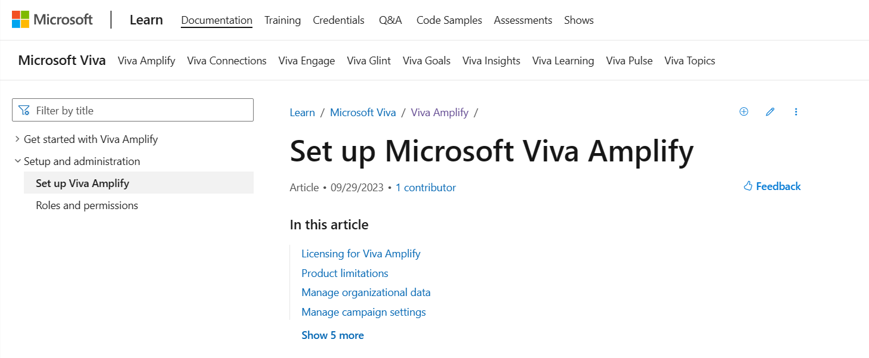
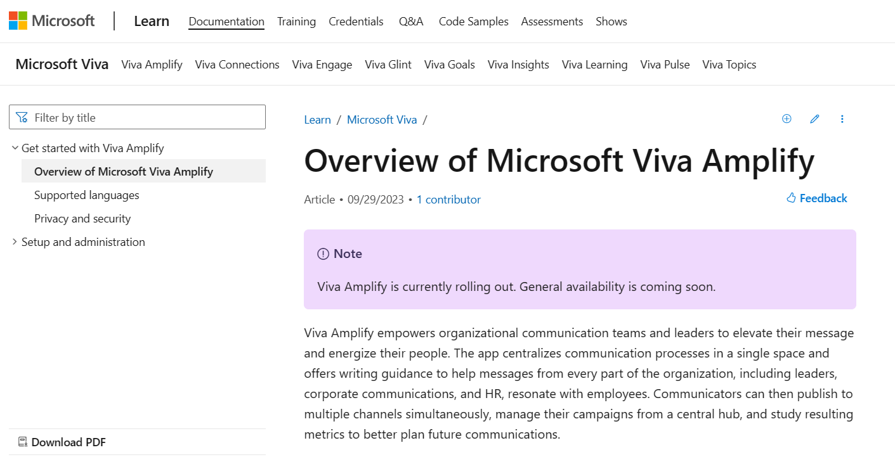

Resources for planning your Configuration
Leverage these resources to plan for your Viva Amplify deployment.
Set up Microsoft Viva Amplify | Microsoft Learn
Overview of Microsoft Viva Amplify | Microsoft Learn
TIP
Be sure to review and understand the adoption recommendations detailed in this document before you begin the deployment phase.

Slide 21
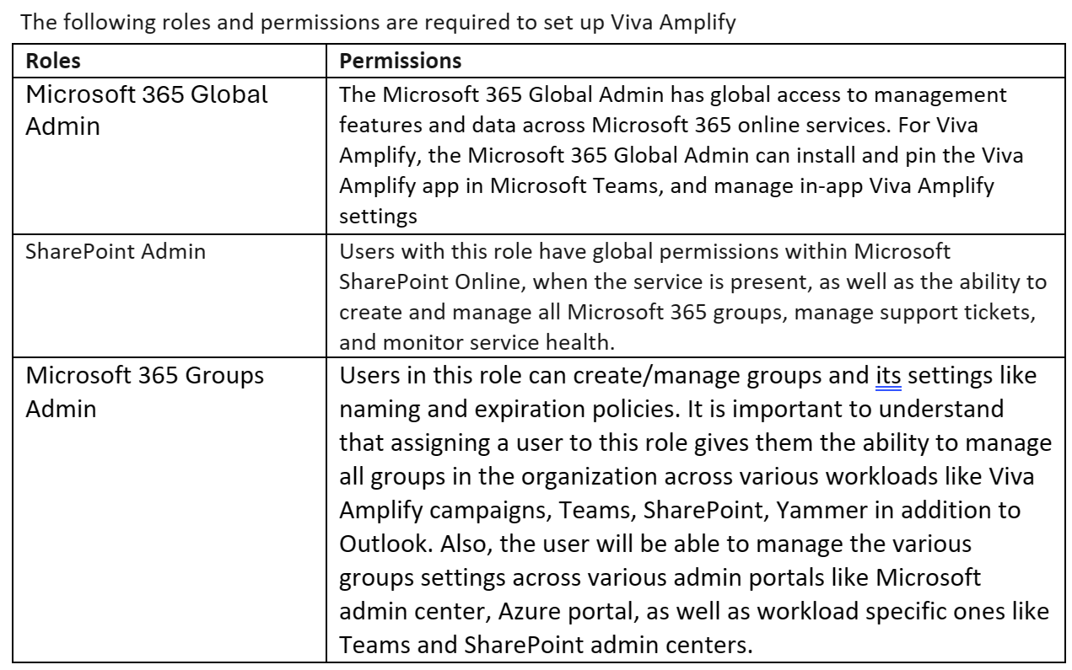
Admin Roles
Notes:
Learn more about Microsoft 365 roles here: Azure AD built-in roles - Microsoft Entra | Microsoft Learn

Slide 22
Steps to Assign Admin Roles
Assign Admin Roles
Sign in to the Microsoft 365 admin center and go to Microsoft Viva and select ‘Viva Amplify’
Choose Assign SharePoint Administrator Role settings
Search for the user by entering the user name or email.
Select the user(s) for whom you want to assign the SharePoint Administrator role.
Choose Assign Groups Administrator Role settings
Search for the user by entering the user name or email.
Select the user(s) for whom you want to assign the Groups Administrator role.
Select Add.
Important:
A user must be assigned both Admin roles to manage settings in Viva Amplify
Alternately, you can also assign roles by going to ‘Roles’ and then Role assignment in the Microsoft Admin Center.

Slide 23
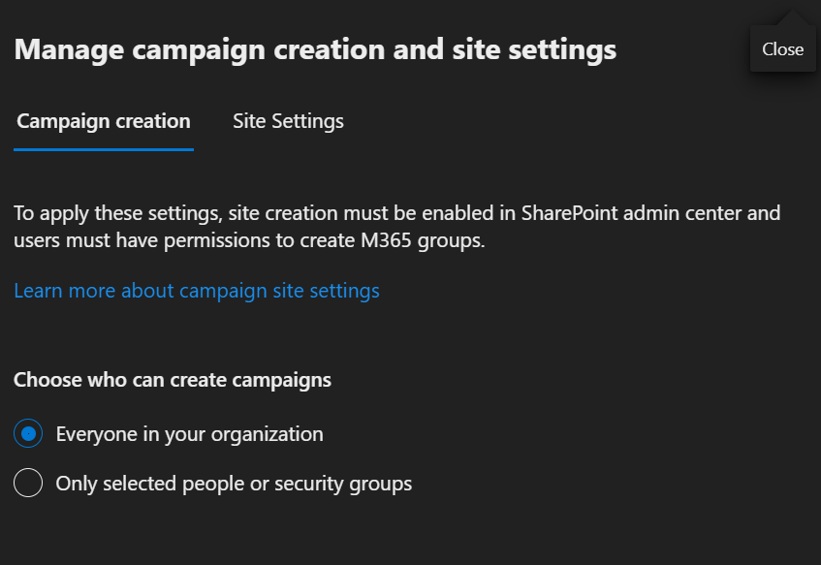
Who can create campaigns?
Viva Amplify is designed so that users with a wide range of roles, such as project managers who do regular status reports for stakeholders, can benefit from using campaigns. You can use the admin controls in Amplify to restrict who can create campaigns:
Keep the default selection that enables everyone in the organization to create campaigns with Amplify.
Choose to indicate specific people or security groups only to allow only select users to create campaigns.
Important Consideration. Both Site creation and group creation permissions need to be enabled and provided to a user in the SharePoint admin center before adding them as a campaign creator. To learn more: https://learn.microsoft.com/en-US/sharepoint/manage-site-creation?WT.mc_id=365AdminCSH_spo
Notes:
Viva Amplify is designed so that users with a wide range of roles, such as project managers who do regular status reports for stakeholders, can benefit from using campaigns. You can use the admin controls in Amplify to restrict who can create campaigns:
Keep the default selection that enables everyone in the organization to create campaigns with Amplify.
Choose to indicate specific people or security groups only to allow only select users to create campaigns.
Important: First, make sure both site creation and group creation permissions have been enabled and provided to a user in the SharePoint admin center before adding them as a campaign creator. Learn more: https://learn.microsoft.com/en-US/sharepoint/manage-site-creation?WT.mc_id=365AdminCSH_spo

Slide 24
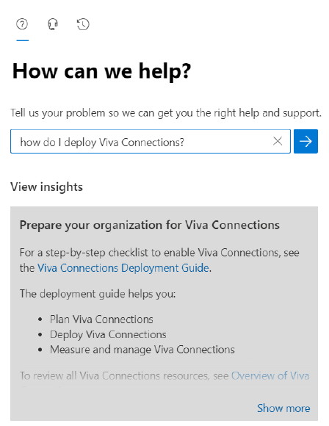
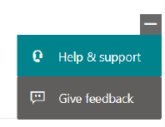
Advanced Deployment Guides
Advanced Deployment Guides are step-by-step online guides that are embedded within your tenant’s administration experience. They allow you to track every step of your deployment journey, and in some cases help you automate it.
To locate the Advanced Deployment Guide, click on the Help & Support button in your Microsoft 365 admin center and search using the plain text search. Here is an example for Viva Connections.
TIP
You can also go directly to your tenant’s Advanced Deployment Guides repository for Employee Experience by visiting https://aka.ms/EmployeeExperienceDashboard.

Slide 25
Train and adopt

Slide 26
Communication plan
Teaser campaign
First day set up
Tips campaign
Campaign to raise awareness across your company about the value Viva Amplify will provide.
Email blast to company introducing Viva Amplify. Highlight scenarios of value that Viva Amplify will provide to the organization and key roles (refer to scenario slides in Plan section).
Generate excitement and awareness regarding the app.
Gain staff buy-in for project by outlining ‘what’s in it for them’.
Use the New Technology Changes campaign from the Campaign Catalog: New technology changes – Microsoft Adoption
Share user guides and help articles to help employees get set up quickly and easily.
Campaign focused on key scenarios and tips to help employees get the most value from using Viva Amplify
Make it top of mind for staff regarding how to work in new ways with Viva Amplify.
Reinforce new behaviors and resources to support – outline key stop, start, continue behaviors.
Share common scenarios with the Campaign Catalog on Microsoft Viva Amplify – Microsoft Adoption
Launch/buzz campaigns
Quick demo in company Town Hall
Scenario-focused events and email campaigns that showcase the user experience.
PRE-LAUNCH
LAUNCH
POST-LAUNCH

Slide 27




Training strategy
Focus on the why
Make sure employees know why the change is
happening, what’s in it for them, and why they’re being asked to change.
Use real work scenarios
Use tasks or processes familiar to your audience to draw them into learning how to use the technology.
Use multiple formats
Training end users should take on multiple forms to accommodate different learning styles, geographical barriers, and resource constraints.
Reinforce
Make the training stick with reinforcement options like on-demand training, lunch and learn sessions, and new employee training options

Slide 28
Align training strategy to launch plan
Design your training strategy to scale with your launch. Start with the groups that will champion Viva Amplify and IT, before launching to the broader organization.
1
2
3
4
Audience
group
Core team
Stakeholders
Company-wide
Ongoing engagement
Audience members
  Success Owner
  Early Adopters (pilot group)
  Champions
  Program Manager
  IT Specialists
  Communications Lead
  Executive Sponsors
  Department Leads (Stakeholders) – manager training
  All users
  All users
Type of
training
Full user and admin training
User training
User training
User training
Training methods
  Live training sessions
  End-user Create a publication in Microsoft Viva Amplify - Microsoft SupportOverview of Microsoft Viva Amplify | Microsoft Learn
  Live training sessions
  End-user Create a publication in Microsoft Viva Amplify - Microsoft Support
  Overview of Microsoft Viva Amplify | Microsoft Learn
  On-demand training
  Live training sessions
  End-user Create a publication in Microsoft Viva Amplify - Microsoft Support
  Overview of Microsoft Viva Amplify | Microsoft Learn
  Lunch and Learns
  Tips and tricks

Slide 29
Drive value

Slide 30

Gather insights
    Leverage built-in Viva Amplify reporting (available within the product) to monitor engagement and understand behavior in your organization. Refer to OKRs identified in Plan stage.
    Present trends and progress on KPIs identified earlier to leadership.
    For more information on how to use the Viva Amplify reporting, please see: Use reporting signals in Microsoft Viva Amplify to understand campaign performance - Microsoft Support

Slide 31
Monitor satisfaction
Surveys are a great tool to gather data about user sentiment toward Viva Amplify. The results can help you determine the success of the rollout and get you thinking about necessary next steps.
1
Circulate a baseline survey shortly before users begin using Microsoft Viva Amplify.
  Example questions for survey:
  Please indicate how much you agree or disagree with the following statements (on a scale from strongly disagree to strongly agree):
  I actively engage in professional campaign management.
  I wish I spent more time on campaigns across the organization.
  I have access to campaign resources that help me be successful at work.
  I don’t know what campaign resources would be the most valuable for me.
  I find it difficult to prioritize creating campaigns in my current role/team.
  Compare results before and after rolling out Viva Amplfiy.
2
Conduct a survey halfway through launch to gather data about users’ experiences.
3
Use the results to make any necessary adjustments.
4
Create new awareness or training content to address outstanding needs that arise.
5
Release final survey 90 days after launch, and then in quarterly increments, to help measure user satisfaction and productivity.

Slide 32

Reinforce adoption
  Cultural evolution is critical to adoption. Continuous adoption activities are the key to long term engagement.
Update examples and trainings often so employees can relate to them. Share success stories of Viva Amplify
Add Microsoft Viva Amplify training to employees in applicable roles
Teach people to use the tools as a set –learn how to communicate across multiple channels
Continue to find your Champions – advocates for change within the business – including executives, managers, and admins who will be doing communications as additional scenarios

Slide 33
Adoption best practices

Slide 34

Adoption best practices
Understand the technical architecture of setting up a campaign. Campaigns equate to M365 Groups, so your teams can collaborate in SharePoint and a Teams instance about your campaigns and craft your communications.
Learn where your users want to receive these messages by monitoring the reporting of each of your campaign. Tracking where your users engage the most across multiple channels
Develop strategy for each of the channels as related to a campaign. Some may require more channels or all channels whereas others just require a quick message to just one channel.
Start using the product immediately. The product is built on top of existing technologies so all the security and permissions that already exist in your tenant are applicable to Viva Amplify. End users seeing the message don’t know it’s coming from Viva Amplify in a campaign, so you can leverage this right away.
Have admin configure settings to encourage only those with permissions use the Viva Amplify product to create campaigns. Add other members or entire company as appropriate for your scenarios.

Slide 35
Recommended best practices from the Viva Amplify community
Start with the Campaign Catalog
Guidance is built right into the product.
Monitor your reporting
Check out the campaign catalog for ideas on setting up your first campaign.
Leverage the tips/tricks and documentation right from within the product.
Understanding where your users are engaging is key to your campaigns
Spend time working with your teams to understand your campaign scenarios.
Get started with creating your first campaign. It can be simple or to the entire company.
Join the corporate comms community of like-minded professionals that will offer up ideas to help you start https://aka.ms/corporate
communicationscommunity
Make adjustments in your channels/messages after reviewing reporting
Ask why single messages or authors get better results for future improvement

Slide 36
Use the Campaign Catalog
1

Slide 37
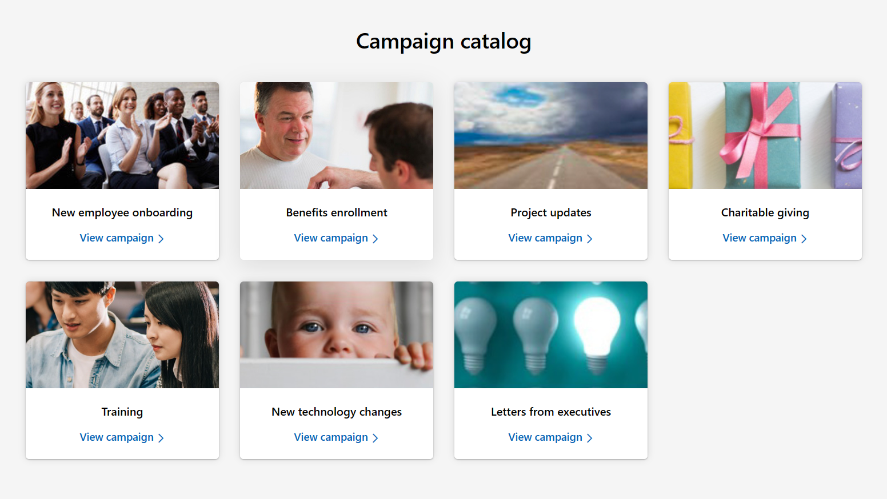
❶ Start with the campaign catalog.
Microsoft Viva Amplify – Microsoft Adoption

Slide 38
Use Built in Product Guidance
2

Slide 39
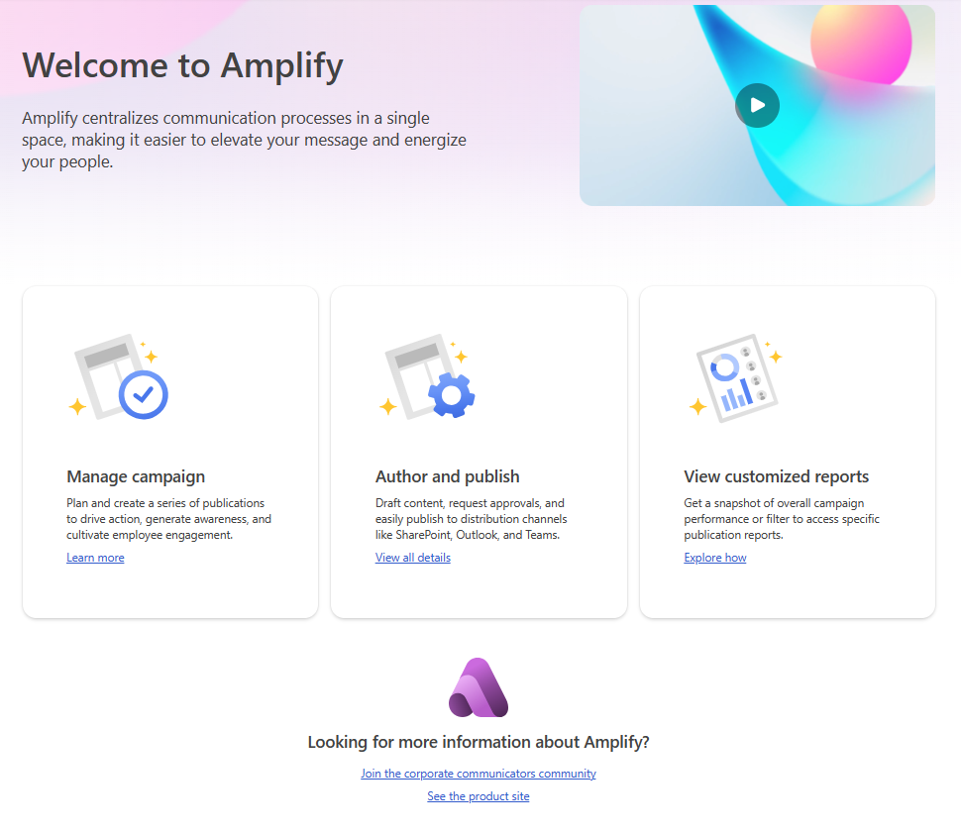
❷ Guidance on how to use the tool is built right into Viva Amplify
Need help on managing a campaign or getting started on your first publication? Or better yet, what is the difference in campaigns and publications. Our in-product guidance is there to help. Just select the “Get Started” tab from within the product to help you ramp up your knowledge and understanding.

Slide 40
Monitor your Reporting
3

Slide 41
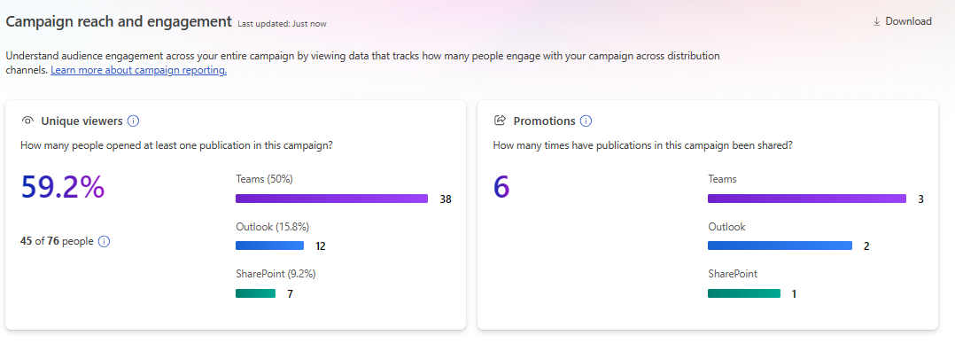
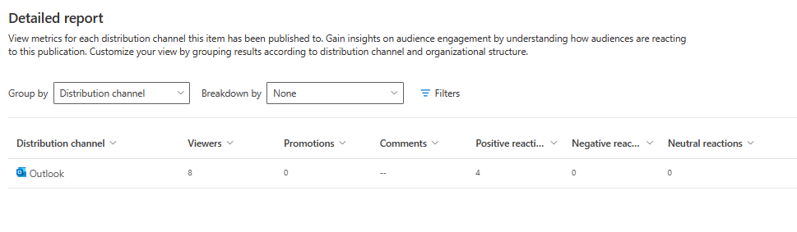
❸ Monitor your Reporting.
Better reporting = better results
Monitor your unique views across which channels
Are you having users across multiple channels?
Is there one channel that majority of people are going to?
Is there a single author that people engage with their writing style more?
Is your message being promoted to others? Which channels are being used?
Understand the detailed reports from each of your communication. Where you are getting sentiment across which channels.
Use analytics from Viva Insights or other 3rd party systems to see your organization details.

Slide 42
Additional resources

Slide 43

Additional resources
Microsoft adoption resources
Learn more about Viva Amplify
Review and download Viva Amplify resources on adoption.microsoft.com, including technical documentation, poster materials, campaign catalog and a Viva Amplify 101 which walks through the entire product.
Microsoft FastTrack for Viva: Deployment assistance including support from Microsoft engineers with technical expertise on Microsoft Viva and other Microsoft tools.
Other Microsoft reps: contact your account lead to see what is available to you for adoption support, i.e., customer success reps, consultants, etc.
Check out the Viva Amplify guided simulation for a walkthrough of using the product. Employee Communication Management | Microsoft Viva Amplify
Read the Viva Amplify technical documentation articles for detailed instructions on technical deployment and admin setup. Introduction to Viva Amplify - Microsoft Support

