Slide 1

Understanding the Business Value of Windows 365
Updated December 1, 2022

Slide 2
Windows 365 Business Value research
ESG Business Value Study – June 2022
Windows 365 Gartner Analysis 11-2021
  Available at https://www.microsoft.com/en-us/windows-365/business and https://www.microsoft.com/en-us/windows-365/enterprise
MEM Blog – https://aka.ms/TheTCOofMEM - April 2022
OnRamp link to this presentation: https://aka.ms/Windows365BizValue

Slide 3
ESG Business Value Study key findings
Cost Predictability
  Reduce end-of-life costs: Annual employee turnover is high (average = 47%), and re-provisioning the users is faster and less costly in a Cloud PC environment.
  Fixed, predictable pricing that makes it easier to allocate costs as opposed to the capital-intensive purchases of on-premises Virtualized Desktop Infrastructure (VDI) or Desktop as a Service (DaaS).
Business and User Agility/IT Management
  60% reduction in productivity when onboarding end users while waiting for equipment can be alleviated with setup and deployment of a Cloud PC in minutes instead of days or even weeks.
    Up to 9% of employees who leave companies each year can be retained by providing an immediate, professional EUC solution.
    Time to combine work environments in an M&A scenario can be reduced 93%.
  Much easier to provision temporary/seasonal workers so it’s more likely that organizations will take on the resources. This leads to increased agility for the organization to benefit from trends or seasonal spikes.
  Less time for IT to prepare, deploy, and maintain other options results in a 46% shift of effort toward strategic activities compared to VDI and competitive DaaS solutions.
Improved Security Posture
  Strong protection that helps prevent data leakage or loss even in BOYPC environments.
  Reduced disruption and lower risk level in the event of disaster or major outage.
  Reduced risk of loss of data and intellectual property.
  Eliminate risk of breach events intentionally caused by terminated employees (44% of total).

Slide 4
Examples of Windows 365 business value
Cost Predictability
  Regular pricing, employee satisfaction, and retention Jackie is impressed that Windows 365 gives her access to all of the company resources she needs with great performance from any device, with per-user, per-month pricing.
Business and User Agility/IT Management
  Fast onboarding of new employees Jackie receives her Windows 365 credentials on her start date and is able to begin her onboarding process immediately by accessing her assigned Cloud PC on her personal devices while she waits for her company-issued device to arrive. Then Jackie has new members added to her team from an acquired company. They are all provided Windows 365 Cloud PCs and have immediate access from their existing devices to the company resources they need.
  Secure temporary work Jackie proposes a new service that requires seasonal employees. She is able to implement the service quickly and profitably because Windows 365 makes it easy to onboard and offboard the seasonal employees using a BYOPC model.
Improved Security Posture
  Flexible and secure computing for hybrid work Jackie is visiting a friend when she receives an urgent request from a colleague to review an invoice. Using her friend's computer, she securely accesses her Windows 365 Cloud PC and handles the request.
  Data security and compliance Jackie is working on her company-issued laptop at the airport. Her device is stolen while she is looking for her boarding pass. She has no company files or data stored on her device, so there is no risk of losing sensitive business information. She continues working from her Windows 365 Cloud PC on her personal device until she receives a replacement.

Slide 5
ESG Business Value Study methodology
ESG used existing research, interviews with internal and external industry experts, existing case studies, and existing financial models to project the financial impact of Windows 365.
  Interviews conducted between Jan and March 2022
Our modeled scenario was created with two views:
  A 1,000-user company supported by a 37-person IT organization generating $180 million per year
  A 250-user, US-based company supported by seven IT employees generating $36 million in annual revenue.
ESG started by modeling the hard costs associated with running Virtualized Desktop Infrastructure (VDI) environments and Desktop as a Service (DaaS) solutions.

Slide 6
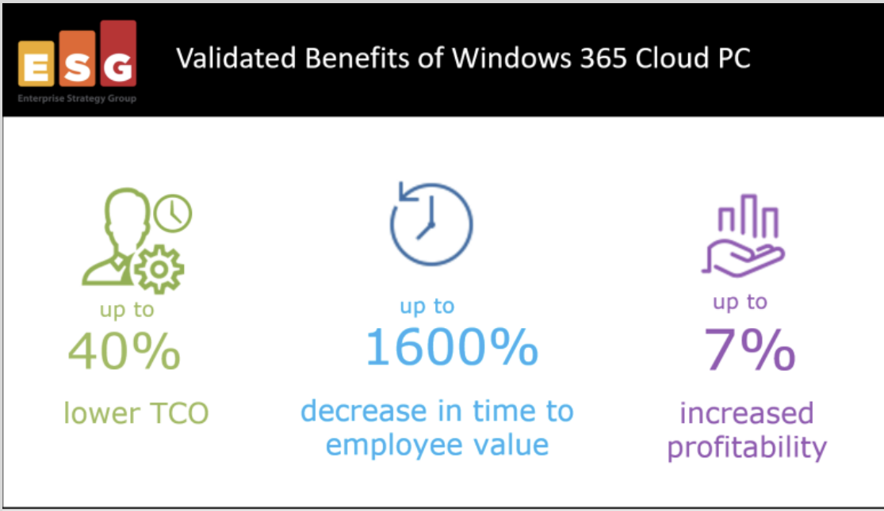
ESG Business Value Study excerpts (1)
Quotes
“IT dollars go further with Windows 365. Companies can realize up to a 40% savings when comparing to on-premises VDI or DaaS offerings.”
"The ability to react to seasonal and trend spikes can increase an enterprise’s revenue growth by up to 1% and a small-to-medium business (SMB’s) revenue by up to 7%. The SMB growth is driven by the ability to harness short-term workers and the gig economy to capitalize on opportunities that would be otherwise missed."
"ESG’s models predicted that Windows 365 Cloud PCs can significantly lower the cost of providing access to an organization’s computing environment. This solution can provide an organization with an annual potential revenue increase of up to $14,013 per user, with an overall annual benefit of up $7,271 per user for small businesses and up to $6,765 per user for companies of 1,000 employees or more, as well as open new business opportunities."

Slide 7
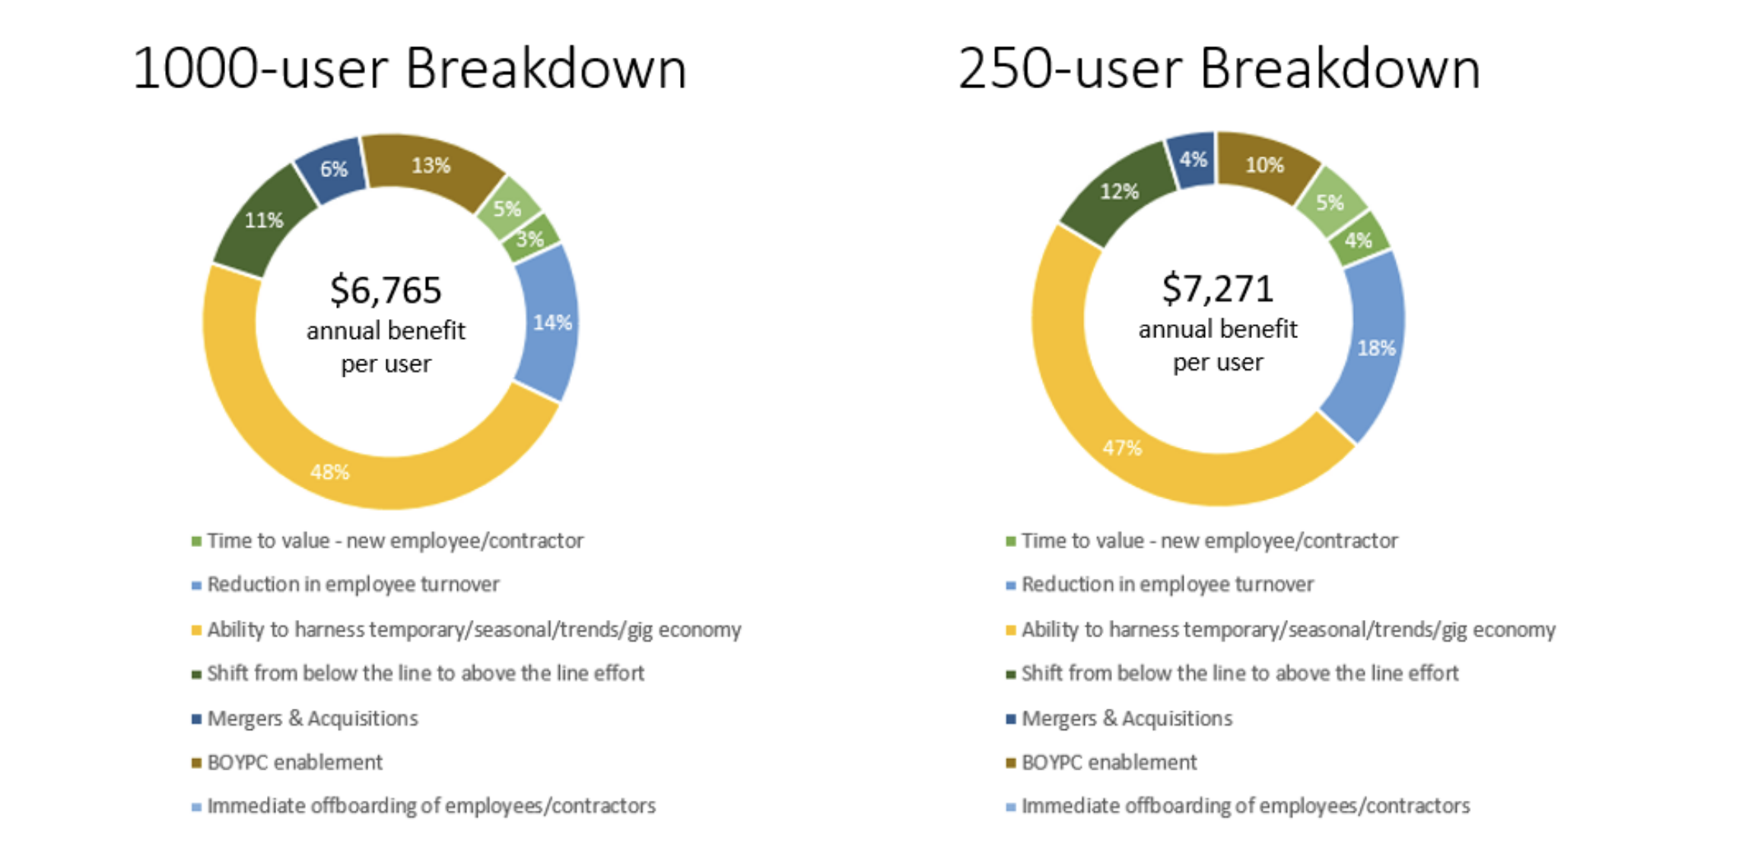
ESG Business Value Study excerpts (2)
1000-user breakdown
250-user breakdown
$6,765
annual benefit
per user
$7,271
annual benefit
per user
Time to value - new employee/contractor - 5%
Reduction in employee turnover - 3%
Ability to harness temporary/seasonal/trends/gig economy – 48%
Shift from below the line to above the line effort – 6%
Mergers & Acquisitions – 11%
BYOPC enablement – 13%
Immediate offboarding of employees/contractors – 14%
Time to value - new employee/contractor - 5%
Reduction in employee turnover - 4%
Ability to harness temporary/seasonal/trends/gig economy – 47%
Shift from below the line to above the line effort – 4%
Mergers & Acquisitions – 12%
BYOPC enablement – 10%
Immediate offboarding of employees/contractors – 18%

Slide 8
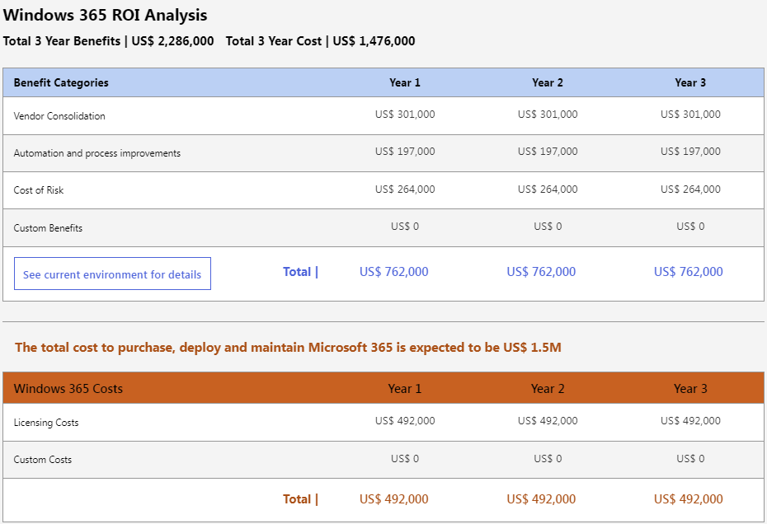
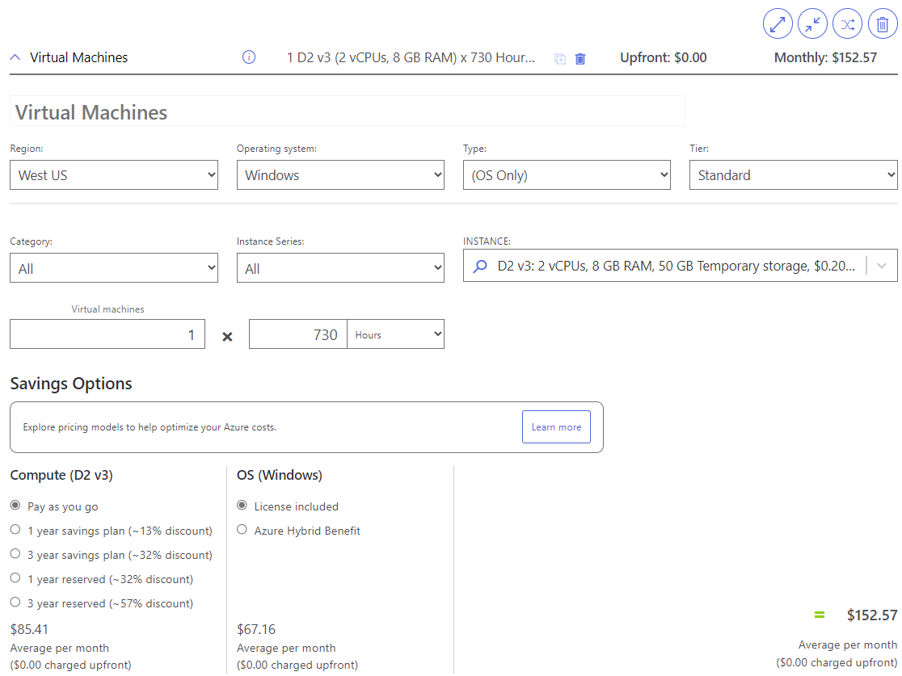
Value and pricing calculators
Windows 365 | Azure Virtual Desktop
The Modern Work Business Value Calculator online module can give customers a product-centric understanding of the cost savings and business value benefits in a more user-friendly interface. Find videos on common business cases and learn how to use the tool here: Microsoft Value Calculator Learning Page or join the Value Calculator Office Hours with questions or help with proposals. Please contact DMWLsupport@microsoft.com to request the invite. | An Azure pricing calculator is available to help estimate hourly or monthly costs of using Azure Virtual Desktop.
Microsoft Confidential

Slide 9





Cost savings and benefits of Windows 365
Annual cost savings will be different for every customer. Business Value & Cost Savings here are estimated from the Microsoft Value Calculator based on the Forrester Total Economic Impact & Enterprise Strategy Group product analysis referred to in the disclaimer.
9%
increase in retention from providing an immediate and professional EUC solution¹
75%
Decreased endpoint configuration times²
Vendor license cost consolidation | $480,000
IT admin, deployment savings | $1,800,000
Reduce total cost of risk | $1,800,000
Savings on automation, process improvement | $2,800,000
Capex to Opex Cash Flow | $982,000
227%
return on investment
5-month
payback period
An organization with 10,000 licenses of Windows E3 and Intune and 2,000 licenses of Windows 365 may recognize benefits of $16.5 million over three years, adding up to a net present value of $13.7 million, or $1,370 per user.
Source: Results from the Microsoft Value Calculator for the Windows E3, Microsoft Intune, and Windows 365 license combination. Results based on multiple studies* by Forrester Consulting and the Enterprise Strategy Group, commissioned by Microsoft, combined with Microsoft research. The cost savings in this presentation are illustrative and only intended for your internal use. Prices may vary by reseller and channel. The results may not be accurate or appropriate for your needs and should not be relied upon as your sole reference. MICROSOFT MAKES NO WARRANTIES OF ANY KIND, EXPRESS OR IMPLIED, ABOUT THE RESULTS WITHIN THIS PRESENTATION *Third party research used as inputs for this Sales Play: The Total Economic Impact™ Of Microsoft 365 E3, December 2020²; The Total Economic Impact™ Of Microsoft Endpoint Manager, April 2021. Enterprise Strategy Group Economic Validation; Exploring the Economic Benefits of Windows 365, May 2022¹.
Microsoft Confidential
Notes:
Talk Track:
This slide shows the potential cost savings for a customer with 10,000 licenses of Windows E3 and Microsoft Intune combined with 2,000 licenses of Windows 365 (2 x 4 x 64) generated by the Value Calculator (https://vc.transform.microsoft.com/). Potential cost savings can vary based upon their size, deployment schedule, cloud adoption maturity, & software landscape, etc. These numbers are to provide you with a general idea of the potential savings your company could achieve with NextGen Windows Devices.
Our example organization recognizes benefits of $16.5M over three years resulting in a 227% ROI with just a 5-month payback period.
Calculations in the Value Calculator are derived from various Third-Party Research conducted by Forrester Consulting, the Enterprise Strategy Group, and Microsoft Research.
Instructions for Sellers:
For a customized Cost Savings and ROI calculation, take your customer through the Value Calculator. Accuracy depends on the amount of fidelity you have on a customer’s IT environment. An initial conversation can be conducted with calculations made based on your assumptions. Best Practice: With fragmented IT environments consider, using the Customer Questionnaire, available on the Current Environment tab, to collect the necessary information for a customized ROI analysis.
For further customization to better reflect your customer's environment, see the instructions on each individual tab.

Slide 10



Economic overview of Windows 365
Financial benefits
Lower costs
  Moving to Windows 365 can reduce or eliminate costs in multiple areas.
  For example: VDI licenses, server OS, RDS licenses, administration, power and cooling.
Predictable price model
  Most VDI pricing models are consumption based. This may seem like an advantage.
  But: Organizations sometimes find that their monthly costs far exceed expectations, e.g., when consumption unexpectedly skyrockets.
Maximize existing IT investments
Manage your physical and Cloud PCs using your existing tools and skills.
With Microsoft Intune, you can provision a single Windows 365 Cloud PC or thousands at the same time, allowing you to reduce endpoint configuration times
Microsoft Confidential

Slide 11



Economic overview of Windows 365
Business and user agility
Cut onboarding time
The time from when an employee or contractor is hired to when they are fully onboarded is often associated with lower productivity.
This time to wait has significantly increased over the past 18 months as many employees no longer work in centralized offices,
Provide employees with a highly secure Windows experience on any device
Windows offers organizations enhanced security and device protection. Some companies have chosen to allow BYOPC for employees or short-term staff such as interns, contractors, and consultants.
React to seasonal trends with fast enablement of temporary work force
The financial and time investment required to provide short-term employees with an enterprise work environment can be high.
Cloud PCs enable organizations to create and decommission work environments almost instantly to respond to changing opportunities.
Microsoft Confidential

Slide 12



Economic overview of Windows 365
Improved security posture
Ensure business continuity and governance
Supply chain issues are often a problem. These can impact business continuity.
Cloud PCs mitigate this concern and provide business continuity and governance, regardless of the user's location.
Prevent data loss through isolation
Cloud PCs offer a layer of isolation that provides strong protection for the work environment and helps prevent data leakage or loss. Customers have configurable options for how the Cloud PC interacts with available physical devices.
Protect your digital workforce
Windows 365 is managed just like a physical device.
This means that the Cloud PC can help you secure end user computing environment in the same way as other devices without incremental costs.
Microsoft Confidential

Slide 13


Azure Virtual Desktop helps companies improve productivity while keeping costs in check
22
34%
Hours of increased productivity per person annually*
Reduced licensing and IT infrastructure costs when moving from on-prem solutions to Azure Virtual Desktop*
*The Total Economic Impact™ of Microsoft Azure Virtual Desktop, a commissioned study conducted by Forrester Consulting, January 2021
Microsoft Confidential

Slide 14

Three ways to save when migrating RDS to Azure Virtual Desktop
Infrastructure Costs
Licensing
Costs
Total Cost of Ownership
Scale infrastructure up or down in Azure based on your business needs
Pay only for what you use
Leverage multi-session and reserved instances to maximize VM usage
Use existing eligible Windows or Microsoft 365 licenses
No Windows Remote Desktop Service (RDS) required with multi-session
App Assure available to address compatibility issues
No requirement for brokering, Gateway or Web Access
Track performance and resolve issues with Log Analytics and Azure Monitor
Automate deployment with ARM and Azure DevOps
Three Ways to Save – Migrate Remote Desktop Services to Azure Virtual Desktop
Microsoft Confidential

Slide 15
Total Cost of Ownership of Endpoint Management
April 2022 thought leadership blog about the TCO of Endpoint Management Microsoft on the Microsoft 365 blog https://aka.ms/TheTCOofMEM
In this blog, "The business case for endpoint management modernization according to Microsoft," Steve Dispensa shares new ways of thinking about the economics of unified endpoint management given the current trends in the new world of Hybrid work. Steve recaps Forrester's TCO of Endpoint Manager for savings in three main areas: reducing the bottom line by lowering IT supporting needs, centralizing endpoint management by attaching to the cloud, and reducing the risk of security breach and associate costs from data loss. And then goes on to explain the impact of a tight labor market and wage inflation coupled with the higher cost of a data breach.

Slide 16






Microsoft 365 Business Value Framework
Vendor license cost consolidation | IT administration and deployment savings | Reduce total cost of risk
Consolidate to a single platform v/s buying standalone for different capabilities | Manage IT better across hardware & software thus enabling IT to transition to higher-value activities. | Reduce breaches and enhance privacy/remediation by better Security. Reduce risk through Compliance
Physical and T&E cost displacement | Save on automation and process improvements | Capex to Opex cash flow
Reduce hard costs eg: real estate, utilities, travel & entertainment through secure WFH. | Transform business processes & save using workflows, dashboards, AI while increasing employee productivity | Optimize Cash Flow Management by changing upfront license payments to Operating Expenses
Notes:
Talk track: These are the cost savings buckets
These speaker notes talk about how Microsoft helps in these 6 buckets
Consolidating to a single vendor can cost much less than choosing different vendors for multiple capabilities. Microsoft 365 includes many of the capabilities for which you are currently paying other vendors.
The expectation is that every customer should be able to reduce administration effort because Microsoft will now be responsible for maintaining the hardware and software. This helps IT transition to higher-value activities and boost morale.
The security solutions within Microsoft 365 greatly reduce the number of successful end user security attacks. Attacks that are successful are usually found faster when the impact is less severe. That means easier remediation. Compliance solutions help reduce your risk by managing alerts on potential insider risk, protecting sensitive information, and quickly finding and responding to regulatory requests.
Microsoft 365 helps organizations reduce office space costs by enabling them to move on-site employees to permanent, secure and remote positions. It also allows for valuable collaboration while reducing travel costs.
Microsoft 365 helps organizations transform and streamline business processes through workflows, dashboards, AI capabilities, and more.
Any customer previously paying for Microsoft client software and CALs that would no longer be required after licensing Microsoft 365 would receive this benefit.

Slide 17
From Microsoft 365 Blog
Reducing the risk of data breaches or non-compliance: Finally, unified endpoint management helps reduce the risk of data breaches. Forrester estimates the lost productivity of a security breach per affected employee at almost half a working day (about 3.5 hours) per year,⁵ as they may need to update their device with the latest patch or recover work or data that is impacted by the breach. Reducing the risk of a data breach by 30 to 50 percent (as some of our customers have estimated, especially as part of a broader Zero Trust approach) therefore results in significant enterprise savings. On top of the lost employee productivity costs, there are direct out-of-pocket costs of a data breach, such as the extra work in remediating the breach and possible increases in insurance premiums.
The cost of a data breach is higher the more an organization has moved to remote and hybrid work environments. According to the Cost of a Data Breach report by IBM and the Ponemon Institute, the cost of data breaches rose nearly 10 percent year over year in 2021. Moreover, the average total cost of a data breach was 28 percent higher when remote working was a factor in causing the breach.
From The business case for endpoint management modernization according to Microsoft - Microsoft 365 Blog

