Slide 1

Driving climate action with Windows 11 and Windows 365
A study conducted by Px³
Notes:
I’d like to share the results of a recent study we commissioned from Px³. Driving climate action with Windows looks at how using Windows for your workforce can help you reduce emissions and save on energy costs.

Slide 2

Background and methodology
Windows sustainability study | Px³
Microsoft commissioned ‘green IT’ analyst firm Px³ to conduct a research study to examine the potential for carbon emissions or energy cost savings with the Windows operating system and devices.
Px³ conducted lab tests on Windows 365 running Windows 10 and Windows 11 on laptop devices and analyzed the results against industry benchmarks.
For the purposes of this study, Px³ devised equations about typical carbon emissions of various PC configurations and applied them to a 1,000-person user group during the period 2023-2030.
Utility and hardware procurement costs are also calculated.
Notes:
We wanted to understand the potential climate impact of Windows and Windows 365 at businesses like yours, so we commissioned this study from Px3, a UK-based IT sustainability research and consulting organization.

Slide 3

Windows sustainability data
Windows Sustainability | Driving Climate Action with Windows
The research concluded that the Windows approach to modern workplace applications and endpoints can significantly reduce greenhouse emissions at scale. It helps reduce both energy use and embodied emissions.
Windows and Windows 365 enable responsible procurement policies and carbon consumption intensity that helps organizations fulfill SDG 13: climate action.
In particular, compared to the on-premises result of 126,164 CO2e (figure 4), with Windows 365 running on an average laptop or desktop, 10,484 kgCO2e scope 2 (operating) GHG emissions are avoided.
For each user group of 1,000, this avoids pollution equal to 39,000 car miles and requires two less forest acres per year for sequestration purposes.
Notes:
Px³ discovered that Windows 365 Cloud PCs can help reduce emissions associated with SDG 13 scope 2, electricity consumption. Virtual device infrastructure is much more efficient than on-premises hardware, so scope 2 emissions are dramatically lower when organizations use Windows 365.
By extending device lifecycles and enabling flexible work, Cloud PCs also help reduce scope 3 emissions, those that come from the supply chain and employee commuting.

Slide 4

For an average 1,000-person user group:
Windows Sustainability | Driving Climate Action with Windows
Microsoft-hosted Windows 365 Cloud PCs offer 4% reduced operating emissions from 2023 to 2030 compared to on-premises virtual device and computing infrastructure.
They also offload power draw and processing to cloud servers, extending the life of devices to significantly reduce supply chain emissions.

Slide 5

How it works
Windows Sustainability | Driving Climate Action with Windows
How it works
“
The key to reductions is based upon the way end-user computing is consumed. Software as a Service (SaaS) solutions such as Windows 365 transition end-user computing workloads away from the end-point device and into highly efficient cloud data centers powered predominantly by renewable energy. Px³, 2023
”
“
The Windows 365 approach to modern workplace applications and endpoints at scale can deliver significant GHG abatement. Doing so enables responsible production and consumption and ultimately drives the United Nations Sustainable Development Goal (SDG) number 13, climate action. Px³, 2023
”
Notes:
Windows 365 in particular is all about simplicity and experience, and we love how those pair with sustainability. You can see from these excerpts that the same features that make Windows 365 Cloud PCs easy for IT to manage and employees to use also make them powerful tools in the fight against climate change.
And all of that scales easily alongside your organization.

Slide 6
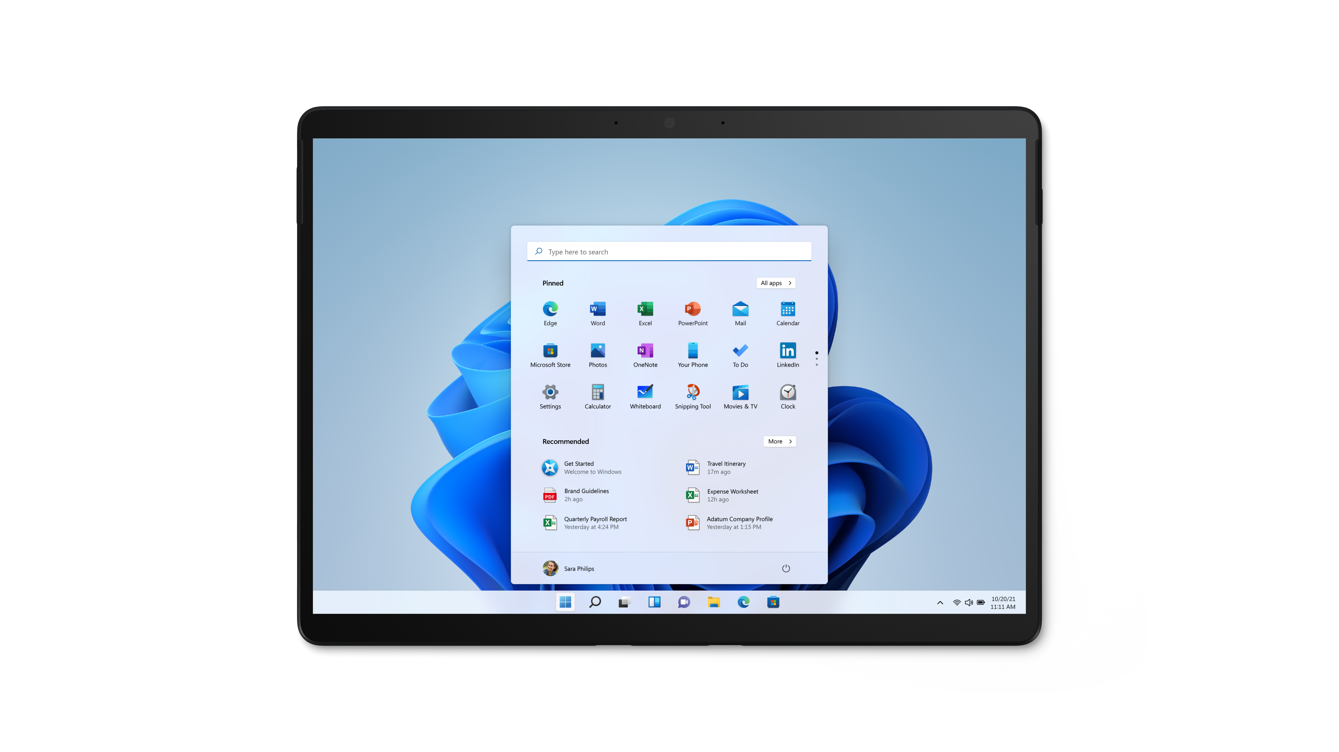
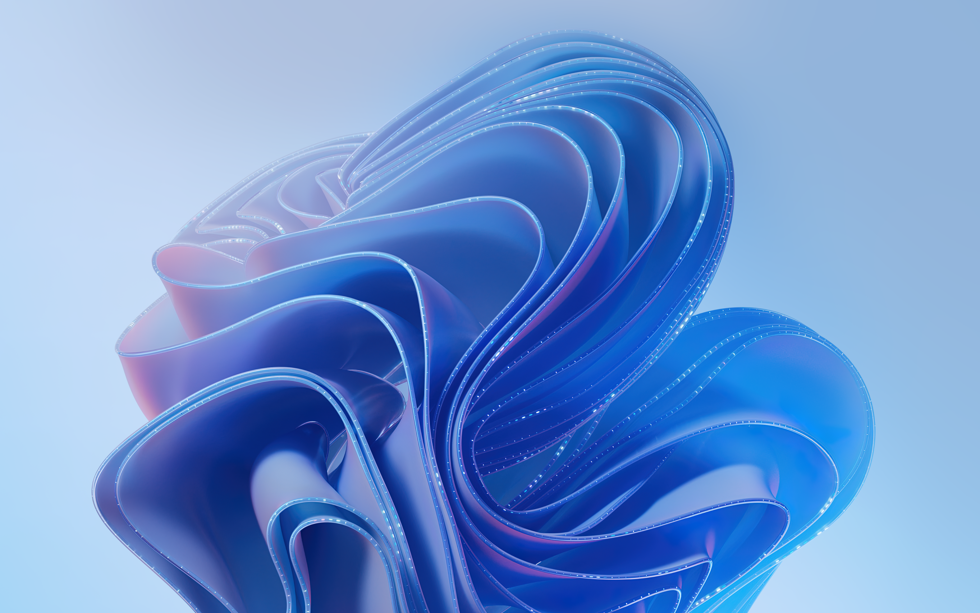
Windows 365 and the UN Sustainable Development Goals
Windows Sustainability | Driving Climate Action with Windows
End-user computing (EUC) is a potentially rich source of greenhouse gas (GHG) emissions abatement. It generates 1% of annual global emissions from the yearly manufacture of 460M new devices and the electricity consumption of 4.2B users. Organizations who want to align with UN Sustainable Development Goal (SDG) 13 on climate action can leverage end-user computing to make positive environmental impacts by significantly reducing scope 2 emissions from electricity consumption and scope 3 emissions related to the supply chain. They can also achieve indirect capabilities like reduced scope 3 emissions from employee commuting through ICT-enabled remote working solutions.
The key to these reductions comes from how organizations consume end-user computing. Software as a service (SaaS) solutions like Windows 365 transition EUC workloads away from the endpoint device and into highly efficient cloud data centers predominantly powered by renewable energy. Empirical research conducted by specialist sustainable IT consultancy Px³ showcases how Windows 365 offers environmental benefits compared to on-premises device operations as part of the new generation of Microsoft modern workplace applications.
Notes:
This study came about because we wanted to know how end-user computing, or EUC, affects greenhouse gas emissions and whether using Windows 365 Cloud PCs could help organizations meet their sustainability commitments.
Organizations around the world are working hard to align with UN Sustainable Development Goal number 13: climate action. Within SDG 13, scope 2 on electricity consumption and scope 3 on the supply chain and employee commuting are especially relevant.
By using SaaS solutions like Windows 365, organizations can transition their EUC workloads into more efficient cloud operations. That saves emissions everywhere from electricity usage through the supply chain and even commuting.
We partnered with the sustainable IT specialists at Px³ for this study. They took a look at Windows 365 and unpacked its environmental benefits.

Slide 7


HP
Windows Sustainability | Our partners’ climate action commitments
Climate action Goals: HP Inc. Announces Ambitious Climate Action Goals
Achieve net-zero greenhouse gas (GHG) emissions across the HP value chain by 2040, beginning with the supplies business, achieving carbon neutrality by 2030.
Reduce HP value chain GHG emissions 50% by 2030.
Reach carbon neutrality and zero waste in HP operations by 2025.
Reach 75% circularity for products and packaging by 2030.
Maintain zero deforestation for HP paper and paper-based packaging.
Counteract deforestation for non-HP paper used in our products and print services by 2030.
Introducing environmentally friendly packaging and recycling solutions: HP Introduces Innovative and Environmentally Friendly Packaging and Production Solution
Having the most sustainable PC portfolio based on the criteria set out by EPEAT—the most comprehensive, measurable, and transparent eco-label in the IT industry: HP Announces the World’s Most Sustainable PC Portfolio
Sourcing paper only from certified responsibly managed forests or recycled content: HP Sustainable Products and Solutions | HP® Official Site
Notes:
Microsoft works with technology partners who have strong commitments to taking climate action.
HP is working to achieve net-zero greenhouse gas emissions by 2040 and carbon neutrality by 2030. On the way to their goals, they plan to reduce value-chain greenhouse gas emissions by 50% by 2030, reach carbon neutrality and zero waste in operations by 2025, attain 75% circularity for products and packaging by 2030, maintain zero deforestation for their own paper and packaging, and counteract deforestation for non-HP paper in their products by 2030.
You can read a little more about these goals through the resources you see here.

Slide 8



Dell and Lenovo
Windows Sustainability | Our partners’ climate action commitments
Using renewable materials and environmentally sound practices for packaging, such as bamboo and ocean-bound plastics
Launching new products and accessories with bio-based rubber from castor beans and recycled plastics: Dell Technologies launches new products and sustainable materials - Business Review (business-review.eu)
Designing according to the high standards of eco-labeling: Responsible products | Dell USA
Working to reduce emissions across all scopes and achieve their net-zero target by 2050: Advancing Sustainability | Dell USA
Decreasing emissions during the extraction of raw materials and product manufacturing processes, and improving energy efficiency of products over the course of their lifetime by 2030: Lenovo’s Journey to Net-Zero: Sustainable Product Design - Lenovo StoryHub
Increasing the amount of recycled material in their products and packaging while offering repair solutions and second-life server options
Designing packaging to use more sustainable materials like bamboo and sugar cane: Sustainable Innovation for a Smarter Future - Lenovo StoryHub
Committing to achieving net-zero GHG emissions by 2050: Lenovo’s Path to a Brighter, More Sustainable Future - Lenovo StoryHub
Notes:
Dell and Lenovo are also taking big steps to fight climate change.
Dell is working toward renewable materials and environmentally sound practices like bamboo and ocean-bound plastics for packaging. They’re also launching new products that use bio-based rubber. It comes right down to designing according to high eco-labeling standards. Their goal is to achieve net-zero greenhouse gas emissions by 2050.
Lenovo is working to decrease emissions during raw material extraction and manufacturing as they improve energy efficiency for their products. A big part of that will be increasing the amount of recycled material in products and packaging, as well as better repair options. They’re also using more sustainable materials like bamboo and sugarcane. They share Dell’s goal of going net-zero by 2050.

Slide 9

Thank you
Notes:
Thanks so much! I’m happy to answer any questions you might have.

