Slide 1
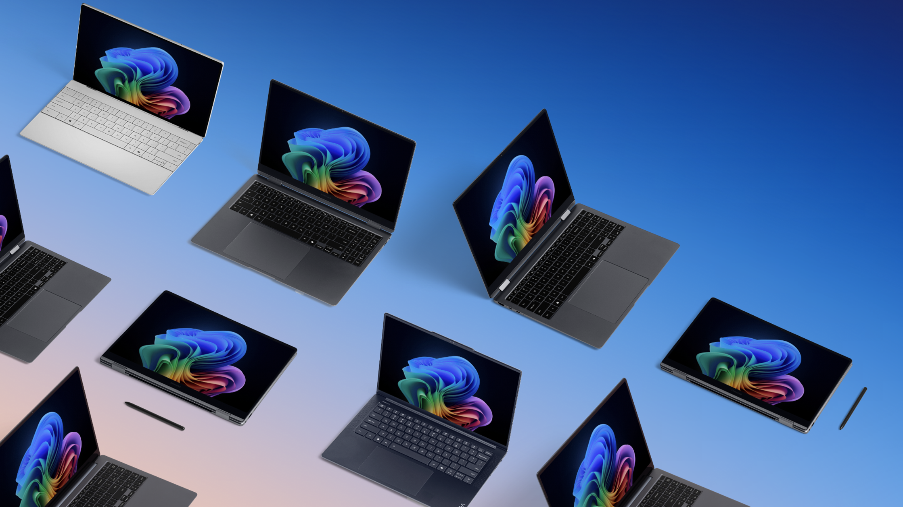
Device selection guidance

Slide 2
Ready to recommend the right device for finance organizations and employees?
Guide to choose a Windows 11 Pro device for your finance professionals
When available, always recommend a Copilot+ PC as the best option. Device examples below are based on current featured devices and expected Copilot+ PC portfolio/through March 2025.
Power ($1,000+)*
High-level productivity
Data analytics
CAD
AV production
Modeling and simulations
Coding, machine learning, and AI
IT management
Premium desktops and workstations
Mobile workstations
Premium notebooks
Look at what Jacob, the finance manager, needs from his device:
1. Performance (Y-axis on the graph): Jacob, the finance manager, is a power user who analyzes large amounts of complex financial data. He needs a device that responds quickly with no lag and works across all applications seamlessly.
​2. Mobility (X-axis): In today’s hybrid world, Jacob needs a device with all-day battery life that is flexible, thin, and light; one that he can use whether he is working from home, at the office, or across multiple conference rooms.
​Need an NPU? A device with an NPU (neural processing unit) running trillions of operations per second (TOPS) is optimal for AI workloads. Jacob could use Microsoft 365 Copilot and NPU-powered features like Windows Studio Effects to create and deliver polished presentations for his organization.
NPU <40 TOPS
Dell Precision 5690
HP ZBook Power G11
Lenovo ThinkPad P1 Gen7 and P14s G5
NPU <40 TOPS
HP EliteBook 800, 1040, x360
Dell Latitude 7000, 9450
Lenovo X1 Carbon Gen 12
Surface Laptop
Acer TravelMate P6
Copilot+ PC (40+ TOPS NPU)
Dell 7455
HP EliteBook Ultra G1Q
Lenovo ThinkBook 16 Gen 7, ThinkPad T14s Gen 6, or ThinkPad X1 Carbon G13
Surface Laptop or Surface Pro 2-in-1
Acer TravelMate P6 14 AI
ASUS ExpertBook P5
Non-NPU only
Dell OptiPlex and Precision workstations
HP EliteOne and ZBook series
Lenovo ThinkCenter
Compute capability needs (CPU, GPU, RAM)
Advanced ($800–999)*
Broad productivity
Heavy multitasking
Video conferencing
AV editing
Project management
Reporting
Training
Advanced desktops
Advanced notebooks
Non-NPU only
Dell OptiPlex line
HP EliteOne and ZBook series
Lenovo ThinkCentre line
NPU <40 TOPS
HP ProBook 400 line
Dell Latitude 5000 line
Lenovo ThinkBook 14/16 Gen 7
Surface Laptop or Pro 2-in-1
Copilot+ PC (40+ TOPS NPU)
Dell Latitude 5455
Lenovo ThinkBook 16 Gen 7
We recommend the following device category for Jacob: A thin, light, and powerful Copilot+ PC with a 40 TOPS NPU in power productivity with medium-to-high mobility.
Other options include Windows 11 Pro advanced or premium AI PC notebooks. (An exception to a notebook might be a premium desktop for those that work at a fixed location such as trading floors.)
Core ($500–799)*
Core productivity
Light multitasking
Web/software-as-a-service apps
Customer support
Operations and admin
Standard desktops
Standard notebooks
Standard detachables, tablets
Non-NPU only
Dell OptiPlex Mini
HP Pro and Elite line
Lenovo IdeaCentre line
Non-NPU only
Dell Lati 3000 line
HP ProBook 400 line
Lenovo ThinkBook line
Surface Laptop Go
Non-NPU only
ASUS ExpertBook B3
Surface Go 4
Mobility needs (battery life, weight, size)
*This matrix does not include all available OEM devices, just examples from our featured devices program. This will be updated as our device portfolio expands. For a more comprehensive view of Microsoft recommended devices across all vendors, price points, and form factors, please talk to your device partner or visit the device section of Windows for Business. Price based on MSRP, pricing may vary, and all currency is in US dollars.

Slide 3


Additional resources
Check out the Device Segmentation Guide to learn more about Windows Pro NPU devices, app compatibility when upgrading, and how to guide recommendations for the best devices for your users.
Learn more

