Slide 1
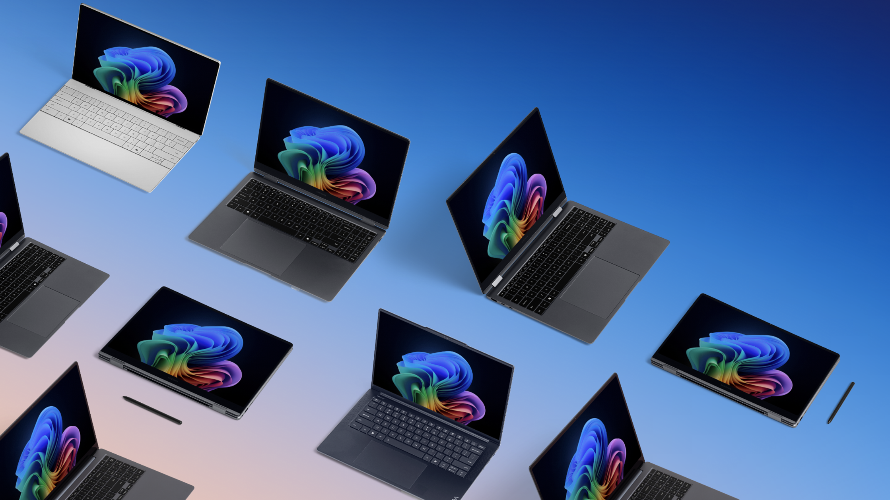
Device selection guidance

Slide 2
Guide to choose a Windows 11 Pro device for your legal professionals.
Ready to recommend the right device for legal organizations and employees?
When available, always recommend a Copilot+ PC as the best option: Device examples below based on current featured devices and expected Copilot+ PC portfolio/through March 2025.
Look at what Linda, a corporate attorney, needs from her device:
1. Performance (Y-axis on the graph): Linda, a legal professional, is an advanced user with broad productivity needs. In addition to the legal documents, client data, and meeting notes she needs to create and summarize quickly, she develops many strategic presentations, contracts, and policy documents for other attorneys on the same case. She works with private client information when navigating legal proceedings. Linda requires a high-performing Windows 11 Pro device that is fast, portable, secure, and powered by AI. With a Copilot+ PC, she can stay in the flow while keeping proprietary information protected.
2. Mobility (X-axis): Linda needs a thin and light device that offers all-day battery life and unparalleled portability, because she’s moving between conference rooms, and she sometimes works from home. The Copilot+ PC thin and light design ensures she stays productive on the go. With the most advanced Windows security by default, Linda can confidently keep things like critical client information secure, no matter her location.
3. ​Need an NPU? A device with an NPU (neural processing unit) runs trillions of operations per second (TOPS) and is optimal for AI workloads. With Copilot+ PC exclusive NPU-powered AI features like Live Captions with translation, Linda can easily communicate in meetings with clients who speak other languages and broaden the reach of her legal services.
We recommend the following device category for Linda: A thin, light Copilot+ PC with a 40+ TOPS NPU for advanced productivity and medium to high mobility needs.
Other options include Windows 11 Pro advanced AI PC notebooks with <40 TOPs NPU.
Power ($1,000+)*, **
High-level productivity
Data analytics
CAD
AV production
Modeling and simulations
Coding, machine learning, and AI
IT management
Premium desktops and workstations
Mobile workstations
Premium notebooks
Non-NPU only
Dell OptiPlex and Precision Workstations
HP EliteOne and ZBook Series
Lenovo ThinkCenter
AI PC (<40 TOPS)
Dell Precision 5690
HP ZBook Power G11
Lenovo ThinkPad P1 Gen7 and P14s G5
AI PC (<40 TOPS)
HP EliteBook 800, 1040, x360
Dell Latitude 7000, 9450
Lenovo X1 Carbon Gen 12
Surface Laptop
Acer TravelMate P6
Copilot+ PC (40+ TOPS)
Dell 7455
HP EliteBook Ultra G1Q
Lenovo ThinkBook 16 Gen 7, ThinkPad T14s Gen 6, or ThinkPad X1 Carbon G13
Surface Laptop or Surface Pro 2-in-1
Acer TravelMate P6 14 AI
ASUS ExpertBook P5
Compute capability needs (CPU, GPU, RAM)
Advanced ($800–999)*
Broad productivity
Heavy multitasking
Video conferencing
AV editing
Project management
Reporting
Training
Advanced desktops
Advanced notebooks
Non-NPU only
Dell OptiPlex line
HP EliteOne and ZBook Series
Lenovo ThinkCentre line
AI PC (<40 TOPS)
HP ProBook 400 line
Dell Latitude 5000 line
Lenovo ThinkBook 14/16 Gen 7
Surface Laptop or Pro 2-in-1
Copilot+ PC (40+ TOPS)
Dell Latitude 5455
Lenovo ThinkBook 16 Gen 7
Core ($500–799)*
Core productivity
Light multitasking
Web/SaaS apps
Customer support
Operations and admin
Standard desktops
Standard notebooks
Standard detachables, tablets
Non-NPU only
Dell OptiPlex Mini
HP Pro and Elite line
Lenovo IdeaCentre line
Non-NPU only
Dell Lati 3000 line
HP ProBook 400 line
Lenovo ThinkBook line
Surface Laptop Go
Non-NPU only
ASUS ExpertBook B3
Surface Go 4
Mobility needs (battery life, weight, size)
*The matrix does not include all available OEM devices, just examples from our featured devices program. They will be updated as our device portfolio expands. For a more comprehensive view of Microsoft-recommended devices across all vendors, price points, and form factors, please talk to your device partner or visit the device section of Windows for Business. Price based on MSRP; pricing may vary. ** All currency in US dollars.
Notes:
Generated by Copilot, verified for accuracy
This slide outlines the essential device requirements for legal professionals, emphasizing the balance between performance and mobility. For someone like Linda, a corporate attorney, the need for a powerful yet portable device is paramount. She requires a Windows 11 Pro device that can handle extensive productivity tasks, including document creation and strategic presentations, while also ensuring the security of sensitive client information. The recommendation of a thin, light Copilot+ PC with a neural processing unit (NPU) highlights the importance of advanced AI capabilities, which can enhance productivity and facilitate communication in diverse environments. The slide also categorizes devices based on their power and mobility needs, providing a clear guide for selecting the right technology for legal professionals. This structured approach ensures that organizations can make informed decisions that align with their operational requirements.
______

Slide 3
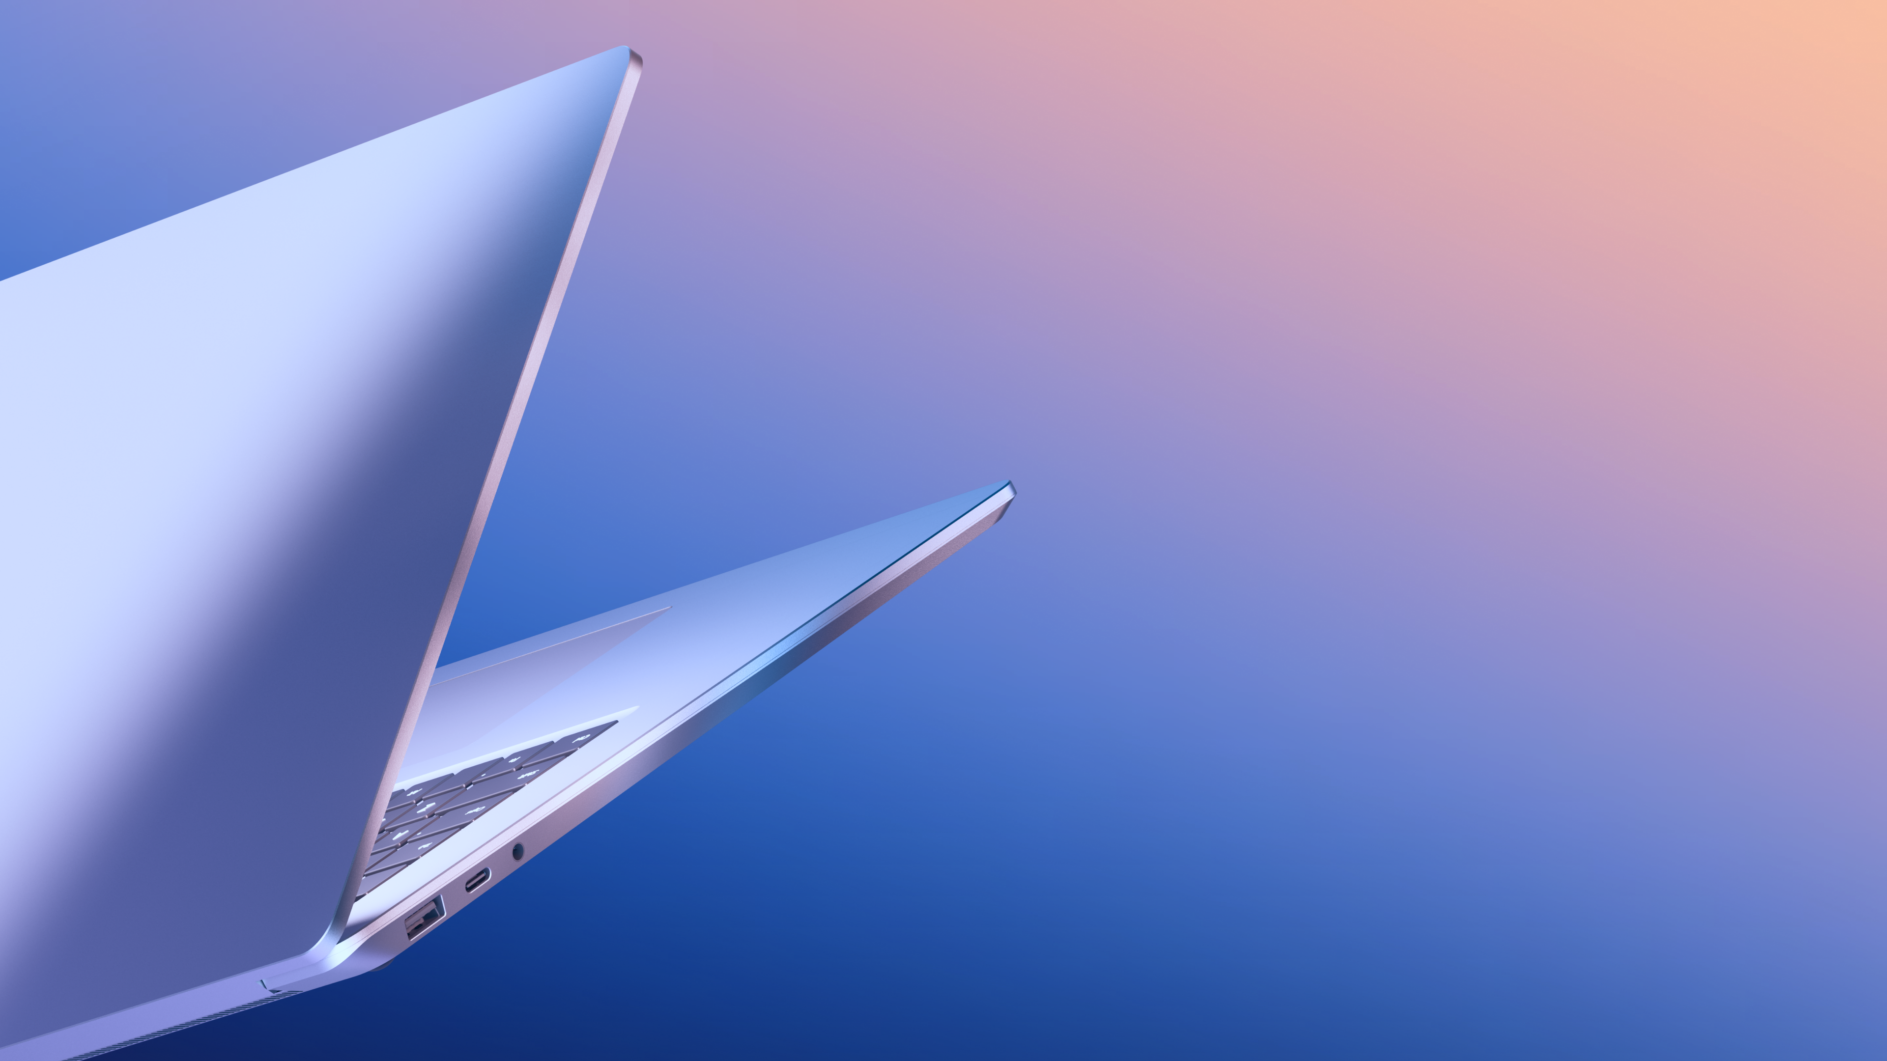

Check out the Device Segmentation Guide to learn more about Windows Pro NPU devices, app compatibility when upgrading, and how to guide recommendations for the best devices for business customers.
Learn more

