Slide 1


Slide 2

A future in chemistry
About me
Brief intro here
Where I work
Company name to go here
What inspired me to choose my career here
What is the ‘impact’ of what I do here
Sub header here
Sentence describing what I do
Sentence describing what I enjoy about it
Sentence describing why I love it

Slide 3

About you
A future in chemistry
Don’t know what you want to do? That’s ok!
First step: get to know YOU by asking yourself a few questions What do you enjoy?
What’s important to you?
How much science do you want in your life?
How much studying do you want to do when you leave school?
Have you ruled anything out? Why?

Slide 4



Where do you want to work?
A future in chemistry
In education?
Part of a shared-interest community, teaching courses, publishing papers
In industry?
Good salaries, deadline-driven, careers in different areas across the business
In a small company?
Fast-paced, more responsibility, learn on the job, opportunities to rise fast

Slide 5

Now write down:
A future in chemistry
What you enjoy
What’s important to you
One or two jobs you’ve ruled out – and why

Slide 6


Slide 7

Chemistry is at the centre of everything
Everything you can see, smell, touch and taste
A future in chemistry
Chemistry helps protect and clean up the environment
Chemistry saves lives
Chemistry feeds the world
Chemistry helps solve crime
Chemistry helps sort out the world’s biggest challenges

Slide 8

Chemistry is at the centre of everything
Everything you can see, smell, touch and taste
A future in chemistry
Energy and the environment
Chemistry is helping us to cope with increasing pressures on energy, food, water and other scarce natural resources and to live more sustainably.
Lifestyle and recreation
From skincare to sport, chemistry is all around us. Here are some of the ways that chemistry makes life more enjoyable.
Find out more
Find out more
Something different
Love chemistry but have no idea what to do with a chemistry qualification? Here’s a range of people who use their chemistry skills and knowledge in unexpected ways.
Human health
Chemistry is helping to improve and maintain human health for all in a rapidly changing world.
Find out more
Find out more

Slide 9

Learning chemistry lets you think like a scientist
A future in chemistry
Chemistry helps you:
Appreciate what things are made of and how they work – like understanding the ingredient list on your cereal box
Describe and explain natural occurrences
Have opinions on subjects in the news – such as climate change and vaccinations
Understand scientific issues and talk about them
9

Slide 10
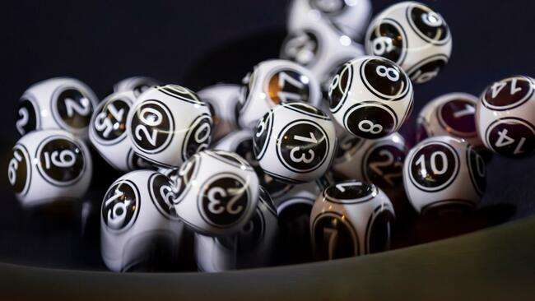
Career quiz
Fill in the questionnaire*
It’s just for fun!
This quiz should show that studying chemistry could take you into so many different areas of work. It’s not designed to tell you what you should or shouldn’t want to be!
*answer the questions on the next slide or on a print-out
10

Slide 11
Where could chemistry take you?
A future in chemistry
1
What sort of work do you like the sound of most?
3
What do you love doing in your spare time?
5
You’d think your life was a success if you:
A. Working with your hands | A. Building things, arts and crafts | A. Cured a disease
B. Working with numbers and data | B. Puzzles, strategy games | B. Earned a lot of money
C. Helping others | C. Meeting lots of different people | C. Made a lot of people’s lives better
D. Problem solving | D. Reading the news, discussing politics | D. Fixed some of society’s biggest issues
E. Something creative | E. Reading books, listening to music | E. Could express yourself
2
4
Apart from science, what subjects at school do you like most?
6
Pick the word that most closely describes what you’d like the world to be in 10 years’ time:
What’s your biggest strength?
A. Your attention to detail | A. Art / textiles / design tech | A. Healthy
B. Thinking logically | B. Maths / ICT / computer science | B. Prosperous
C. Getting on with different types of people | C. Health and social care / sociology | C. Happy
D. Working through problems | D. History / politics / geography | D. Harmonious
E. Your imagination | E. English / music / media | E. Radiant

Slide 12
Check your answers
Check your scores and find the most relatable jobs
A future in chemistry
Mostly As |  | Mostly Cs |  | Mostly Es
Researcher |  | Teacher |  | Games designer
Medicinal chemist |  | Doctor |  | Food scientist
Cosmetic scientist |  | Vet |  | Science journalist
Biochemist |  | Nurse |  | Art restorer
Material scientist |  | Midwife |  | Chef
Oceanographer
Mostly Bs
Mostly Ds
Tax accountant
Forensic scientist
Patent attorney
Science policy advisor
Systems analyst
Politician
Software designer
Environmental scientist
Conservationist
Seismologist

Slide 13
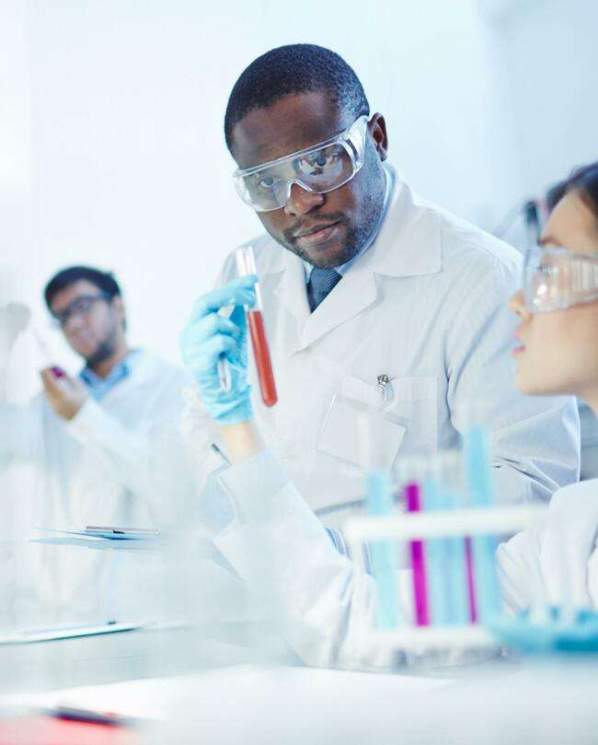
Chemical scientists are well paid
A future in chemistry
Chemistry graduates get 15% higher starting salaries compared with the average for graduates
Chemistry graduates have a high employment rate
70%+ of chemistry students enter a professional or managerial role after graduation
There are about 275,000 chemistry-using professionals in the UK (2019)
Chemistry-using professionals contribute an enormous £87 billion to UK GDP (2019)

Slide 14

Learning chemistry is useful!
You’ll learn skills for being successful in the future, such as:
A future in chemistry
Problem solving
Computer skills
Logical thinking
Teamwork
Reasoning
Communication skillls

Slide 15
So… what else you can do with chemistry?
From teaching and writing, to the law and banking, so many employers value a chemistry qualification. One chemistry graduate even went on to be Prime Minister!
A future in chemistry
Become a teacher
You could
Become a science writer
Advise on science policy
Help people protect their ideas
Become a doctor
Work with animals
Help solve crime
Analyse data for reports
Sell scientific equipment
15

Slide 16

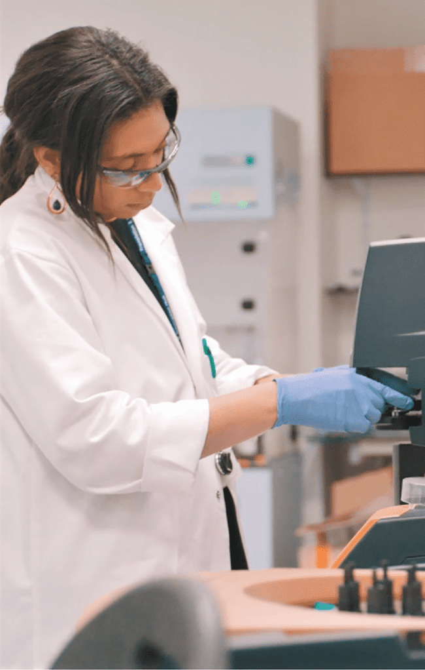
Take chemistry and you could become…
A future in chemistry
An analytical chemist
You’ll be checking what’s in substances
– for example, breath samples, or blood at a crime scene.
A lab technician
You’ll collect samples, analyse and carry out tests on chemicals, materials or products.
16

Slide 17


Take chemistry and you could become…
A future in chemistry
An associate scientist
You’ll design and develop medicines to treat diseases.
A development chemist
You’ll develop things that are made from chemical reactions, such as inks, makeup and fertilisers.
15

Slide 18

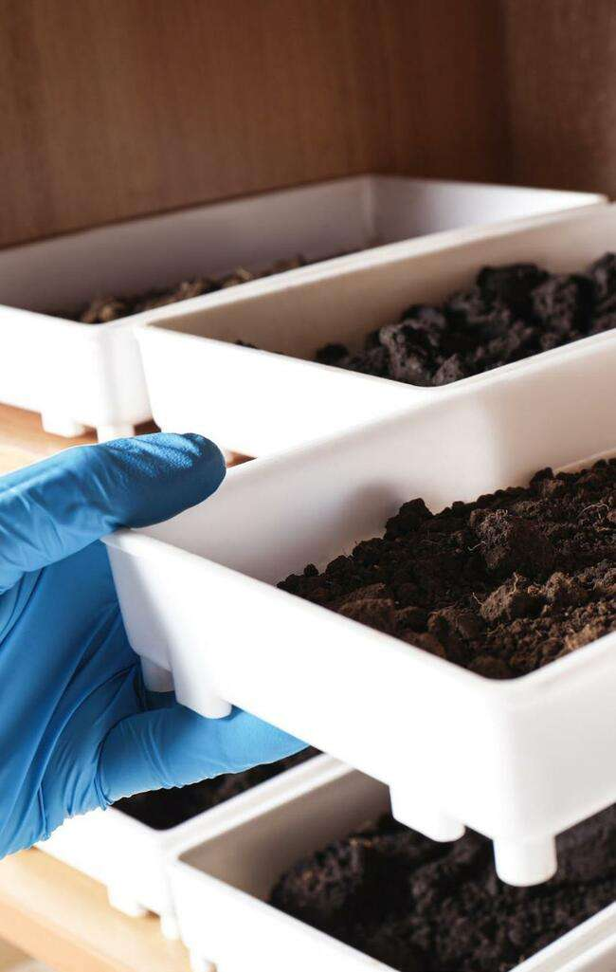
Take chemistry and you could become…
A future in chemistry
A research chemist
You’ll study substances to find out the best ways to make products
such as new medical treatments, makeup, electrical goods, food and drink.
An environmental chemist
You’ll find out what’s in the air, water and soil to understand our world better and how humans affect it.

Slide 19

Where can you work?
A future in chemistry
You could work at a
Company making medicines, food, energy, packaging, paint or chemicals
Hospital
Environmental agency Consultancy
University
Government agency
Public health laboratory Testing company
Just about anywhere!
19

Slide 20

What surprised you about the jobs that are linked to chemistry? Tell the person next to you!
Now ask the same person:
“Tell me one thing that might be good for your future if you take a chemistry qualification”

Slide 21

Now what? Find out more!
A future in chemistry
A future in chemistry
Your career starts here
Discover your future in chemistry at our careers website rsc.li/future-in-chemistry

Slide 22

Find out more about careers in chemistry
A future in chemistry
Ask questions and share ideas with
teachers
career leaders
me
National careers service: browse 100s of roles nationalcareers.service.gov.uk/search-results? searchTerm=chemistry
#TeamScience: compare careers
www.teamscience.org.uk

Slide 23

Follow-up activity
A future in chemistry
Choose a classmate to work with
Ask your partner a couple of questions about their interests, what they’re good at, what they like at school, etc.
Then find them some jobs you think they’d like using: www.nationalcareers.service.gov.uk
www.rsc.org/careers/future/all-profiles

Slide 24

Useful links
A future in chemistry
Teach chemistry: faces of chemistry: printable career profiles www.rsc.org/learn-chemistry/collections/faces-of-chemistry/ careers-with-chemistry
LMI for all: compare up to three careers
www.lmiforall.org.uk/widget
National careers service: browse 100s of roles nationalcareers.service.gov.uk/search-results? searchTerm=chemistry
#TeamScience: compare careers
www.teamscience.org.uk

