Slide 1
Virtual Machine and UNIX

Slide 2
What is a VM?
VM stands for Virtual Machine. It is a software emulation of hardware.
By using a VM, you can have the same hardware and software environment that CSUG has

Slide 3
How do I get it?
The image for CSUG is at https://confluence.cornell.edu/display/coecis/CIS+UGC+Linux+Lab+VM+Information
Follow the directions there. There is even a helpful video! If you have any questions, feel free to ask for help!
Note: Make sure that virtualization is enabled in your BIOS.

Slide 4
VM Setup Checklist
Download the image, Install VirtualBox/VMWare Player
Import the image/setup
Login as root (user: root, pass: csuglab)
Create your own user AND add yourself to the sudoer’s file
  echo "foo ALL=(ALL) ALL" > /etc/sudoers.d/99_foo where foo is your username
Login as your create user and make sure you have internet
  Ping google.com
  Perform an update “sudo yum update”
If you have downloaded the GUI version, “startx” to start the GNOME
  If you start seeing lots of File Managers, drop to shell, update and restart

Slide 5
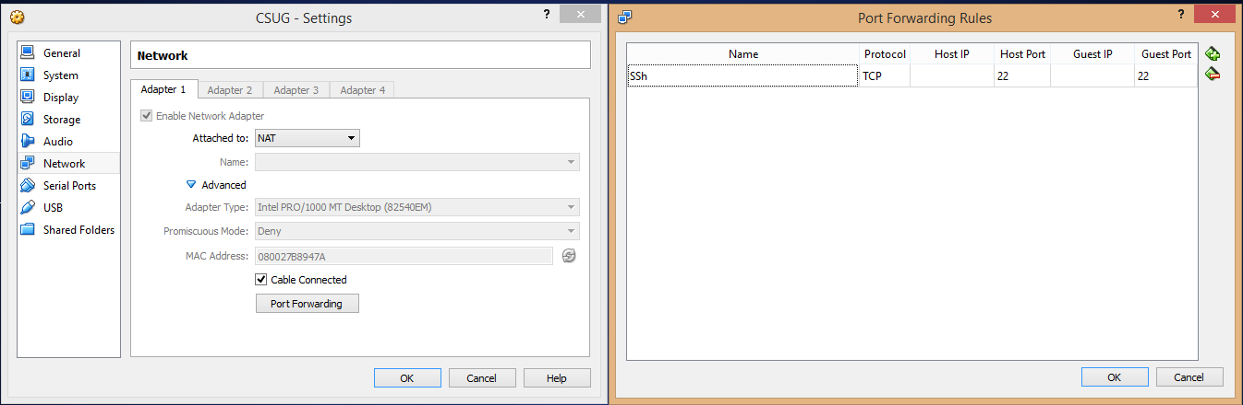
Getting file to and from your VM
Make sure that your network adapter setting is NAT (which should be default) and port forwarding is set up to forward port 22
  Note: If you’re using a Mac, you must forward to a port above 1024!
Connecting to your VM is exactly the same as connecting to CSUG
Time for some SSH!

Slide 6
SSH (Secure Shell)
Allows you to execute commands on a remote computer (as if you were there). Your VM’s host will be localhost
Command: ssh user@host
If you’re on Windows: use Putty or Cygwin
Specify the port by using –p #
Hint: If you are on Mac or Linux, and your remote computer has a GUI interface, you can forward the X session (GUI) in addition to the shell by giving ssh the –X parameter

Slide 7
Unix Basics
The root of the file system (think C:) is ‘/’
Your home folder (think Documents) is ‘/home/[username]’
  Most terminals will expand ‘~’ to be your home folder
Your current directory shortcut is “.”
Files and folders are case sensitive
  CS3410 != cs3410
Spaces MUST be quoted or escaped (unlike in CMD)
For more info, you can take a half semester course in Unix Scripting offered every year

Slide 8
Basic Unix Commands
man (p7): The Hitchhiker's Guide to the Galaxy, for UNIX
  Your first and primary source for help on any command
Control-c (p35): Kill the current process
  Do NOT use Control-z as this suspends the process!
ls (p4): lists the files in the current directory (cmd equivalent is dir)
mkdir (p41): create a directory
rmdir(p41): remove a directory
pwd (p41): prints the current working directory

Slide 9
More Unix Commands
rm (p39): remove files and directories
  Note that by default you cannot remove directories with files. Use –r (recursive) to do so
  Use –rf when you don’t care and just want things gone. BE VERY CAREFUL. No confirmation will be given.
cp (p38): copies from source to destination
mv (p38): move from source to destination (also used to rename)
cat (p44): can be used to quickly display the content of a file
less (45): view a text file will scrolling (q to quit)

Slide 10
Rsync (p115) and SCP (p152)
Use to copy to and from your VM
If you want to copy to your real local machine, you should be in a shell on your real local machine
Cygwin provides both of these. You can also use a GUI such as WinSCP
For example to copy from the VM to your machine (where user is your username that you created):
  rsync user@localhost:/home/user/file .
  scp user@localhost:/home/user/file .
You should now be able to see “file” if you do ls

Slide 11
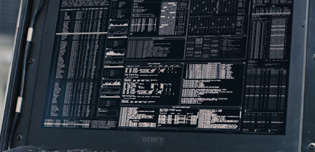
Questions?

