Slide 1
Synchronization 3 and GPUs
CS 3410, Spring 2014
Computer Science
Cornell University
See P&H Chapter: 6.7

Slide 2
Administrivia
Next 3 weeks
Prelim2 Thu May 1st : 7:30-9:30
Olin 155: Netid [a-g]*
Uris G01: Netid [h-z]*
Proj3 tournament: Mon May 5 5pm-7pm (Pizza!)
Proj4 design doc meetings May 5-7 (doc ready for mtg)
Final Project for class
Proj4 due Wed May 14
Proj4 demos: May 13 and 14
Proj 4 release: in labs this week
Remember: No slip days for PA4

Slide 3
Academic Integrity
All submitted work must be your own
OK to study together, but do not share soln’s
Cite your sources
Project groups submit joint work
Same rules apply to projects at the group level
Cannot use of someone else’s soln
Closed-book exams, no calculators
Stressed? Tempted? Lost?
Come see us before due date!
Plagiarism in any form will not be tolerated

Slide 4
Synchronization
Threads
Critical sections, race conditions, and mutexes
Atomic Instructions
HW support for synchronization
Using sync primitives to build concurrency-safe data structures
Example: thread-safe data structures
Language level synchronization
Threads and processes

Slide 5
Synchronization in MIPS
Load linked: LL rt, offset(rs)
Store conditional: SC rt, offset(rs)
Succeeds if location not changed since the LL
Returns 1 in rt
Fails if location is changed
Returns 0 in rt
Any time a processor intervenes and modifies the value in memory between the LL and SC instruction, the SC returns 0 in $t0
Use this value 0 to try again
Notes:
LL is like LW. You are loading into rt. But also marking a synchronization desire.
SC is like SW, but also changes rt

Slide 6
Mutex from LL and SC
Linked load / Store Conditional
m = 0; // 0 means lock is free; otherwise, if m ==1, then lock locked
mutex_lock(int m) {
while(test_and_set(&m)){}
}
int test_and_set(int *m) {
old = *m;
*m = 1;
return old;
}
LL Atomic
SC
Notes:
LL just like LW
SC jus like SW, but overwrites src register with 1 “success” or 0 “fail”

Slide 7
Mutex from LL and SC
Linked load / Store Conditional
m = 0;
mutex_lock(int *m) {
while(test_and_set(m)){}
}
int test_and_set(int *m) {
try:
LI $t0, 1
LL $t1, 0($a0)
SC $t0, 0($a0)
BEQZ $t0, try
MOVE $v0, $t1
}
Notes:
LL just like LW
SC just like SW, but overwrites src register with 1 “success” or 0 “fail”

Slide 8
Mutex from LL and SC
m = 0;
mutex_lock(int *m) {
test_and_set:
LI $t0, 1
LL $t1, 0($a0)
BNEZ $t1, test_and_set
SC $t0, 0($a0)
BEQZ $t0, test_and_set
}
mutex_unlock(int *m) {
*m = 0;
}
Notes:
LL just like LW
SC jus like SW, but overwrites src register with 1 “success” or 0 “fail”

Slide 9
Mutex from LL and SC
m = 0;
mutex_lock(int *m) {
test_and_set:
LI $t0, 1
LL $t1, 0($a0)
BNEZ $t1, test_and_set
SC $t0, 0($a0)
BEQZ $t0, test_and_set
}
mutex_unlock(int *m) {
SW $zero, 0($a0)
}
This is called a
Spin lock
Aka spin waiting
Notes:
LL just like LW
SC jus like SW, but overwrites src register with 1 “success” or 0 “fail”

Slide 10
Mutex from LL and SC
m = 0;
mutex_lock(int *m) {
Time Step | Thread A | Thread B | ThreadA $t0 | ThreadA $t1 | ThreadB $t0 | ThreadB $t1 | Mem M[$a0]
0 |  |  |  |  |  |  | 0
1 | try: LI $t0, 1 | try: LI $t0, 1
2 | LL $t1, 0($a0) | LL $t1, 0($a0)
3 | BNEZ $t1, try | BNEZ $t1, try
4 | SC $t0, 0($a0) | SC $t0, 0 ($a0)
5 | BEQZ $t0, try | BEQZ $t0, try
6
Notes:
LL just like LW
SC jus like SW, but overwrites src register with 1 “success” or 0 “fail”

Slide 11
Mutex from LL and SC
m = 0;
mutex_lock(int *m) {
Time Step | Thread A | Thread B | ThreadA $t0 | ThreadA $t1 | ThreadB $t0 | ThreadB $t1 | Mem M[$a0]
0 |  |  |  |  |  |  | 0
1 | try: LI $t0, 1 | try: LI $t0, 1 | 1 |  | 1 |  | 0
2 | LL $t1, 0($a0) | LL $t1, 0($a0) | 1 | 0 | 1 | 0 | 0
3 | BNEZ $t1, try | BNEZ $t1, try | 1 | 0 | 1 | 0 | 0
4 | SC $t0, 0($a0) | SC $t0, 0 ($a0) | 0 | 0 | 1 | 0 | 1
5 | BEQZ $t0, try | BEQZ $t0, try | 0 | 0 | 1 | 0 | 1
6
Notes:
LL just like LW
SC jus like SW, but overwrites src register with 1 “success” or 0 “fail”

Slide 12
Mutex from LL and SC
m = 0;
mutex_lock(int *m) {
Time Step | Thread A | Thread B | ThreadA $t0 | ThreadA $t1 | ThreadB $t0 | ThreadB $t1 | Mem M[$a0]
0 |  |  |  |  |  |  | 0
1 | try: LI $t0, 1 | try: LI $t0, 1 | 1 |  | 1 |  | 0
2 | LL $t1, 0($a0) | LL $t1, 0($a0) | 1 | 0 | 1 | 0 | 0
3 | BNEZ $t1, try | BNEZ $t1, try | 1 | 0 | 1 | 0 | 0
4 | SC $t0, 0($a0) | SC $t0, 0 ($a0) | 0 | 0 | 1 | 0 | 1
5 | BEQZ $t0, try | BEQZ $t0, try | 0 | 0 | 1 | 0 | 1
6 | try: LI $t0, 1 | Critical section
Notes:
LL just like LW
SC jus like SW, but overwrites src register with 1 “success” or 0 “fail”

Slide 13
Summary
Need parallel abstraction like for multicore
Writing correct programs is hard
Need to prevent data races
Need critical sections to prevent data races
Mutex, mutual exclusion, implements critical section
Mutex often implemented using a lock abstraction
Hardware provides synchronization primitives such as LL and SC (load linked and store conditional) instructions to efficiently implement locks

Slide 14
Topics
Synchronization
Threads
Critical sections, race conditions, and mutexes
Atomic Instructions
HW support for synchronization
Using sync primitives to build concurrency-safe data structures
Example: thread-safe data structures
Language level synchronization
Threads and processes

Slide 15
Next Goal
How do we use synchronization primitives to build concurrency-safe data structure?
Let’s look at a ring buffer

Slide 16
Attempt#1: Producer/Consumer
Access to shared data must be synchronized
goal: enforce datastructure invariants
// invariant: // data is in A[h … t-1]
char A[100];
int h = 0, t = 0;
// producer: add to list tail
void put(char c) {
// Need: check if list full
A[t] = c;
t = (t+1)%n;
}
head
tail
1
2
3
4
// consumer: take from list head
char get() {
while (empty()) { };
char c = A[h];
h = (h+1)%n;
return c;
}
Notes:
draw picture
invariant broken just before last/first increments
needs: make the list into a ring buffer, add code in writer to wait if list is full

Slide 17
Testing the invariant
Various ways to implement empty()
1. h==t
but then the put has to be careful
2. could be a separate boolean
…

Slide 18
Attempt#1: Producer/Consumer
// invariant: // data is in A[h … t-1]
char A[100];
int h = 0, t = 0;
// producer: add to list tail
void put(char c) {......
A[t] = c;
t = (t+1)%n;
}
head
tail
2
3
4
// consumer: take from list head
char get() {
while (empty()) { };
char c = A[h];
h = (h+1)%n;
return c;
}
Error: could miss an update to t or h due to lack of synchronization
Current implementation will break invariant:
only produce if not full and only consume if not empty
Need to synchronize access to shared data
Notes:
draw picture
invariant broken just before last/first increments
needs: make the list into a ring buffer, add code in writer to wait if list is full

Slide 19
Attempt#2: Protecting an invariant
// invariant: (protected by mutex m) // data is in A[h … t-1]
pthread_mutex_t *m = pthread_mutex_create();
char A[100];
int h = 0, t = 0;
// consumer: take from list head
char get() {
pthread_mutex_lock(m);
while(empty()) {}
char c = A[h];
h = (h+1)%n;
pthread_mutex_unlock(m);
return c;
}
Rule of thumb: all access and updates that can affect invariant become critical sections
Notes:
bug: can’t do busy waiting inside mutex… what to do?

Slide 20
Attempt#2: Protecting an invariant
// invariant: (protected by mutex m) // data is in A[h … t-1]
pthread_mutex_t *m = pthread_mutex_create();
char A[100];
int h = 0, t = 0;
BUG: Can’t wait while holding lock
// consumer: take from list head
char get() {
pthread_mutex_lock(m);
while(empty()) {}
char c = A[h];
h = (h+1)%n;
pthread_mutex_unlock(m);
return c;
}
Rule of thumb: all access and updates that can affect invariant become critical sections
Notes:
bug: can’t do busy waiting inside mutex… what to do?

Slide 21
Guidelines for successful mutexing
Insufficient locking can cause races
Skimping on mutexes? Just say no!
But poorly designed locking can cause deadlock
Know why you are using mutexes!
Acquire locks in a consistent order to avoid cycles
Use lock/unlock like braces (match them lexically)
lock(&m); …; unlock(&m)
Watch out for return, goto, and function calls!
Watch out for exception/error conditions!
P1: lock(m1); lock(m2);
P2: lock(m2); lock(m1);
Circular
Wait

Slide 22
Attempt#3: Beyond mutexes
Writers must check for full buffer & Readers must check if for empty buffer
ideal: don’t busy wait… go to sleep instead
Cannot check condition while
Holding the lock,
BUT, empty condition may no
longer hold in critical section
char get() {
while (empty()) { };
lock (L);
char c = A[h];
h = (h+1)%n;
unlock (L);
return c;
}
head
tail==head
empty
Dilemma: Have to check while holding lock

Slide 23
Attempt#3: Beyond mutexes
Writers must check for full buffer & Readers must check if for empty buffer
ideal: don’t busy wait… go to sleep instead
char get() {
lock (L);
while (empty()) { };
char c = A[h];
h = (h+1)%n;
unlock (L);
return c;
}
Dilemma: Have to check while holding lock,
but cannot wait while holding lock

Slide 24
Attempt#4: Beyond mutexes
Writers must check for full buffer & Readers must check if for empty buffer
ideal: don’t busy wait… go to sleep instead
char get() {
do {
lock (L);
if (!empty()) {
c = A[h];
h = (h+1)%n;
}
unlock (L);
} while (empty);
return c;
}
Notes:
Works, but wasteful sin will spin wait

Slide 25
Language-Level Synchronization
Condition variables
Wait for condition to be true
Thread sleeps while waiting
Can wake up one thread or all threads
Monitors, …

Slide 26
Summary
Hardware Primitives: test-and-set, LL/SC, barrier, ...
… used to build …
Synchronization primitives: mutex, semaphore, ...
… used to build …
Language Constructs: monitors, signals, ...

Slide 27
Prelim 2 content TILL HERE

Slide 28
Abstraction of Processes
How do we cope with lots of activity?
Simplicity? Separation into processes
Reliability? Isolation
Speed? Program-level parallelism
OS
ls
www
emacs
gcc
nfsd
emacs
nfsd
lpr
ls
www
lpr
OS
Notes:
(isolation e.g. virtual memory)
(parallelism e.g. during I/O)

Slide 29
Process and Program
Process
OS abstraction of a running computation
The unit of execution
The unit of scheduling
Execution state + address space
From process perspective
a virtual CPU
some virtual memory
a virtual keyboard, screen, …
Program
“Blueprint” for a process
Passive entity (bits on disk)
Code + static data
Header
Code
Initialized data
BSS
Symbol table
Line numbers
Ext. refs
Notes:
A virtual machine of sorts
Draw saved PTBR and Registers table

Slide 30
Process and Program
Process
Program
mapped segments
DLL’s
Stack
Header
Code
Heap
Initialized data
BSS
BSS
Symbol table
Initialized data
Line numbers
Ext. refs
Code

Slide 31
Role of the OS
Role of the OS
Context Switching
Provides illusion that every process owns a CPU
Virtual Memory
Provides illusion that process owns some memory
Device drivers & system calls
Provides illusion that process owns a keyboard, …
To do:
How to start a process?
How do processes communicate / coordinate?
Notes:
Draw OS on next slide

Slide 32
How to create a process?
Q: How to create a process?
A: Double click
After boot, OS starts the first process
…which in turn creates other processes
parent / child → the process tree
Notes:
1st process = init

Slide 33
pstree example
$ pstree | view -
init-+-NetworkManager-+-dhclient
|-apache2
|-chrome-+-chrome
| `-chrome
|-chrome---chrome
|-clementine
|-clock-applet
|-cron
|-cupsd
|-firefox---run-mozilla.sh---firefox-bin-+-plugin-cont
|-gnome-screensaver
|-grep
|-in.tftpd
|-ntpd
`-sshd---sshd---sshd---bash-+-gcc---gcc---cc1
|-pstree
|-vim
`-view

Slide 34
Processes Under UNIX
Init is a special case. For others…
Q: How does parent process create child process?
A: fork() system call
int fork() returns TWICE!
Notes:
1. creates new address space (Copy-On-Write duplicate of parent’s)
2. creates new execution state in OS process table (Exact copy of parent’s)
3. returns child’s id to parent (context[parent_id]->v0 = child_id)
4. returns zero to child (context[child_id]->v0 = 0)

Slide 35
Example
main(int ac, char **av) {
int x = getpid(); // get current process ID from OS
char *hi = av[1]; // get greeting from command line
printf(“I’m process %d\n”, x);
int id = fork();
if (id == 0)
printf(“%s from %d\n”, hi, getpid());
else
printf(“%s from %d, child is %d\n”, hi, getpid(), id);
}
$ gcc -o strange strange.c
$ ./strange “Hey”
I’m process 23511
Hey from 23512
Hey from 23511, child is 23512
Notes:
Draw OS state

Slide 36
Inter-process Communication
Parent can pass information to child
In fact, all parent data is passed to child
But isolated after (copy-on-write ensures changes are invisible)
Q: How to continue communicating?
A: Invent OS “IPC channels” : send(msg), recv(), …
Notes:
IPC = inter-process communication
sockets, RMI, ipc, unix-domain sockets, pipes

Slide 37
Inter-process Communication
Parent can pass information to child
In fact, all parent data is passed to child
But isolated after (C-O-W ensures changes are invisible)
Q: How to continue communicating?
A: Shared (Virtual) Memory!
Notes:
Before fork: allocate pages, mark as “shared”
During fork: don’t set copy-on-write for these pages
After fork: either can read/write

Slide 38
Processes and Threads

Slide 39
Processes and Threads
Process
OS abstraction of a running computation
The unit of execution
The unit of scheduling
Execution state + address space
From process perspective
a virtual CPU
some virtual memory
a virtual keyboard, screen, …
Thread
OS abstraction of a single thread of control
The unit of scheduling
Lives in one single process
From thread perspective
one virtual CPU core on a virtual multi-core machine
Notes:
d/Unit of scheduling/
s/execution state/one or more threads/
s/virtual CPU/virtual multi-core machine/

Slide 40
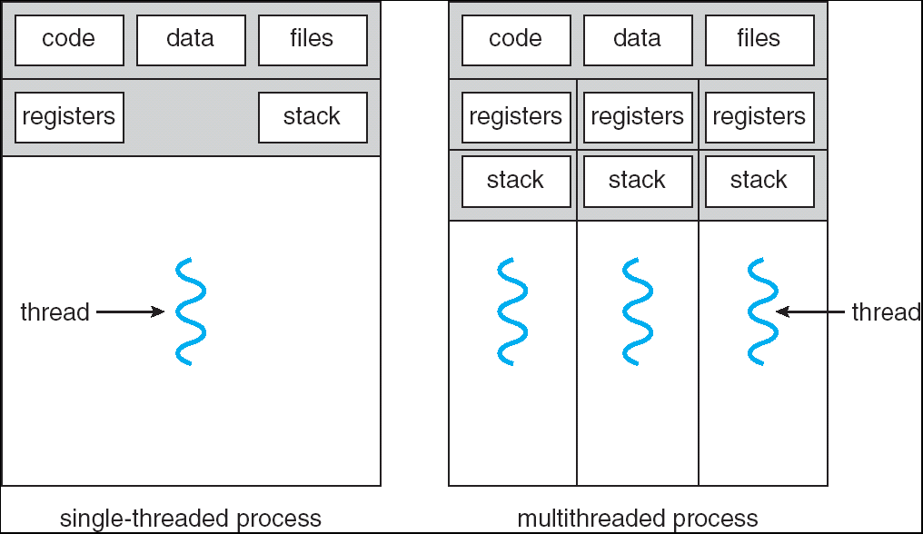
Multithreaded Processes

Slide 41
Threads
#include <pthread.h>
int counter = 0;
void PrintHello(int arg) {
printf(“I’m thread %d, counter is %d\n”, arg, counter++);
... do some work ...
pthread_exit(NULL);
}
int main () {
for (t = 0; t < 4; t++) {
printf(“in main: creating thread %d\n", t);
pthread_create(NULL, NULL, PrintHello, t);
}
pthread_exit(NULL);
}

Slide 42
Threads versus Fork
in main: creating thread 0
I’m thread 0, counter is 0
in main: creating thread 1
I’m thread 1, counter is 1
in main: creating thread 2
in main: creating thread 3
I’m thread 3, counter is 2
I’m thread 2, counter is 3

Slide 43
Summary
Processes and Threads are the abstraction that we use to write parallel programs
Fork and Join and Interprocesses communication (IPC) can be used to coordinate processes
Threads are used to coordinate use of shared memory within a process

Slide 44
GPUs

Slide 45
The supercomputer in your laptop
GPU: Graphics processing unit
Very basic till about 1999
Specialized device to accelerate display
Then started changing into a full processor
2000-…: Frontier times

Slide 46
Parallelism
CPU: Central Processing Unit
GPU: Graphics Processing Unit

Slide 48
GPUs: Faster than Moore’s Law Moore’s Law is for Wimps?!
nVidia
G70
10
9
10
9
One-pixel polygons (~10M polygons @ 30Hz)
10
8
10
8
Slope ~2.4x/year
UNC/HP PixelFlow
ATI
Radeon 256
SGI
(Moore's Law ~ 1.7x/year)
R-Monster
Peak
7
SGI
GeForce
10
7
Performance
10
Division
Pxpl6
IR
E&S
Nvidia TNT
(Δ's/sec)
Harmony
3DLabs
SGI
Cobalt
UNC Pxpl5
Glint
SGI SkyWriter
Accel/VSIS
Voodoo
6
10
6
Megatek
10
SGI VGX
SGI
E&S Freedom
HP VRX
HP TVRX
RE1
SGI
RE2
PC Graphics
Flat
shading
10
5
E&S
Textures
Division VPX
10
5
Stellar GS1000
F300
UNC Pxpl4
SGI GT
Gouraud
shading
Antialiasing
HP CRX
10
4
SGI Iris
10
4
86
88
90
92
94
96
98
00
Year
Graph courtesy of Professor John Poulton (from Eric Haines)

Slide 49
Programmable Hardware
Started in 1999
Flexible, programmable
Vertex, Geometry, Fragment Shaders
And much faster, of course
1999 GeForce256: 0.35 Gigapixel peak fill rate
2001 GeForce3: 0.8 Gigapixel peak fill rate
2003 GeForceFX Ultra: 2.0 Gigapixel peak fill rate
ATI Radeon 9800 Pro : 3.0 Gigapixel peak fill rate
2006 NV60: ... Gigapixel peak fill rate
2009 GeForce GTX 285: 10 Gigapixel peak fill rate
2011
GeForce GTC 590: 56 Gigapixel peak fill rate
Radeon HD 6990: 2x26.5
2012
GeForce GTC 690: 62 Gigapixel/s peak fill rate

Slide 50
Evolution of GPU

Slide 51
Around 2000
Fixed function pipeline

Slide 52
Around 2005
Programmable vertex and pixel processors

Slide 53
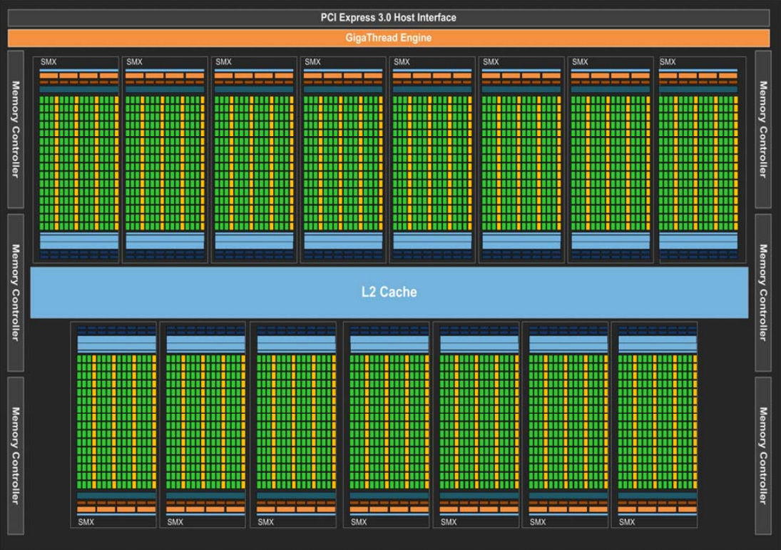
Post 2006: Unified Architecture
nVIDIA Kepler

Slide 54
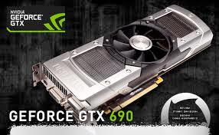
Why?
Parallelism: thousands of cores
Pipelining
Hardware multithreading
Not multiscale caching
Streaming caches
Throughput, not latency

Slide 55
Flynn’s Taxonomy
Single Instruction Single Data (SISD) | Multiple Instruction Single Data (MISD)
Single Instruction Multiple Data (SIMD) | Multiple Instruction Multiple Data (MIMD)

Slide 56
MIMD array of SIMD procs
nVIDIA Kepler

Slide 57
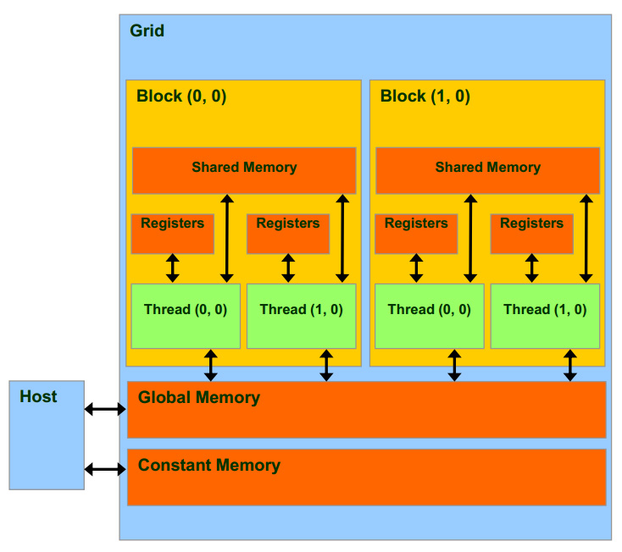
Grids, Blocks, and Threads

Slide 58
CUDA Memory
Faster, per-block
Fastest, per-thread
Slower, global
Read-only, cached

Slide 59
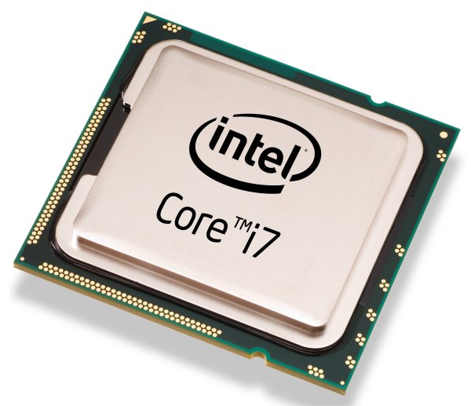
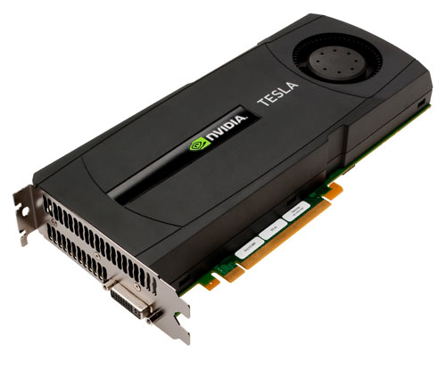
Heterogeneous Computing
Host: the CPU and its memory
Device: the GPU and its memory

Slide 60
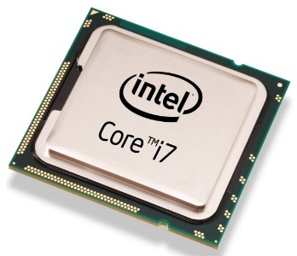
Programming using CUDA
Compute Unified Device Architecture
do_something_on_host();
kernel<<<nBlk, nTid>>>(args);
cudaDeviceSynchronize();
do_something_else_on_host();
…
Highly parallel

Slide 61
Hardware Thread Organization
Threads in a block are partitioned into warps
All threads in a warp execute in a Single Instruction Multiple Data, or SIMD, fashion
All paths of conditional branches will be taken
Warp size varies, many graphics cards have 32
NO guaranteed execution ordering between warps

Slide 62
Branch Divergence
Threads in one warp execute very different branches
Significantly harms the performance!
Simple solution:
Reordering the threads so that all threads in each block are more likely to take the same branch
Not always possible

Slide 63
