Slide 1
Parallel Algorithm Configuration
Frank Hutter, Holger Hoos, Kevin Leyton-Brown
University of British Columbia, Vancouver, Canada

Slide 2
Algorithm configuration
Most heuristic algorithms have parameters
  E.g. IBM ILOG CPLEX:
    Preprocessing, underlying LP solver & its parameters, types of cuts, etc.
    76 parameters: mostly categorical + some numerical
Automatically find good instantiation of parameters
Notes:
Eliminate most tedious part of algorithm design and end use
Save development time & improve performance
The Algorithm Configuration (AC) problem:
Given:
Runnable algorithm A, its parameters and their domains
Distribution D over problem instances I = {I₁, I₂, I₃, …}
Performance metric m
Find:
Parameter setting (“configuration") θ* of A optimizing m on D

Slide 3
Related work on parameter optimization
Optimization of numerical algorithm parameters
Population-based, e.g. CMA-ES [Hansen et al, '95-present]
Model-based approaches: SPO [Bartz-Beielstein et al., CEC’05]
Experimental Design: CALIBRA [Adenso & Laguna, OR’06]
General algorithm configuration (also categorical parameters)
Racing: I/F-Race [Birattari et al., GECCO’02, MH’07, EMOAA’09]
Iterated Local Search: ParamILS [Hutter et al., AAAI’07 & JAIR ’09]
Genetic algorithms: GGA [Ansotegui et al., CP’09]
Model-based approaches: SMAC [Hutter et al., LION’11]

Slide 4
Algorithm configuration works
Problem | Algorithm name and #parameters | Speedups | Reference
SAT | Spear (26) | × 4.5 – 500 | [Hutter et al., ’07b]
SAT | SATenstein (41) | × 1.6 – 218x | [KhudaBukhsh et al., ‘09]
Most probable explanation (MPE) | GLS+ (5) | ≥ × 360 | [Hutter et al., ’07a]
MIP | CPLEX (76) | × 2 – 52 | [Hutter et al., ‘10]
AI Planning | LPG (62) | × 3 – 118 | [Vallati et al., ‘11]

Slide 5
Can parallelization speed up algorithm configuration?
Multiple independent runs of the configurator
Our standard methodology for using ParamILS
Here: first systematic study of this technique’s effectiveness
Parallelism within a single configuration run
GGA [Ansotegui et al, CP’09]
  Evaluates 8 configurations in parallel & stops when one finishes
BasicILS variant of ParamILS [Hutter et al, JAIR’09]
  Distributed target algorithm runs on a 110-core cluster
Here: a new distributed variant of SMAC: d-SMAC
Notes:
Fixed number of 8 local worker processes

Slide 6
Overview
Multiple independent configuration runs: an empirical study
Distributed variant of model-based configuration: d-SMAC
Conclusions

Slide 7
Overview
Multiple independent configuration runs: an empirical study
Distributed variant of model-based configuration: d-SMAC
Conclusions

Slide 8
Parallelization by multiple independent runs
Many randomized heuristic algorithms have high variance
  Some runs perform much better than others (different random seeds)
We can exploit that variance!
  Multiple independent runs in sequence: random restarts
  Multiple independent runs in parallel
    Run multiple copies of an algorithm in parallel & return best result
    Perfect speedups for exponential runtime distributions [Hoos & Stützle, AIJ’99]
    Can reduce expected runtime even on a single core [Gomes & Selman, AIJ’01]
Notes:
Random restarts (multiple independent runs in sequence)
Commonly used in local search and tree search
Can substantially speed up some SLS algorithms [Hoos & Stützle, JAR’00]
Can exploit heavy tails [Gomes & Selman, J ALGO’00]

Slide 9
Multiple independent runs of configurators
Our standard methodology for using ParamILS
  Perform 10 to 25 parallel ParamILS runs
  Select the run with the best training (or validation) performance
How much do we gain by performing these parallel runs?
Notes:
(“some runs are very poor”)
Is it a good idea to perform these parallel runs?
So far: only informal observations
Does it make effective use of parallel resources?
Does it make ParamILS more robust?
How well does this strategy work for other configurators?

Slide 10
Experimental Setup
  5 configuration scenarios from previous work
  [Hutter et al., CPAIOR’10]
  Optimize solution quality that CPLEX achieves in a fixed time limit
  2010: ParamILS achieved substantial improvements
  Side effect of this paper: SMAC & d-SMAC even a bit better
We studied k × ParamILS, k × SMAC, k × d-SMAC
  200 runs for each underlying configurator on each scenario
  To quantify performance of one run of (e.g.) k × ParamILS:
    Draw bootstrap sample of k runs from the 200 ParamILS runs
    Out of these k runs, pick the one with best training performance
    Return its test performance

Slide 11
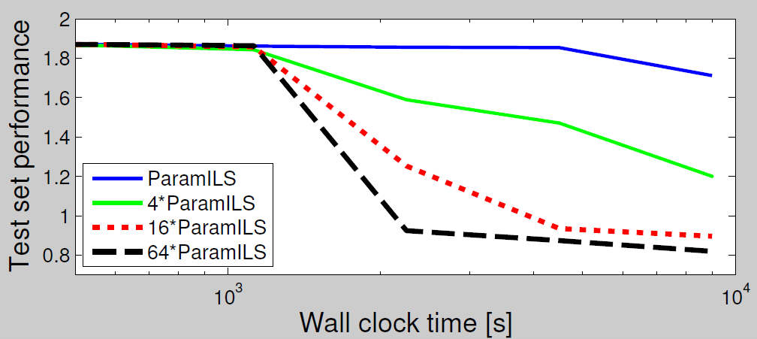
Example speedups for k × ParamILS
5.6-fold speedup
Configuration scenario: Regions 200
Small (or no) speedup for small time budgets
  Each run starts with the default configuration
Substantial speedups for large time budgets
  5.6-fold speedup from 4-fold parallelization?

Slide 12
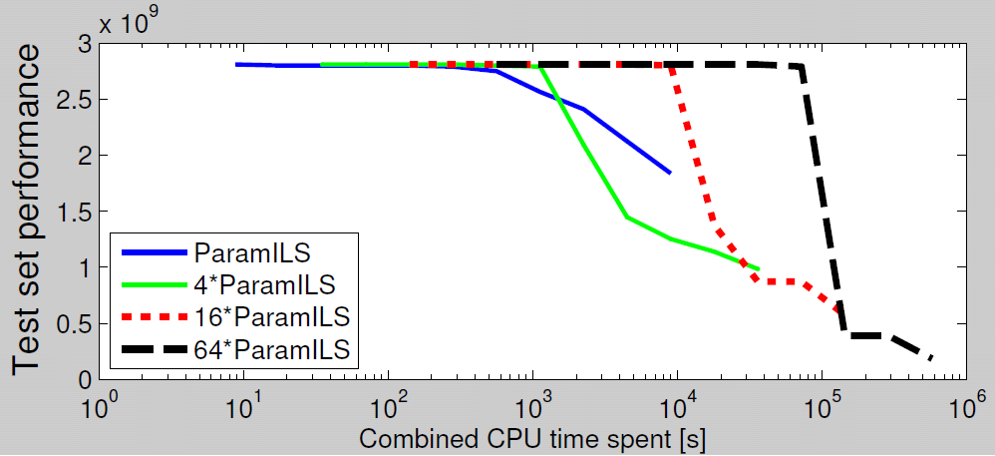
Utilization of total CPU time spent
Configuration scenario: CORLAT
4×ParamILS often better than 1×ParamILS, even on a single core
  I.e. > 4-fold wall clock speedups with k=4
Almost perfect speedups up to k=16; then diminishing returns

Slide 13
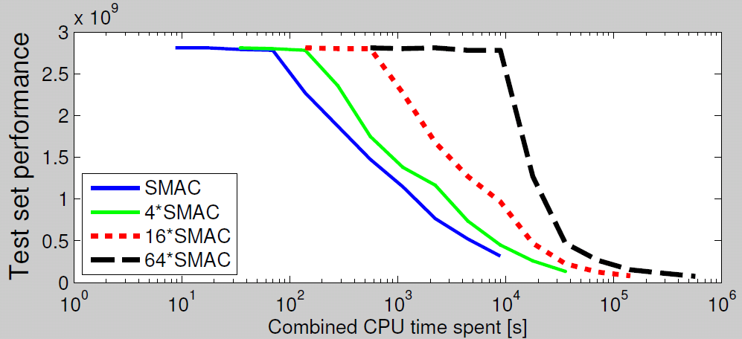
Utilization of total CPU time spent
Configuration scenario: CORLAT
Multiple independent runs are not as effective in SMAC
  SMAC is more robust [Hutter et al., LION’11]
  It has lower variance
  Parallelization by independent runs doesn’t help as much

Slide 14
Overview
Multiple independent configuration runs: an empirical study
Distributed variant of model-based configuration: d-SMAC
Conclusions

Slide 15
SMAC in a nutshell
Algorithm performance data:
(configuration, instance, performance) tuples
Construct model
Regression model predicts performance
of new (configuration, instance) pairs
Select new target algorithm runs
Could parallelize this stage.
But the two other
sequential steps
would become chokepoints
Execute new target algorithm runs

Slide 16
Control flow in distributed SMAC
Start new target algorithm runs
…
Construct model
Worker 1
Worker k
Select new target algorithm runs
Wait for workers and get results
Note: synchronous parallelization

Slide 17
Selecting multiple promising configurations
We leverage existing work on
parallelizing model-based optimization
Simple criterion from [Jones, ‘01]
  Yields a diverse set of configurations
  (detail for experts only: we minimize μ-λσ with sampled values of λ)
Other approaches could be worth trying
  E.g. [Ginsbourger, Riche, Carraro, ‘10]
  Very related talk tomorrow @ 11:55am:
  Expected improvements for the asynchronous parallel global optimization of expensive functions: potentials and challenges
  Janis Janusevskis, Rodolphe Le Riche, and David Ginsbourger
Notes:
that are likely good
but that the model is uncertain about
We want a diverse set of configurations
That are predicted to be good (low predictive mean μ)
For which predictions are uncertain (high predictive variance σ²)
We leverage existing work on
parallelizing model-based optimization
Simple criterion: sample values of λ and minimize μ-λσ [Jones, ‘01]

Slide 18
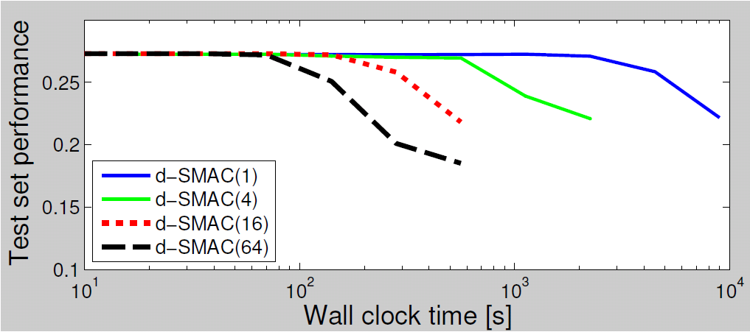
d-SMAC with different numbers of workers
2.6-fold
6.2-fold
2.9-fold
Speedups even for short runs!
Almost perfect speedups with up to 16 workers
Overall speedup factor with 64 workers: 21× – 52×
  Reduces 5h run to 6 – 15 min

Slide 19
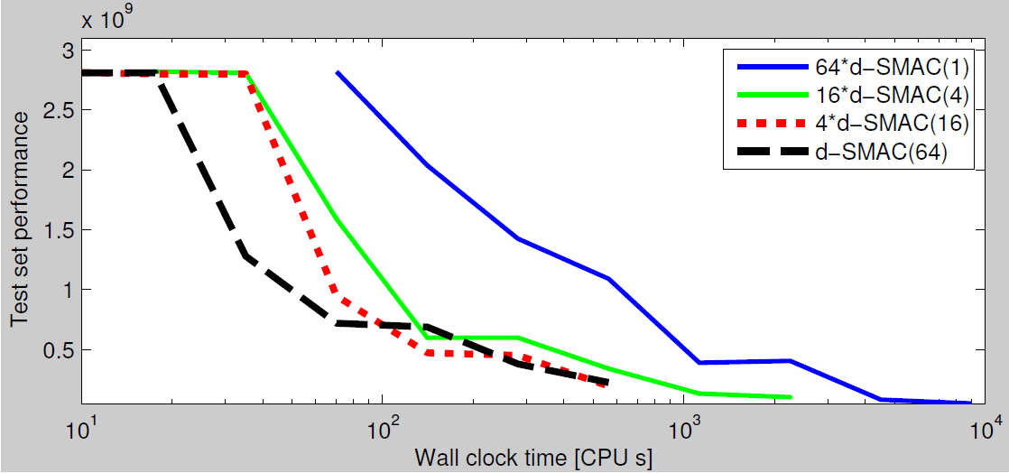
Should we perform independent runs of d-SMAC?
Typically best to use all cores in a single d-SMAC(64) run
4 × d-SMAC(16) comes close:
no statistical difference to 1 × SMAC(64) in 3 of 5 scenarios

Slide 20
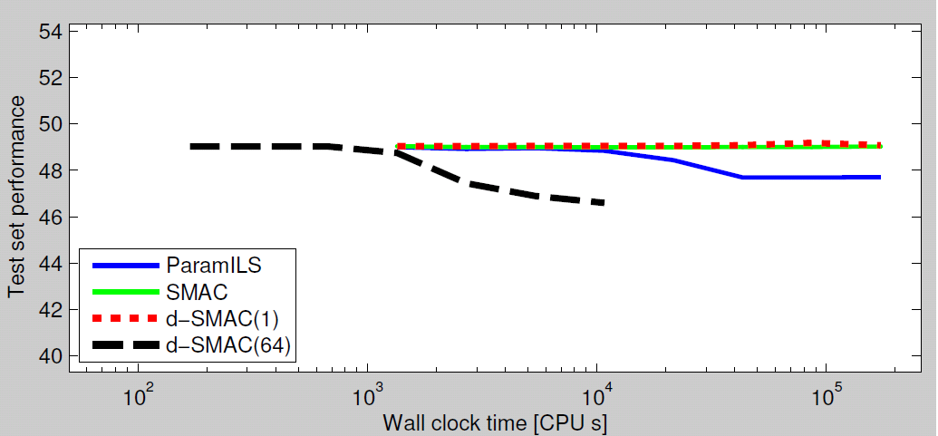
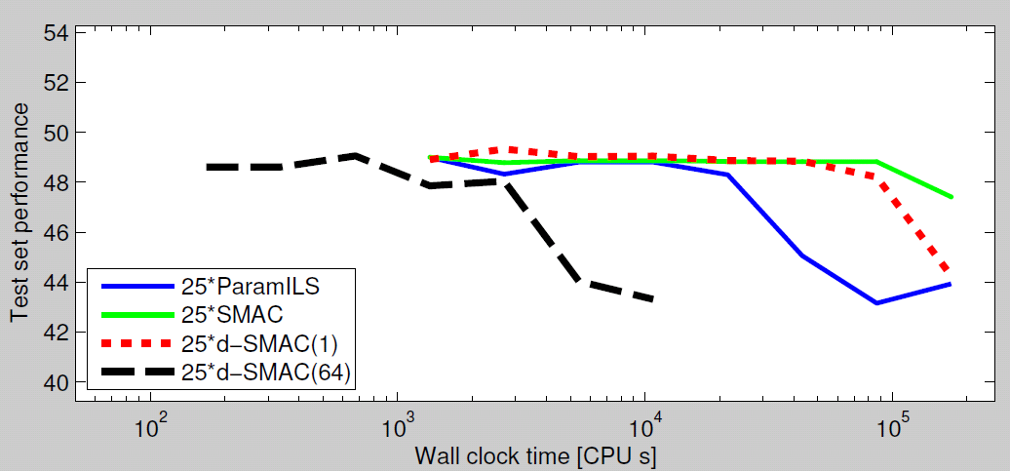
Experiments for a harder instance distribution
d-SMAC(64) takes
40 minutes to find better results
than the other
configurators in 2 days
25×d-SMAC(64)
takes 2 hours to find
better results than 25×ParamILS
in 2 days
Notes:
1600 CPUs !!

Slide 21
Conclusion
Parallelization can speed up algorithm configuration
Multiple independent runs of configurators
  Larger gains for high-variance ParamILS than lower-variance SMAC
  4 × ParamILS better than 1 × ParamILS even on a single CPU
  Almost perfect speedups with up to 16 × ParamILS
  Small time budgets: no speedups
Distributing target algorithm runs in d-SMAC
  Almost perfect speedups with up to 16 parallel workers
    Even for short d-SMAC runs
  Up to 50-fold speedups with 64 workers
    Reductions in wall clock time: 5h → 6 min -15 min
    2 days → 40min - 2h

Slide 22
Future Work
Asynchronous parallelization
  Required for runtime minimization,
  where target algorithm runs have vastly different runtimes
Ease of use
  We needed to start cluster workers manually
  Goal: direct support for clusters, Amazon EC2, HAL, etc.
Notes:
Further use of SMAC’s models
Adaptive selection of most useful instances
Automated analysis to identify important algorithm components
Help algorithm designer focus their efforts

