Slide 1
CS 4410 / CS4411
Operating Systems
Prof. Sirer & Prof. George
Fall 2014
Cornell University

Slide 2
What’s This Course About?
Ostensibly, it’s about operating systems
  architecting complex software
  identifying needs and priorities
  separating concerns
  implementing artifacts with desired properties
It’s really about software design principles
  It just so happens that OSes illustrate organizational principles and design patterns
Notes:
Could have been about any other software system (e.g. browsers, databases, etc), except no general-purpose system is as complex as an OS

Slide 3
What Kind of a Course Is This?
Constructive, top-down
  We start from first principles and re-derive the design of every component of a complex system
Deconstructive, bottom-up
  We dissect existing systems, learn what tradeoffs they make, what patterns they use
Notes:
It’s kind of like an anatomy course where we dissect a cadaver.
It’s also kind of like a Frankenstein course where we put together a human from pieces.

Slide 4
Course Objective
Establish a foundation for building complex programs
  Architect systems
  Identify desirable properties
  Build large systems
  Debug complex systems
Understand all layers of the software stack between hardware and applications

Slide 5
What is an Operating System?
An operating system (OS) provides a virtual execution environment on top of hardware that is more convenient than the raw hardware interface
  “All of the code you did not write”
  Simpler
  More reliable
  More secure
  More portable
  More efficient
Applications
Operating
System
Hardware

Slide 6
What do OSes do?
Manage physical resources
Provide virtual resources
Implement mechanisms and enforce policies to arbitrate access to resources
Mediate the interaction of mutually distrusting applications
Provide an extensible, general-purpose platform for a variety of applications

Slide 7
What Resources Do OSes Control?
Physical Resources
  CPU, memory, disks, networks, I/O devices, …
Virtual Resources
  Files, directories, sockets, names, …

Slide 8
Issues in OS Design
Structure: how is an OS organized?
Concurrency: how are parallel activities created and controlled?
Sharing: how are resources shared?
Naming: how are resources named by users?
Protection: how are distrusting parties protected from each other?
Security: how to authenticate, authorize and ensure privacy?
Performance: why is it so slow?

Slide 9
More Issues
Reliability: how do we deal with failures?
Extensibility: how do we add new features?
Communication: how do we exchange information?
Scale: what happens as demands increase?
Persistence: how do we make information outlast the processes that created it?
Accounting: who pays the bills and how do we control resource usage?

Slide 10
Why Learn Operating Systems?
At most 1% of software developers will work on OS code
The material taught in this course is critical not just for building Oses, but for building correct, high-performance applications (clients of Oses), as well as building reusable platforms for others
This course will go far beyond OS design to cover all aspects of computer organization, including concurrency, synchronization, input/output, filesystems, networking, routing, distributed systems and so forth
Engineering pride alone requires full understanding

Slide 11
Fact
There has never been as exciting a time to work on systems hardware and software as now!!!
The world is increasingly dependent on computer systems
  Connected, networked, interlinked
People just do not know how to build robust systems

Slide 12
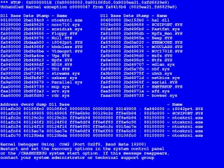
BSOD

Slide 13
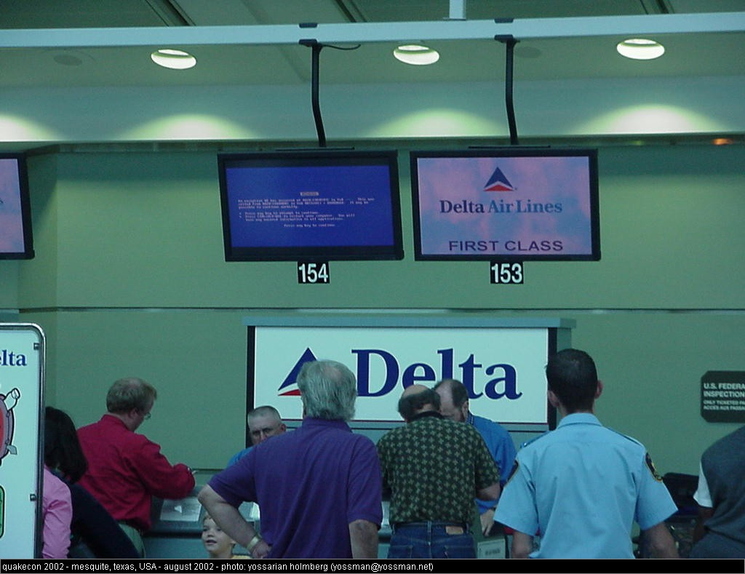
BSOD

Slide 14
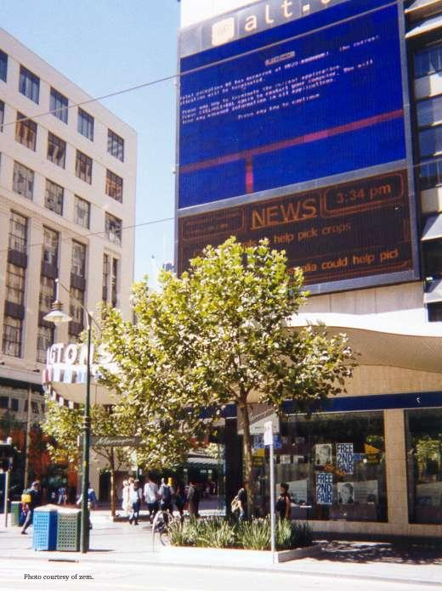
BSOD

Slide 15
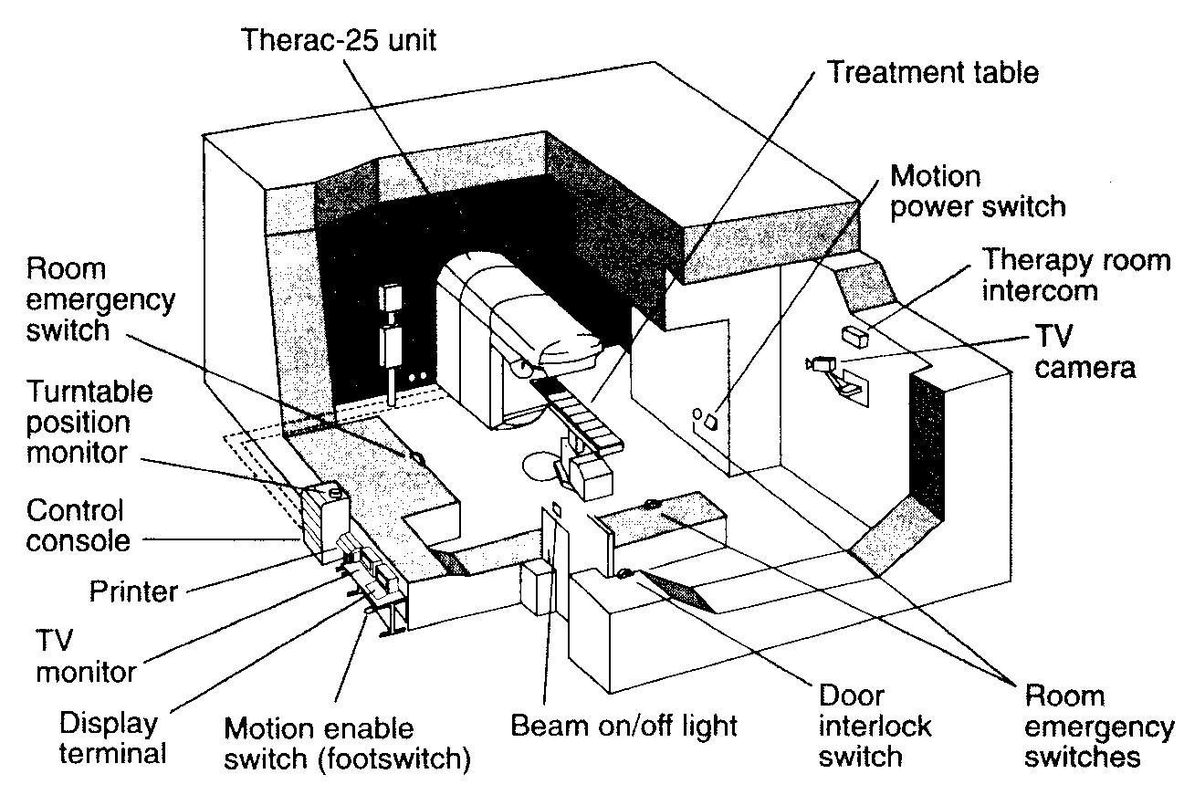
Therac-25
A safety-critical system with software interlocks
Beam controlled entirely through a custom OS

Slide 16
Therac-25
Old system used a hardware interlock
  A lever that could either be in the “zap” or “x-ray” position
New system was computer controlled
A synchronization failure was triggered when competent nurses used the back arrow to change the data on the screen “too quickly”

Slide 17
Therac-25 Outcome
Beam killed one person directly, burned others, and may have given inadequate treatment to cancer patients
Problem was very difficult to diagnose; initial fix involved removal of the back arrow key from the keyboard
People died because a programmer could not write correct code for a concurrent system

Slide 18
Denver airport
The most modern, most expensive airport in recent history
  Cost overrun in excess of $2B
Highly automated luggage handling system was supposed to deliver your luggage to you at arrival
Lack of persistence caused luggage carts to “forget” their contents, sprinkling the luggage on the runway

Slide 19
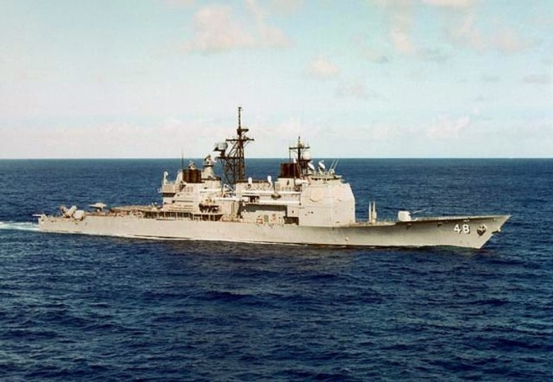
USS Yorktown
Modern guided missile cruiser off of Norfolk, VA in 1998
Crew member entered 0 for a data value
Cascade of failures led to a failure of the propulsion system
Yorktown was dead in the water for a couple of hours

Slide 20
Bitcoin Banks
There is a new crop of systems for holding data known as NoSQL databases
We cautioned about the errors people were committing with NoSQL systems
The simplest attack against banks, of simultaneous withdrawals, actually works! Attackers stole millions of dollars from Bitcoin banks
  One bank lost a million and folded
  Another lost $500K, took losses

Slide 21
Other Systems
FAA air traffic control system
IRS data management system
IBM “Microkernel”
Pentagon data security
Many others, too numerous to list

Slide 22
Summary
We do not have the necessary technologies and know-how to build robust computer systems
There is huge demand for people who deeply understand and can build robust systems

Slide 23
Philosophy
Not your grandfathe’s OS course
We believe that the following topics are critical for every software engineer
  Building concurrent systems
  Architecting networked components
  Building transactional systems
Not widely shared, the course is unique

Slide 24
Logistics
Lectures
  Tuesday, Thursday 2:55-4:10pm, Ives 305
Instructor
  Prof. Sirer, egs at systems.cs.cornell.edu
  Prof. George, mdgeorge at cs.cornell.edu
  Office Hours
    Prof. Sirer: Tuesday 4:10-5:10pm
    Prof. George: Thursday 4:10-5:10pm
TAs

Slide 25
Communication
Course Web Page
  Office hours, assignments, lectures, and other supplemental materials will be on the web site
Email
  cs4410staff at systems.cs.cornell.edu
  The email alias goes to us and the TAs, not to the whole class

Slide 26
Administrative
Course has three components
  Lectures and Readings
  Exams
  Projects and MiniProjects
Textbook
  Anderson and Dahlin
  XXX
You are expected to keep up with all three

Slide 27
Grading
CS4410 Breakdown
  ~40% MiniProjects
  ~12% Prelim 1
  ~18% Prelim 2
  ~25% Final
  ~5% Flexgrade (participation, attitude, effort)
CS4411 Breakdown
  ~90% Projects
  ~10% Flexgrade
Grading will not be done on a curve
  It is our goal to be able to give everyone an A+
  Help us achieve this

Slide 28
Projects in CS4411
Projects will be done in two-person teams
  You may indicate a desired partner
  If they also indicate you, we will pair you up
  If you don’t have a preferred partner, we’ll pair you up with someone suitable
Working in groups
  Start early, time management is key
  Manage the team effort
  Part of what you are supposed to learn is how to manage to get work done in a small team

Slide 29
MiniProjects in 4410
There will be approximately 4-6 miniprojects
MiniProjects will be done individually
Working individually
  Start early, time management is key

Slide 30
Academic Integrity and Honor Code
All submitted work must be your own
  All homeworks must be your own independent work
  OK to study together
  Cannot share solutions, ever
Project groups submit joint work
  All group assignments must represent solely the work of the two people in that group
  Cannot be in possession of someone else’s solution
Violations will be prosecuted to the fullest extent
Closed-book exams, no calculators

Slide 31
Our Expectations
Code of Silence
  Absolute quiet during lectures
  If you have a question, please speak up
    Chances are 100% that someone else has the same question
No electronics, Luddite zone
  Scientific studies show that such classrooms are far more effective
Notes:
We follow the scientific literature on effective education, as well we should.
This literature has found, unequivocably, that classrooms with no distractions are more effective than anything-goes classrooms.

Slide 32
Enrollment SNAFU
There is great demand for CS courses in general, this course in particular
The department has decided that the only way to manage the demand is to award the limited slots according to need
  I was not consulted during the capping process
  I did not implement the caps
  Having said that, I don’t know of any other way to manage the demand
There was an error where the caps were set wrong, as result, some people who enrolled in April had to be unenrolled
  The instructors had nothing to do with this!
Notes:
If you are angry, please direct it away from the course staff.
But don’t be angry, be glad that our field is experiencing such a boom.

Slide 33
Enrollments
If you are enrolled now, congrats!
  If you decide to drop the course, please do so promptly so others can step in!
If you’re not yet enrolled yet, you need to place your name on a department-managed waitlist
The department, not the instructors, will triage the waitlist and send enrollment PINs
Notes:
Course staff will focus exclusively on content. Enrollment decisions and prioritization is done entirely by the CS department.

Slide 34
Prerequisite
CS3410 or equivalent required. Or permission of instructor.
Required means required.
If you did not take CS3410 or equivalent, you must contact course staff, explain your situation and request permission.

Slide 35
Draft Syllabus
Introduction
Architectural Support for Operating Systems
Processes and Threads
Scheduling
Synchronization, Mutual Exclusion, Spin Locks, Semaphores, Condition Variables
Deadlocks, Detection and Avoidance
Memory Management
Networking, LANs, WANs, Ethernet, ARP, IP, UDP, TCP
Disks and RAID
Filesystems, UFS, LFS
Security

Slide 36
Draft Project Plan for CS4411
Threads and Concurrency
Scheduling
Basic Datagram Networking
Reliable Streaming Protocols
Routing
Filesystems

Slide 37
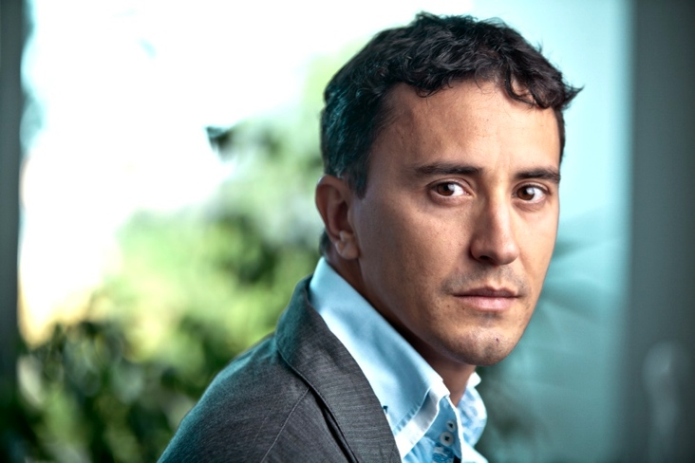
About Prof. Sirer
Interests: OSes,
distributed systems,
self-organizing and
peer-to-peer systems
Bitcoin, flaws within, fixes to
Sailing, wind, sea, woodworking (aka body modification)

Slide 38
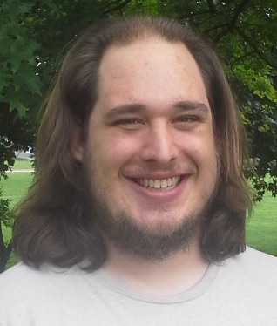
About Prof. George
Cornell grad student through
2013, lecturer since 2013
Took 4410 a decade ago!
Interested in designing and
building systems and reasoning
about code.
Just taught 4410 over the summer

Slide 39
Questions?
And demographics…

