Slide 1

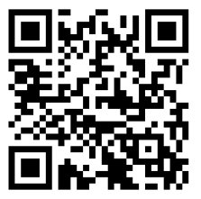
Academic Style
The ACE Team
The session will start at ….
Please mute your microphone/phone when joining the session. You can unmute yourself when necessary.
Please check your speakers are working. If you are having difficulties seeing the screen or hearing, please check your audio settings and / or sign out and in again.
If you are waiting:
These slides can be accessed on our website:
https://qahighereducation.com/the-ace-team/

Slide 2
Today’s session
The ACE Team
Topics
Styles in speaking and writing
Style in assignments
Typical features of academic style
Functions of academic style
Developing your academic style and voice
Learning opportunities
Depending on your current stage, participating in this workshop could help you to develop your understanding of any of these aspects of academic style and prompt you to think further about your own academic voice.

Slide 3
Style or styles?
The ACE Team
Do you have different styles in speaking?
What factors affect your speaking style?
What exactly changes?
Do you have different styles in writing?
What factors affect your writing style?
What exactly changes?

Slide 4
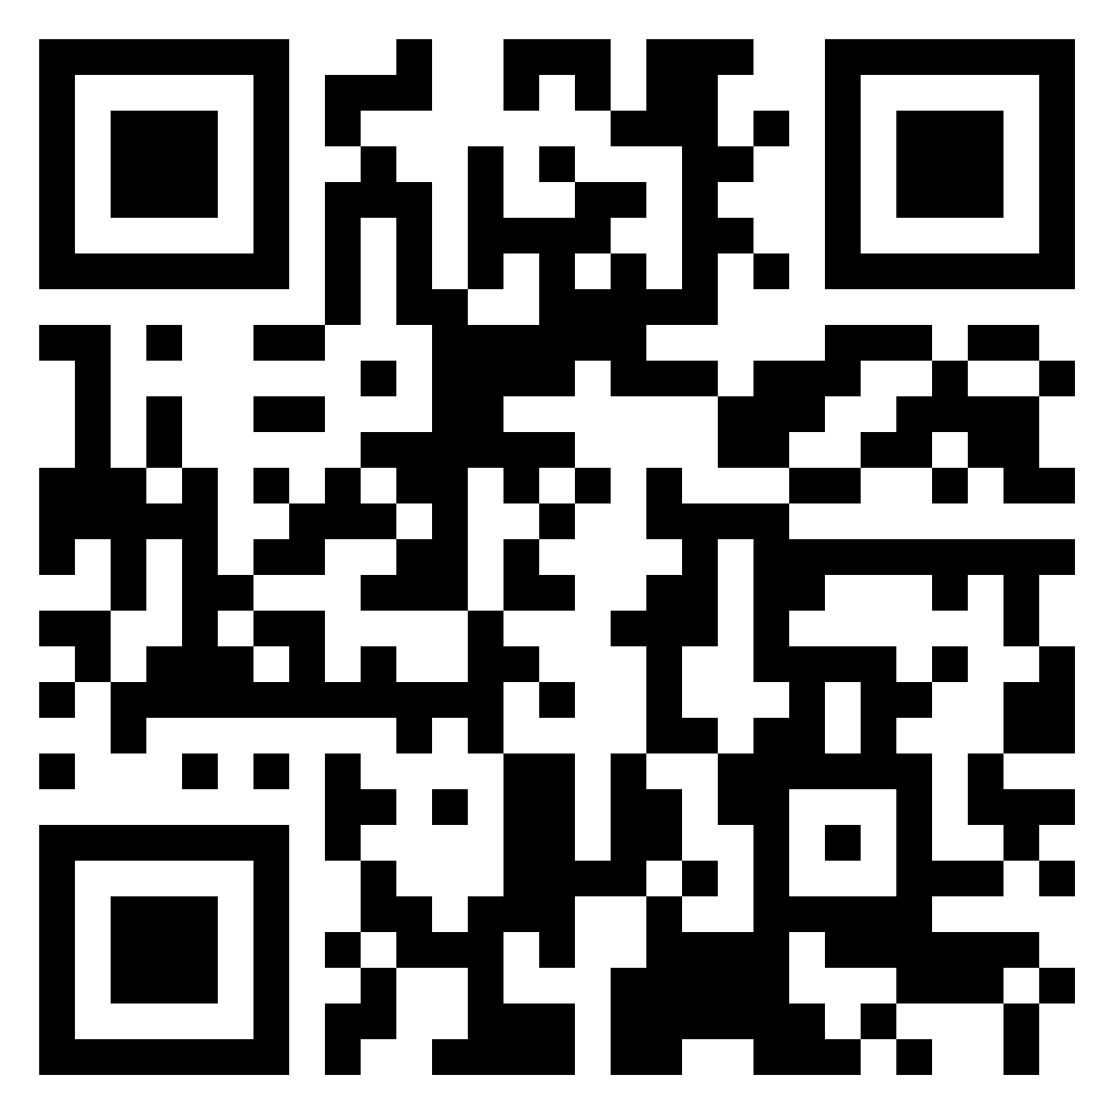
Style in assignments
The ACE Team
Can you make the style in this example more suitable for a university assignment? You can work on the whole paragraph or particular sentences.
Some people say if you have the right to vote, you should use it. In England, women only got the vote in the 20th century, after a lot of trouble. So it’s not fair to just throw it away now. BUT other people don’t agree, because they think it’s wrong to vote if you don’t know enough about the people or what they stand for, or if you aren’t really bothered one way or the other. Which of these is right? You have to make your own mind up, I guess. Young people can’t see the point of voting.
https://padlet.com/lornabrown/can-you-make-the-style-more-suitable-for-a-university-assign-gqvug3zhijyvspp1

Slide 5
Two versions of our paragraph: Comments?
The ACE Team
A The imperative nature of exercising the right to vote has been a subject of contention among different individuals. In the context of England, the granting of voting rights to women occurred during the 20th century, but it was not achieved without facing significant challenges. Consequently, the idea of disregarding this hard-earned privilege is perceived by some as unjust. Conversely, dissenting opinions maintain that casting a vote should not be undertaken if one lacks sufficient knowledge about the candidates and their platforms, or if one remains indifferent to the outcomes. Determining which viewpoint is morally correct necessitates an individual's independent judgment. Notably, a prevailing sentiment among young people revolves around the perceived futility of participating in the electoral process. | B There is some debate over the moral obligations associated with voting. A (1950) and B (2020), for example, argue that those with the right to vote should exercise it because this right was hard-won by campaigners such as the Suffragettes in the early 20th century. Others such as C (1960) and D (2018), on the other hand, believe that those who wish to vote should be able to make an informed choice. Consequently, abstention is a valid option. It appears that older and younger people may evaluate these competing obligations differently: in the 2019 general election, 74% of over-65s voted, compared with only 47% of under-25s. However, these results must be treated with caution because they are based on self-reported intention to vote and take no account of significant differences within these two groups (Ipsos, 2019).

Slide 6
So what are some typical features of more academic style? You can write here, in the chat or on the whiteboard.
The ACE Team

Slide 7
Typical features of academic style
The ACE Team
Formal
Objective
Precise
Cautious about size of claims made
Concise
Clear development of ideas
Careful about supporting claims with evidence
Would you add or take anything away from this list?

Slide 8
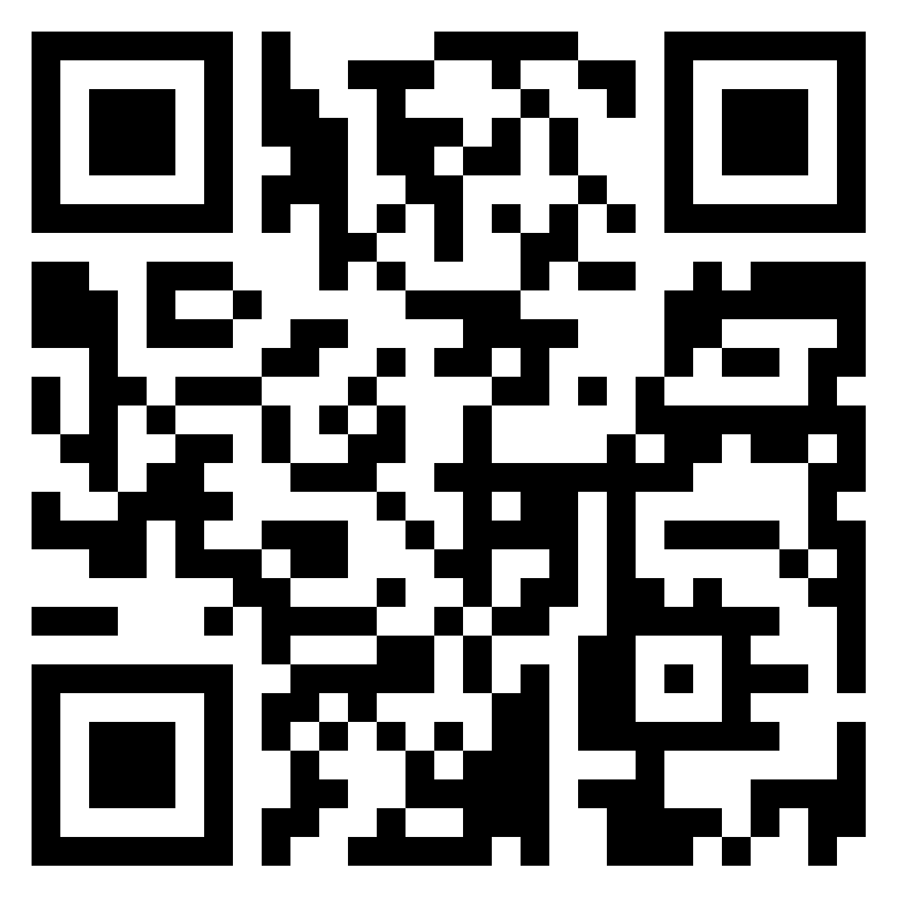
Our example text and features of academic style 1
The ACE Team
On the following slides, in the chat or on the padlet, can you identify examples of problems with each of the typical features we have mentioned?
If it’s useful, take a picture of the text on your phone:
Some people say if you have the right to vote, you should use it. In England, women only got the vote in the 20th century, after a lot of trouble. So it’s not fair to just throw it away now. BUT other people don’t agree, because they think it’s wrong to vote if you don’t know enough about the people or what they stand for, or if you aren’t really bothered one way or the other. Which of these is right? You have to make your own mind up, I guess. Young people can’t see the point of voting.
Padlet: https://padlet.com/lornabrown/example-text-problems-with-the-style-pxhs5i4folqayt26

Slide 9
Our example text and features of academic style 1
The ACE Team
Not suitably … | Example from the text
Formal
Precise
Clear development of ideas
Careful about supporting claims with evidence | The whole text
Some people say if you have the right to vote, you should use it. In England, women only got the vote in the 20th century, after a lot of trouble. So it’s not fair to just throw it away now. BUT other people don’t agree, because they think it’s wrong to vote if you don’t know enough about the people or what they stand for, or if you aren’t really bothered one way or the other. Which of these is right? You have to make your own mind up, I guess. Young people can’t see the point of voting.

Slide 10
Our example text and features of academic style 1
The ACE Team
Not suitably … | Example from the text
Formal | if you it’s not fair to just throw it away BUT don’t if you aren’t really bothered Which is right? You have to make your own mind up I guess
Precise | Some people say a lot of trouble other people
Clear development of ideas | Link from the rest of the text to the final sentence: Young people can’t see the point of voting
Careful about supporting claims with evidence | The whole text

Slide 11
Our example text and features of academic style 2
The ACE Team
Not suitably … | Example from the text
Objective
Concise
Cautious about the size of claims made
Some people say if you have the right to vote, you should use it. In England, women only got the vote in the 20th century, after a lot of trouble. So it’s not fair to just throw it away now. BUT other people don’t agree, because they think it’s wrong to vote if you don’t know enough about the people or what they stand for, or if you aren’t really bothered one way or the other. Which of these is right? You have to make your own mind up, I guess. Young people can’t see the point of voting.

Slide 12
Our example text and features of academic style 2
The ACE Team
Not suitably … | Example from the text
Objective | Some people say if you so it’s not fair
Concise | In England, women only got the vote in the 20th century, after a lot of trouble. So … BUT other people don’t agree, because they think it’s wrong to vote if you don’t know enough about the people or what they stand for, or if …
Cautious about the size of claims made | Young people can’t see the point of voting

Slide 13
Why write in an academic style? You can write here, in the chat or on the whiteboard.
The ACE Team
Pointer | Comment

Slide 14

Functions of academic style
The ACE Team
To communicate subject matter and arguments clearly and effectively
To demonstrate membership of the academic community
Anything else?
.

Slide 15
Some factors affecting academic writing style
The ACE Team
The discipline
The purpose and intended audience
Academic / professional / journalistic?
The type of text
Whether a reflective element is included
Anything else?
.

Slide 16
Features and ‘rules’
The ACE Team
Are the following ‘rules’? Should they be? Why / why not?
Don’t use We in academic writing: ‘In this report, we will discuss …’
‘Don’t use I in academic writing.’
‘Use passive verbs, eg The results were analysed.

Slide 17
What could help you to develop your academic style? Have you found anything helpful up to now?
The ACE Team

Slide 18
Developing your academic style and voice
The ACE Team
When you read:
- Notice examples of more and less effective academic text. What makes the difference?
When you write:
Try to write in a way that feels like your own voice
Think of your reader
- Allow time for re-drafting
If you wish, book with ACE for a 2nd opinion on a short piece of a draft

Slide 19

The ACE Team
Reflection
Learning opportunities
Depending on your current stage, participating in this workshop could help you to develop your understanding of any of these topics: speaking and writing styles; typical features of academic style; functions of academic style; developing your academic style and voice.
Image of a person thinking (Cliparting.com, no date)
What have you learned or started to think about during the workshop?
Has there been anything that could help you to develop your own writing?
Are you interested in the idea of your own academic voice?
What do you plan to do next to work on your writing?
19
Notes:
19

Slide 20
The ACE Team
Reference
Cliparting.com (no date) Person - Image 24568. Available at:
https://cliparting.com/free-person-clipart-24568 (Accessed: 16 July 2023.)
20
Notes:
20

Slide 21
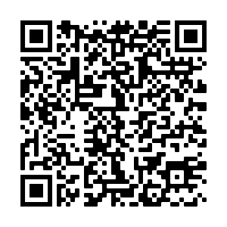
The ACE Team
Thank you for attending the ACE Academic Style workshop today. We would be grateful if you could take 5 minutes to complete our feedback form.
Via the URL in the Chat Box
By scanning the QR Code

